Slide 1
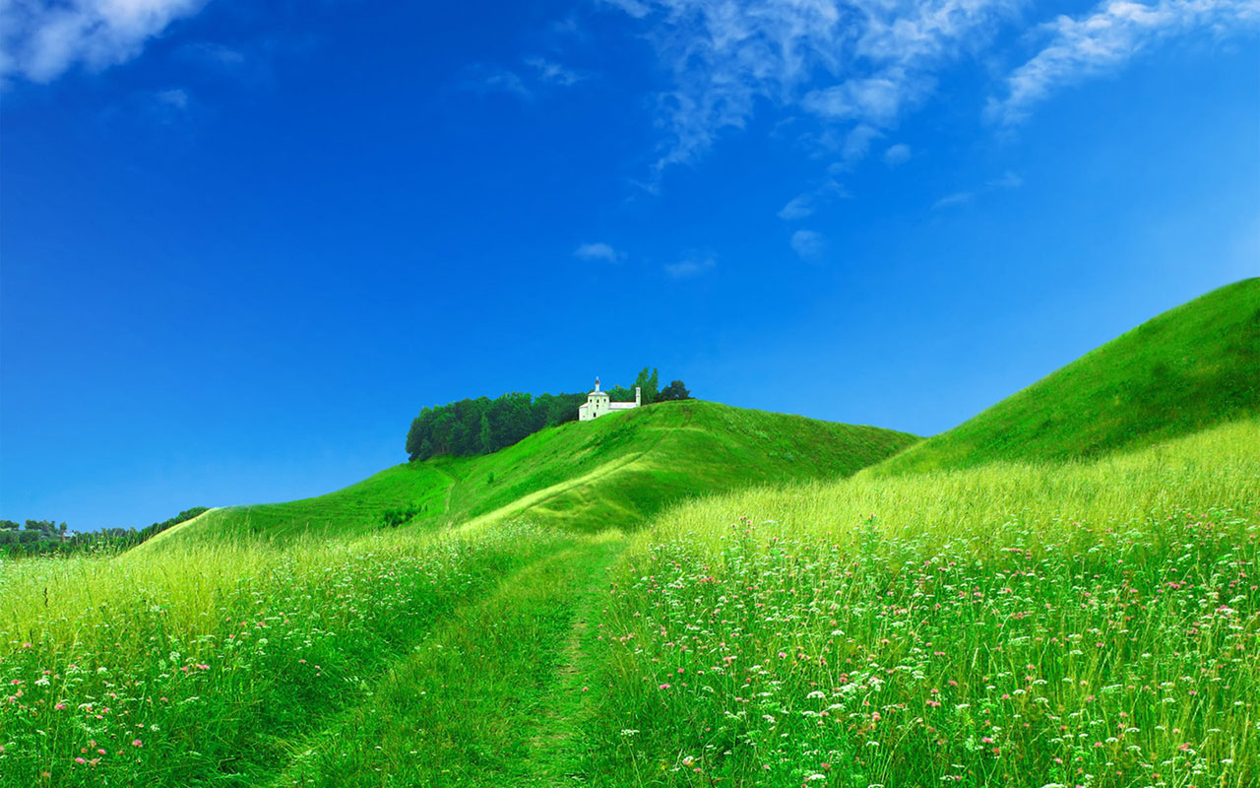



WELCOME TO ALL IN TODAY’S
ENGLISH LESSON

Slide 2




Presented By
Rajib Dutta
Assistant teacher
Bhingrol Govt.Primary School
Anowara, Chottogram
Email: rajibduttaat@gmail.com
Rajib Dutta. Bhingrol gps. Anwara. Ctg.

Slide 3
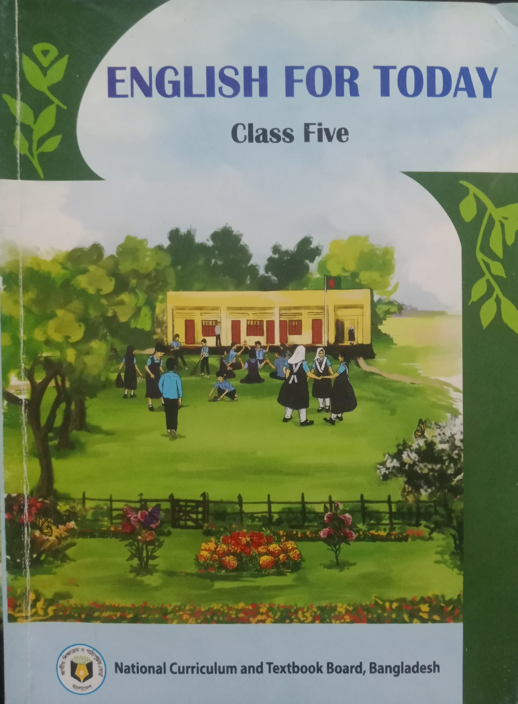
Introduction of the lesson
Class : FIVE
Subject : English
Unit : 17
Lesson : 1 (Page- 91)
Lesson Title :the air we share
Rajib Dutta. Bhingrol gps. Anwara. Ctg.

Slide 4
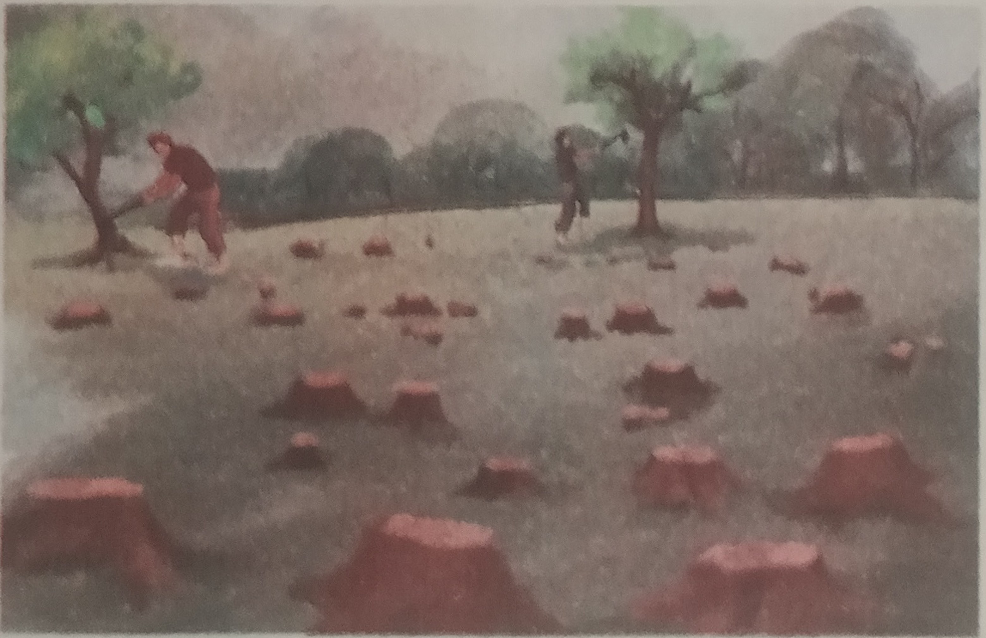
Today’s lesson
The Air
We
Share
Rajib Dutta. Bhingrol gps. Anwara. Ctg.

Slide 5
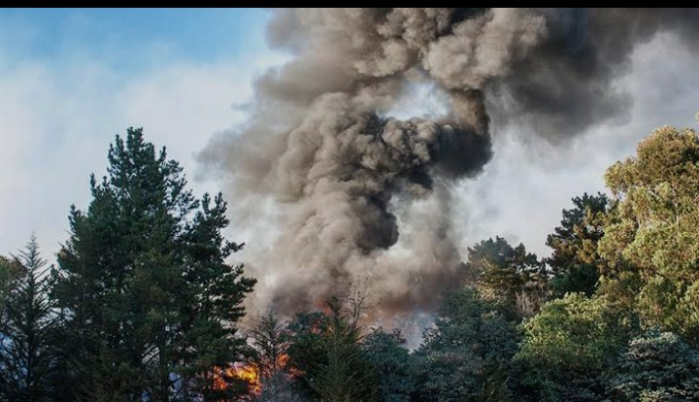
Rajib Dutta. Bhingrol gps. Anwara. Ctg.
Smoke
A visible vapor from fire or gases.

Slide 6
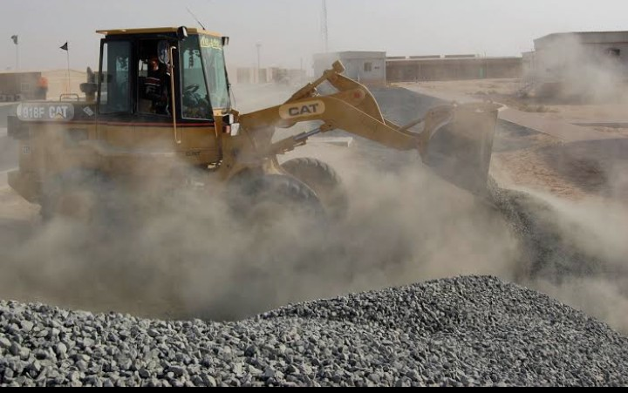
Rajib Dutta. Bhingrol gps. Anwara. Ctg.
Dust
A fine, dry powder made of tiny particles of earth

Slide 7
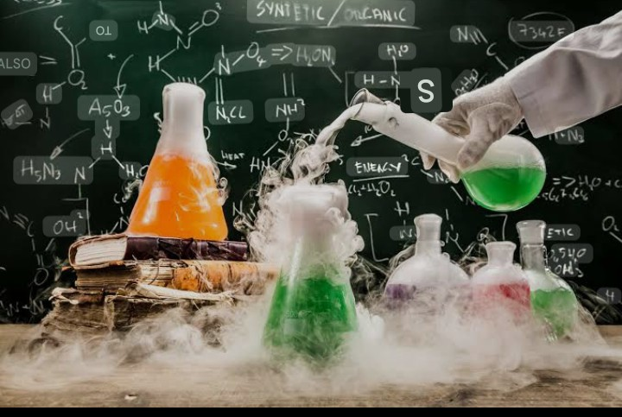
Rajib Dutta. Bhingrol gps. Anwara. Ctg.
Chemical
Any substance with a definite composition and a constant set of properties.

Slide 8
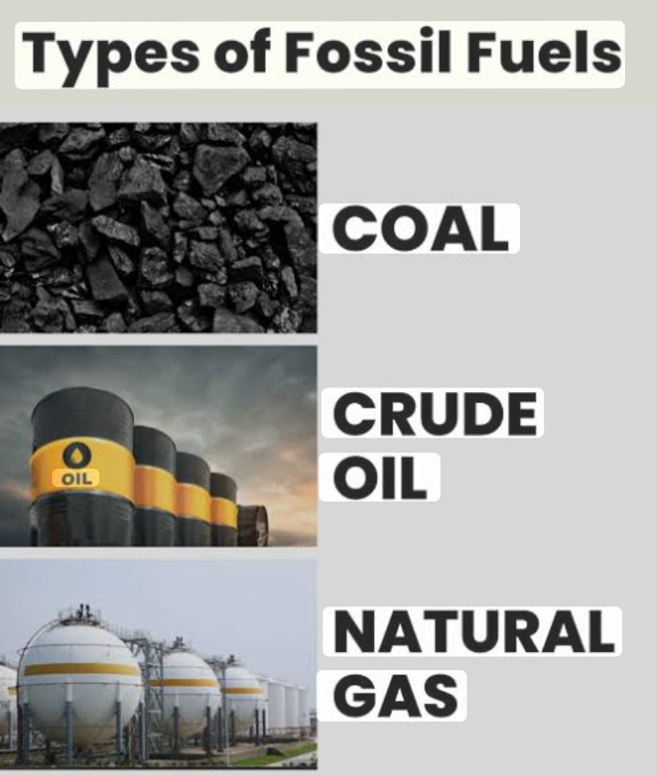
Rajib Dutta. Bhingrol gps. Anwara. Ctg.
Fossil fuels
A non-renewable energy sources

Slide 9
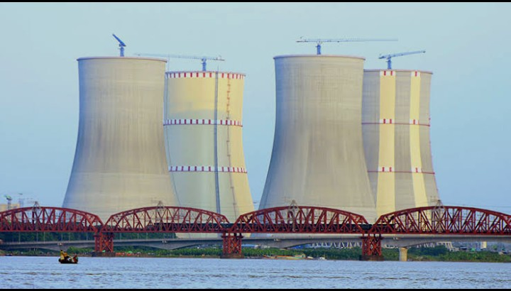
Rajib Dutta. Bhingrol gps. Anwara. Ctg.
Power plant
An industrial facility that generates electricity from energy sources

Slide 10
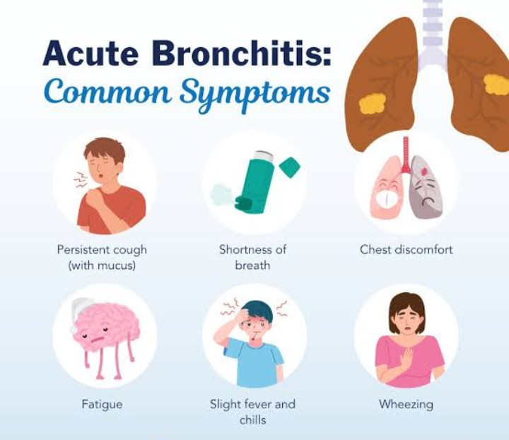
Rajib Dutta. Bhingrol gps. Anwara. Ctg.
Bronchitis
A kind of diseases of lungs.

Slide 11
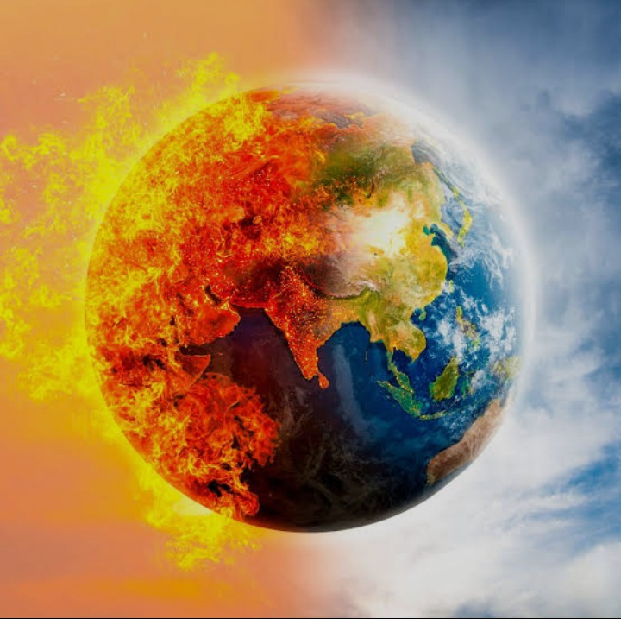
Rajib Dutta. Bhingrol gps. Anwara. Ctg.
Global warming
The long term rise in earth’s temperature.

Slide 12
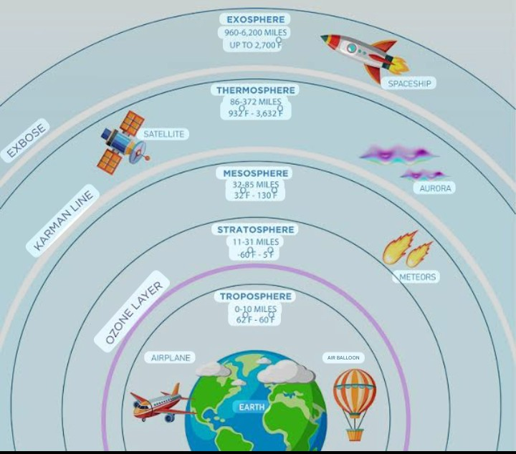
Rajib Dutta. Bhingrol gps. Anwara. Ctg.
Ozone Layer
A layer of earth’s stratosphere.

Slide 13
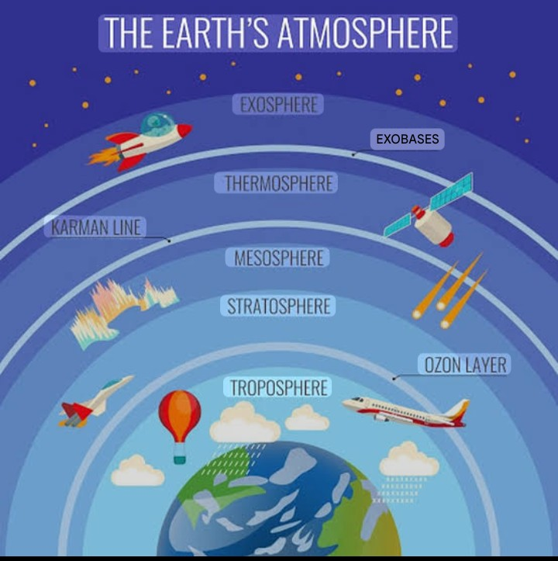
Rajib Dutta. Bhingrol gps. Anwara. Ctg.
Atmosphere
A thin layer of gases surrounding earth, held in place by gravity

Slide 14
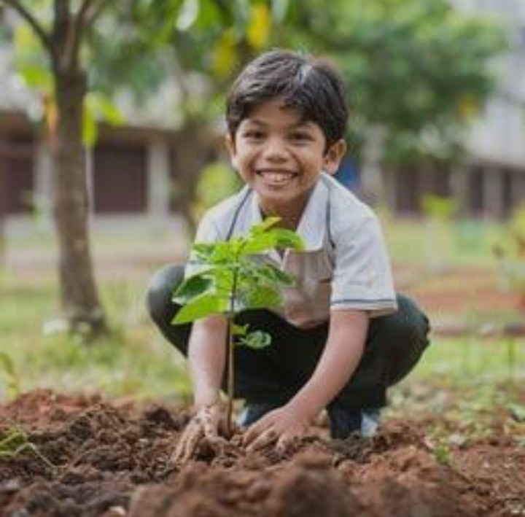
Rajib Dutta. Bhingrol gps. Anwara. Ctg.
Planting Trees
Placing a young tree, sapling or seed into the ground

Slide 15
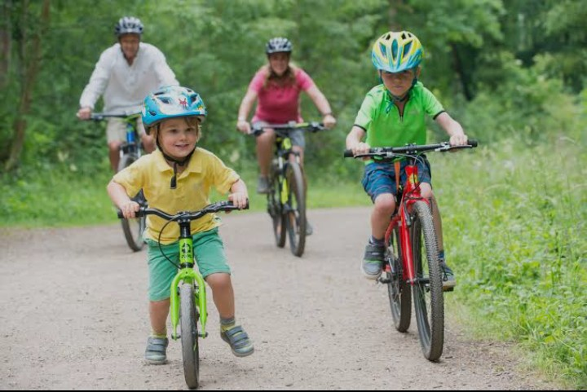
Rajib Dutta. Bhingrol gps. Anwara. Ctg.
Bicycle
A pedel driven single track vehicle with two wheels.

Slide 16
Rajib Dutta. Bhingrol gps. Anwara. Ctg.
Teacher read text with proper
pronounciation two times
The Air We Share
Air is all around us.We breathe air in and out every day. We cannot live without air. But do you know that sometimes the air can get dirty? This is what we call air pollution.
Smoke, dust and chamicals cause air pollution. Burning fossil fuels is one of the main causes for air polluation. Fossil fuels are things like coal, oil and natural gas. Factories, power plants and cars use fuel to make energy. When we burn these fuels, they create smoke and harmful gases.
Breathing in polluted air can make us sick. It can cause diseases like asthma, bronchitis etc. Air pollution leads to global warming. Global warming means gradual rise in the Earth’s temperature over time. Air polluation can also harm the ozone layer. It is a part of yhe atmosphere. It protects us from the harmful rays of the sun.
We all can reduce air pollution. Planting trees is a great way of doing this. Trees absorb harmful gases and release oxygen. They also filter out harmful pollutants. Thus, trees help to clean the air. We can also walk or ride bicycles for a short distance. It does not need to use fossil fuels. Remember, every effort helps and together we can make a big difference.

Slide 17
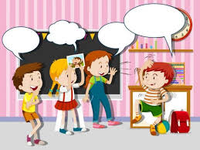
Rajib Dutta. Bhingrol gps. Anwara. Ctg.
Students activities
1.Students will read the text with pair proper pronounciation.
2Students read the text alone with proper pronounciation.
3.Advanced students help to weaker students.

Slide 18

Rajib Dutta. Bhingrol gps. Anwara. Ctg.
Match the words with their meaning
1. stitch a way of doing something that has existed for a long time.
2. quilt to sew pieces of cloth.
3. wrap a warm blanket made by sewing pieces of clothes togather.
4. pattern to put cloth over something to cover it.
5. tradition a design that repeats shapes,colours.lines etc .

Slide 19

Rajib Dutta. Bhingrol gps. Anwara. Ctg.
Answers the following questions
1. What is air pollution?
Ans: Air pollution means to mixture of smoke, dust and chemicals in the air.
2. What are fossil fuels?
Ans: Fossil fuels are coal, oil and natural gas.
3. What is global warming?
Ans: Global warming means gradual rise in the Earth’s temperature over time.
4. How can we reduce air pollution?
Ans: We can reduce air pollution by planting trees.
5. Where do we use fossil fuels?
Ans: We use fossil fuels in factiries, power plants and cars to make energy.

Slide 20
Rajib Dutta. Bhingrol gps. Anwara. Ctg.
Students activities
Students will read the text proper pronunciation with missingwords
Breathing in polluted air can make us sick. It can cause like asthma , etc. Air pollution leads to . Global warming means gradual rise in the Earth’s over time. Air polluation can also harm the .It is a part of the . It protects us from the rays of the sun.
We all can air pollution. Planting is a great way of doing this. Trees absorb harmful gases and release .They also filter out harmful pollutants. Thus, trees help to clean the air. We can also walk or ride for a short . It does not need to use fossil fuels. , every effort helps and we can make a big .
diseases
bronchitis
global warming
temperature
ozone layer
atmosphere
harmful
reduce
trees
oxygen
bicycles
distance
Remember
together
difference

Slide 21

Home work
Write five sentences about ‘Air Pollution’.

Slide 22

