Slide 1
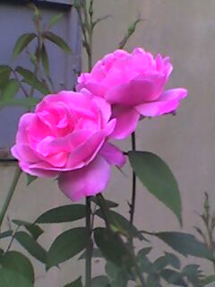
Welcome

Slide 2
Objectives:
After the lesson students will be able to-
identify present continuous tense.
use the structure of present continuous tense to form sentences.
use present continuous tense in proper situation.

Slide 3
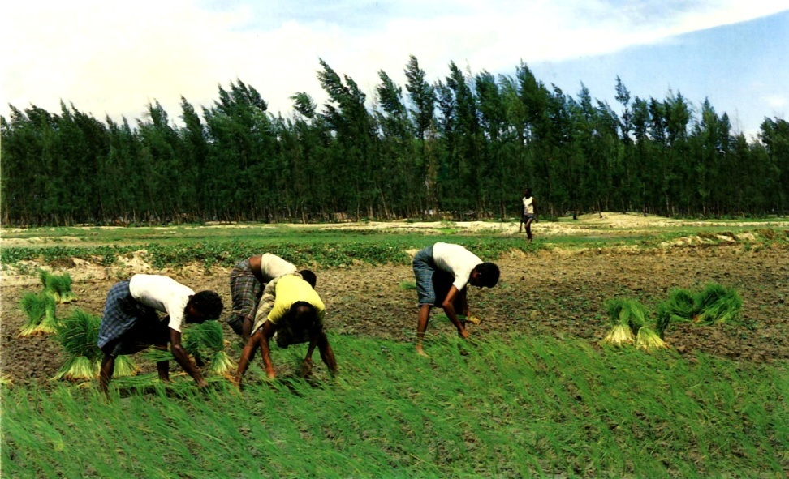
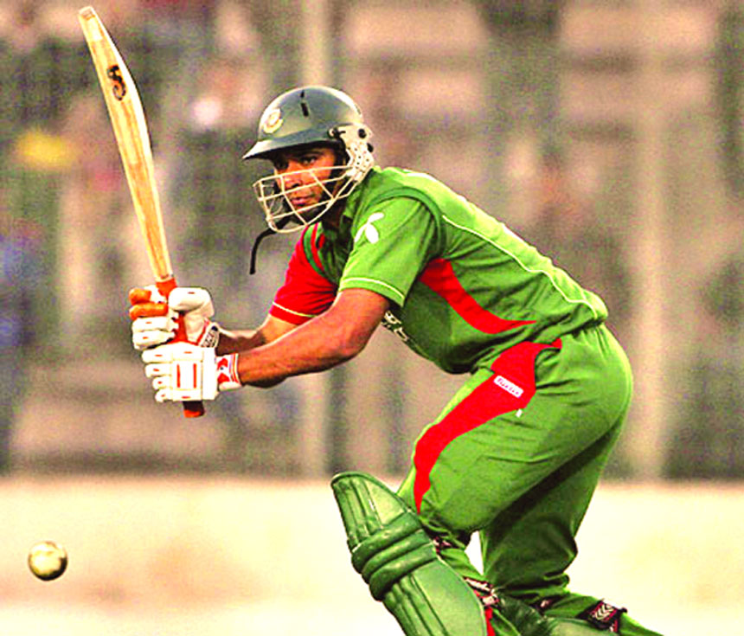
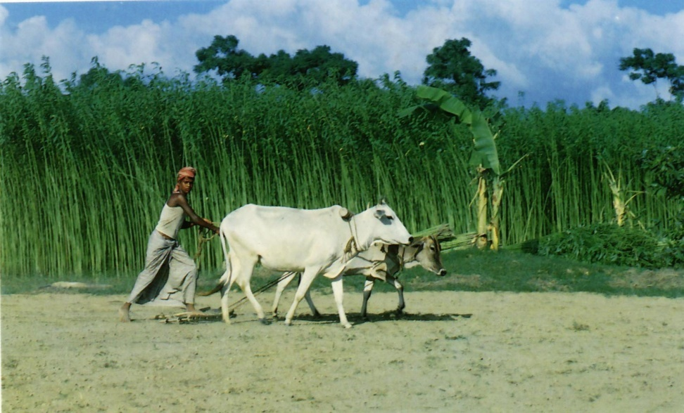
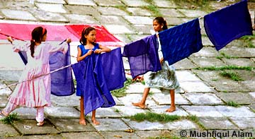
Playing cricket
Drying clothes
Cultivating land
Planting paddy
A
3 M
C
B
D

Slide 4
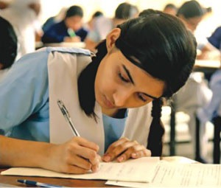
What is she doing?
She is writing.

Slide 5

Present Continuous Tense
2 M
What is he doing?
He
is reciting
the holy Quran.

Slide 6
Present Continuous Tense
They are drying clothes.

Slide 7

Present Continuous Tense
He is cultivating his land.

Slide 8
Present Continuous Tense
He is playing cricket.

Slide 9

Present Continuous Tense
They are planting paddy.

Slide 10
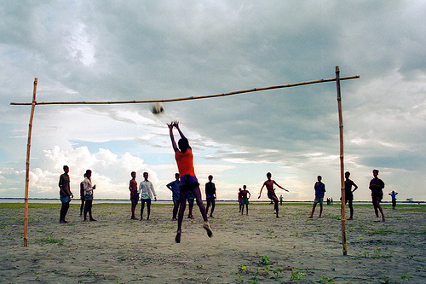
Present Continuous Tense
They are playing football.

Slide 11
Present Continuous Tense
From the sentences have you understood how to form present continuous tense?
Subject
Verb
Object
They
are playing
football

Slide 12
Present Continuous Tense
Structure of Present Continuous Tense
Subject | Verb |  | Object
 | Be verb | Ing form of PV | English.
I | am | teaching
He / She | is | learning
We/You They | are

Slide 13
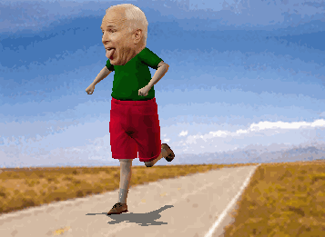
Is he walking?
No, he is not walking.

Slide 14
Present Continuous Tense
If the sentence is negative structure of Present Continuous Tense will be:
Subject | Verb |  |  | Object
 | Be verb | not | Ing form of PV | English.
I | am |  | teaching
He / She | is |  | learning
We/You They | are

Slide 15
Present Continuous Tense
From the pictures have you understood when to use present continuous tense?
We use present continuous tense to describe an action that is happening at this moment.

Slide 16
Correct the following sentences:
Individual Work 5 M
I is speaking English.
You am learning English.
He are taking tea.
Samin am enjoying the match.
The boys are swim in the pond.
am
are
is
is
swimming

Slide 17
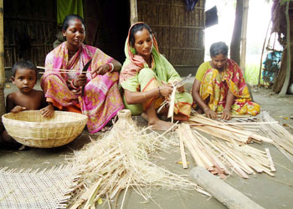
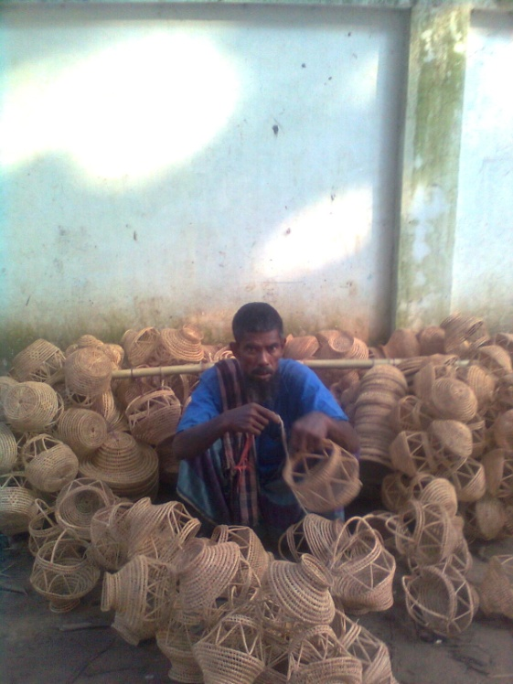
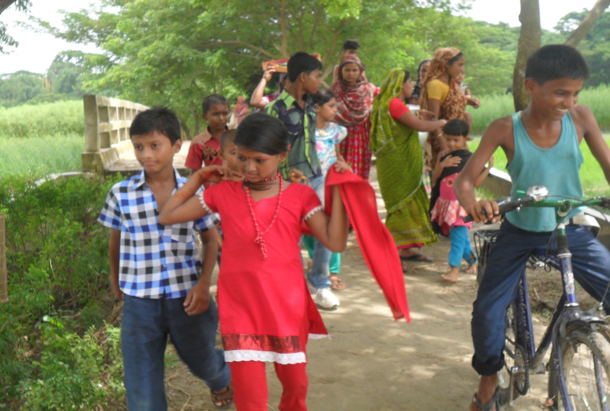
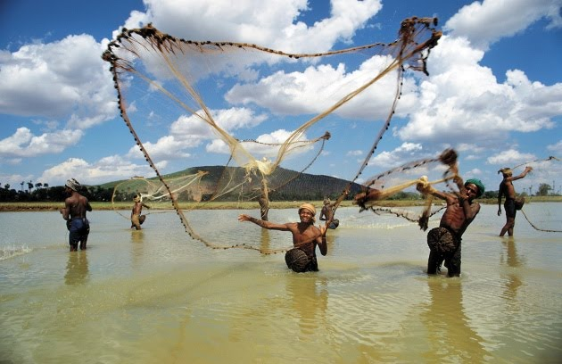
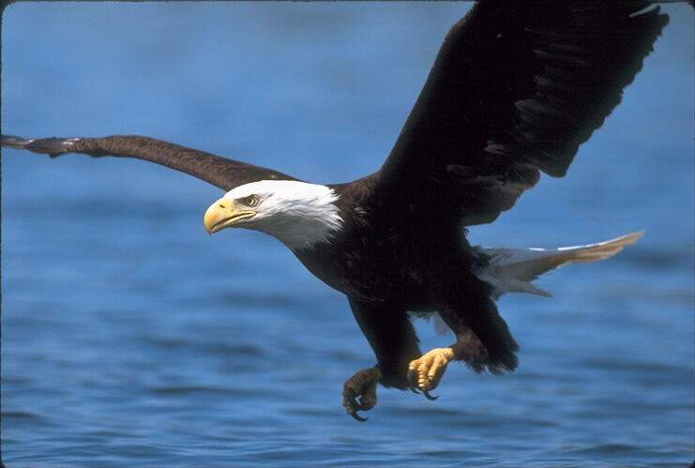
Make sentences using the following clues:
Group Work 5 M
sell
make baskets
catch fish
fly
ride a bi-cycle

Slide 18
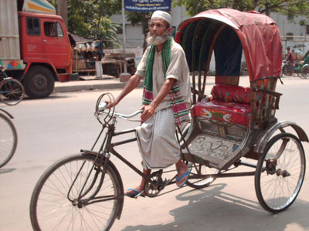
Make true sentences about the picture using the clues. Use am, is or are and not if necessary.
He/ pull/ a rickshaw
He/ drive/ a car.
He/ wear/ a tupi.
He/ walk.
He/ wear/a lungi.
He/ sell/ rickshaws.

Slide 19

Home Work
Write 10 sentences in present continuous tense about the things that will happen around you at home.

Slide 20

Thanks

