Slide 1

Welcome Everyone To The Multimedia Class

Slide 2


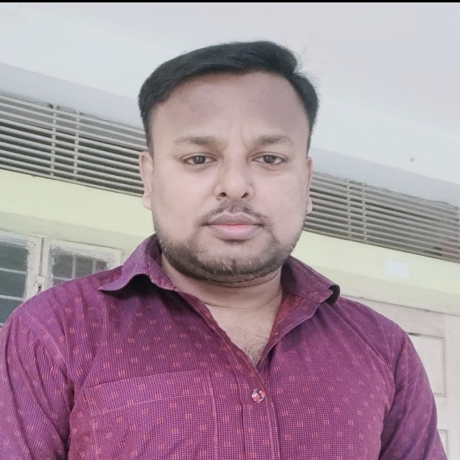
Presented By
SAMIR BISWAS
Assistant teacher
Shaheberchar Government Primary School
Kashiani, Gopalganj.
E-mail: samirbiswas5914@gmail.com

Slide 3



Subject’s Identity
Class: Three
Subject: English
Unit- 6, Lesson- 1
Cleanliness
Time: 40 Minute
Date: 28.09.2026

Slide 4
By the end of the lesson students will be able to
Identify and names objects related to cleanliness.
Pronounce and read the new words correctly.
Understand the meaning of the new words.
Talk about good habit using simple English
Recognize the importance of cleanliness in daily life.

Slide 5
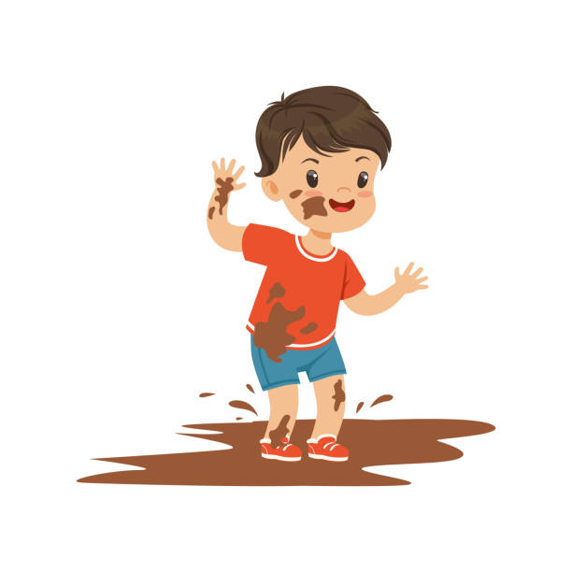
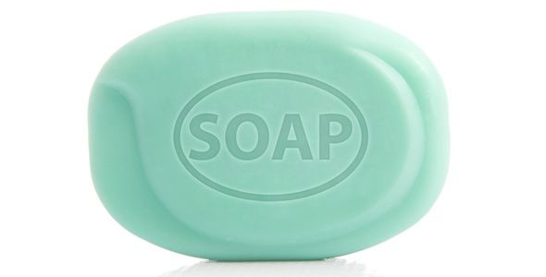
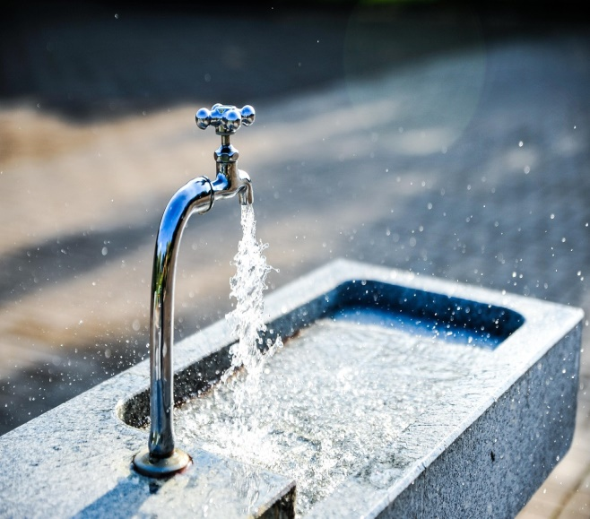
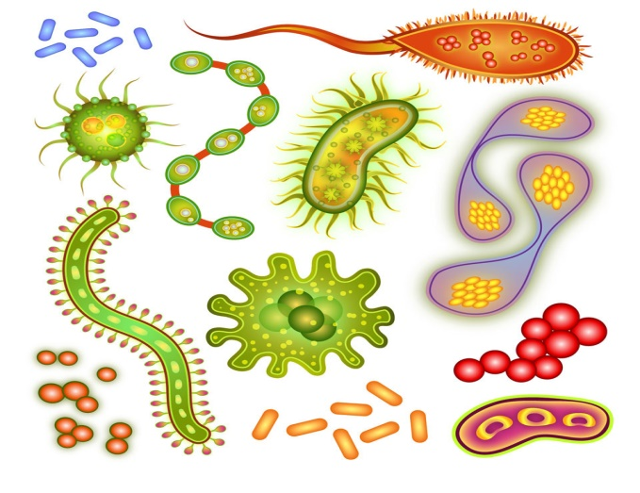
What can you see in the picture ?
1. What do we use to wash our hands?
2. Why do we need to wash our hands?
3. When should we wash our hands?
There is one candle for each year of the person’s life.

Slide 6
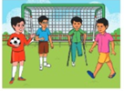

The picture is about…………
Preparing to play
Playing

Slide 7


The picture is about…………
Dirt
Washing hands

Slide 8
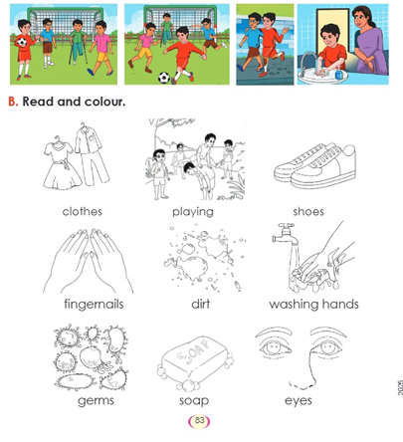
Today we are going to learn the names of some good habits.
Open your English book page at 83.

Slide 9

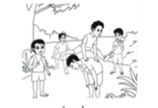




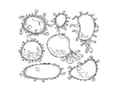


Read and colour the picture
Cloth
Playing
Shoes
Fingernails
dirt
Washing Hands
Germs
Soap
Eyes

Slide 10
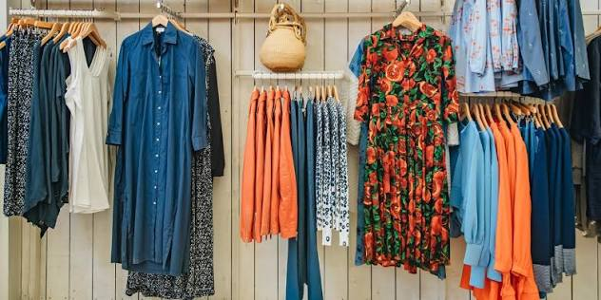
Learning Assessment
Clothes
I wash my clothes every day.

Slide 11
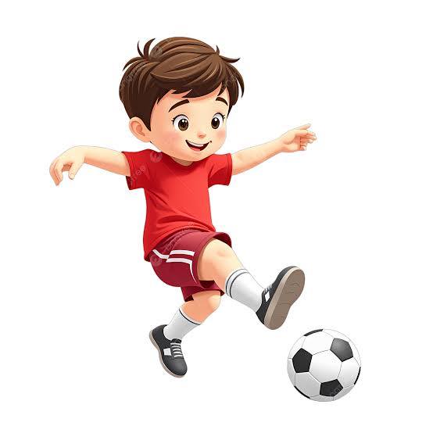
Learning Assessment
Playing
The boy is playing football.

Slide 12
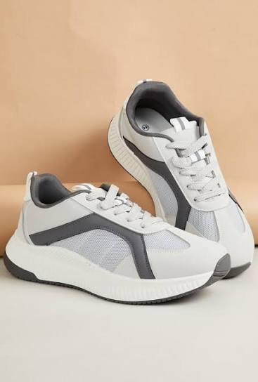
Learning Assessment
Shoes
I have a new shoe.

Slide 13
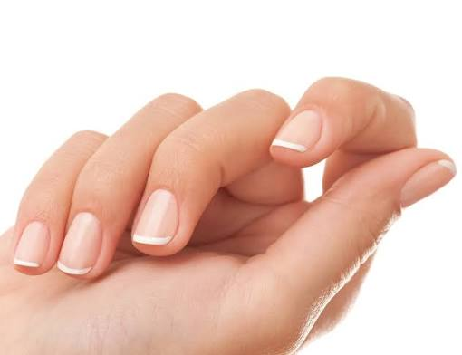
Learning Assessment
Fingernails
My fingernails are clean.

Slide 14
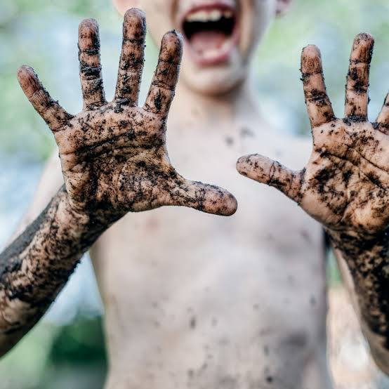
Learning Assessment
Dirt
Dirt can contain germs.

Slide 15
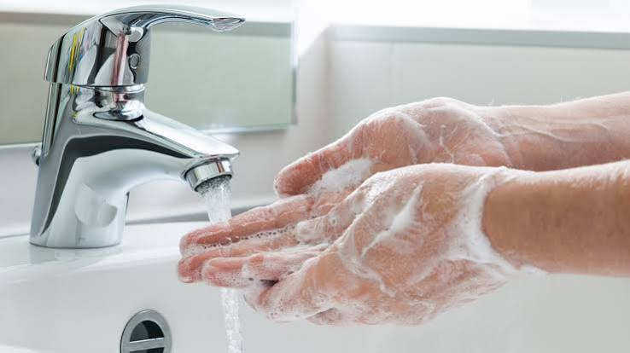
Learning Assessment
Washing hands
Washing hands keep us healthy.

Slide 16
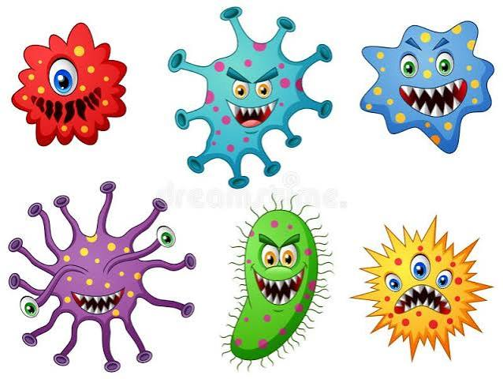
Learning Assessment
Germs
Germs can cause diseases

Slide 17
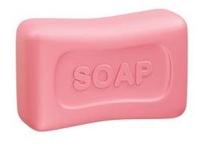
Learning Assessment
Soap
I wash my hands with soap

Slide 18
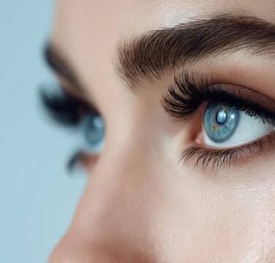
Learning Assessment
Eyes
My eyes help me to see.

Slide 19
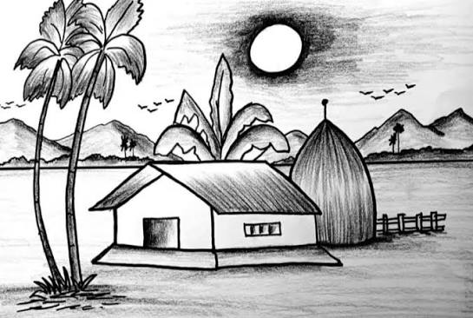
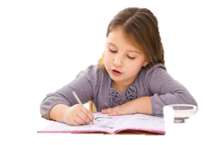



Home Task
Write two sentences with Each word.

Slide 20


