Slide 1


WELCOME

Slide 2
Today’s lesson
Pronunciation

Slide 3

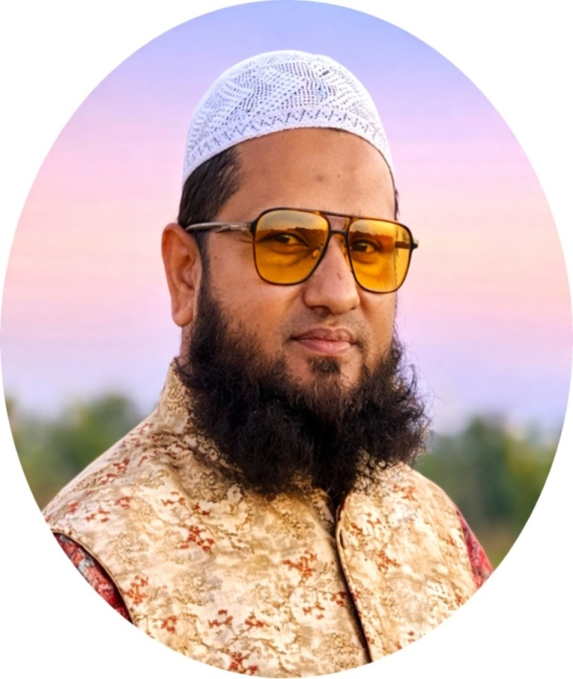
Teacher’s Identity
Mohammad Sohel Rana
Lecturer in English
Abeda Khanam Girls' High School And College
Karatia , Tangail.
Mobile:01725061827

Slide 4
A
এই

Slide 5
Able
Capable
Table
Nation

Slide 6
P
ফি

Slide 7
Picture
Photo
Pen
Poet

Slide 8
T
ঠি

Slide 9
Teacher
Teach
Talk
Taka

Slide 10

K
খেই

Slide 11
Kitty
Kite
Keep
keen

Slide 12
Q
খিউ

Slide 13
Question
Quit
Quick

Slide 14
A F P
T K Q

Slide 15
HSC English Online Tutor

Slide 16


