Slide 1
Welcome

Slide 2
Presented by : Md.Rezaul Haque khan
Ass. Teacher in English
Dautia-Garpara Rahima Hafiz high school
Manikganj.
Subject : English 1st paper
Class : Eight
Time : 50 Min.

Slide 3
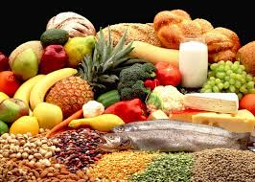
Warm up
After we have studies this unit we will be able to :
Read and understand texts through silent reading
Listen for information
Ask and answers questions
Write answers questtion

Slide 4
So our todays lesson is ………………
Food and nutrition

Slide 5
After we have studied this unit,we will be able to …………..
Read and understand texts through silent reading
Listen for information
Ask and answer questions
Write answers to questions

Slide 6
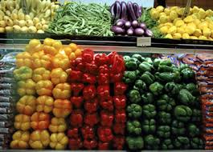
Lesson activities ……..

Slide 7
Answer the following questions….
Why is Ms Rehana talking about?
Why do we eat food?
What is meant by nutritions food?

Slide 8
Group work:
Make a list different sourcs of nutrition food
Make a list of nutrition food

Slide 9
Evaluation:
Complete these sentences:
We should eat good food to…………
Good food means………

Slide 10
Home work:
Write a paragraph about nutrition food

Slide 11
Thanks

