Slide 1

WELCOME

Slide 2
MOHAMMAD SHAHZAMAN
TEACHER
BATAKANDI S.S.A.A.H.M.H.SCHOOL
E-mail address: mshazaman@yahoo.com
Mobile Number: 01933013841

Slide 3
Class: Nine
Subject: English 2nd Paper
Topic: Transformation (Complex to Simple)
Time: 40 minutes

Slide 4


Water
Ice

Slide 5

TRANSFORMATION
(Complex to Simple)

Slide 6
LEARNING OUTCOME
Students will be able to
Tell what the transformation is.
to tell the rules for transformation from Complex to Simple.
transform the complex sentences to simple sentences

Slide 7

though
In spite of
when it is
in
Since/as
because of
so that + sub can/could
to

Slide 8
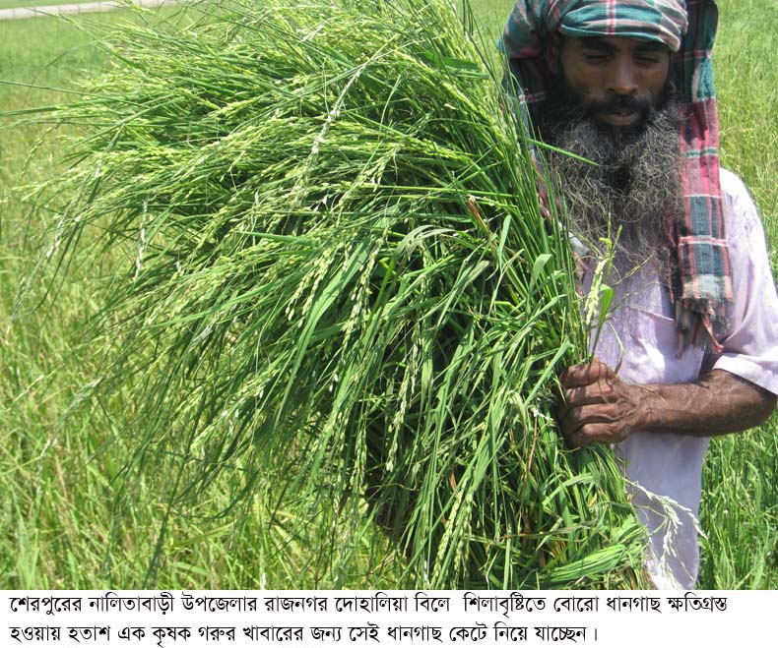

In spite of
his
being
Though
he
is
poor
,
he
is
honest
.

Slide 9
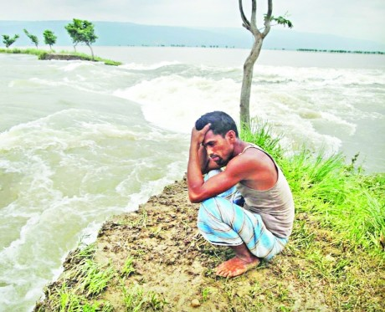

Because of
Since
he
his
having
has
lost
everything
,
he
is
helpless
.

Slide 10


The fishermen
catch
fish
to
so that they can
support
their
families
.

Slide 11
Transform the following sentences:
A
Though they work hard, they could not succeed .
B
Though I helped him, he did not do the work.
C
Since was ill, he could not go to school.
D
Since they have a car, they can go there.
E
We went to Dhaka so that we can buy a car.

Slide 12
HOME WORK
Transformation sheet

Slide 13

THANKS

