Slide 1

Shahnaj Begum
Senior Teacher
Nadona Adarsha High School, Sonaimuri , Noakhali .

Slide 2
WELCOME YOU TODAYS CLASS
How many kinds of Parts of speech ?
Answer : 8 .
What are these ?
Answer: These are
1 . Noun ,
Pronoun ,
Adjective ,
Verb ,
Adverb ,
Preposition ,
Conjunction ,
8 . Interjection
Now I discuss about Noun in details .

Slide 3
ENGLISH SECOND PAPER .
UNIT : 13
Defination of NOUN and it’s Classificaton .
Class Seven

Slide 4
LEARNING OUTCOME
By the end of the lesson you will able to understand ,say and write about ----------
Defination of Noun
It’s Classification
It’s Example

Slide 5
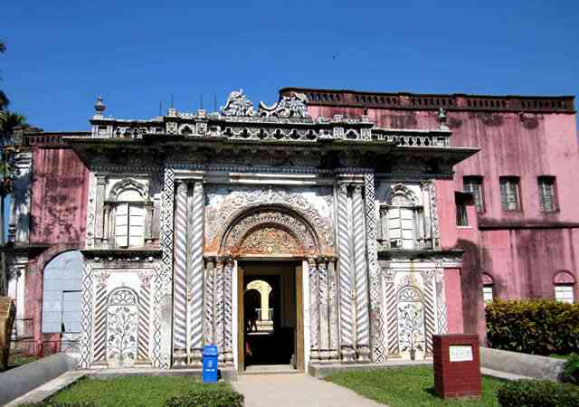
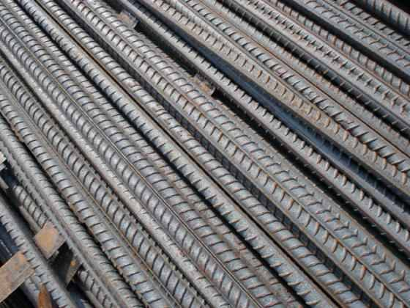
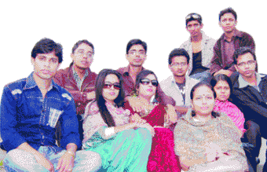
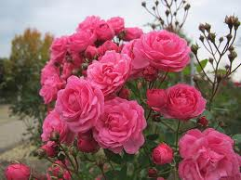
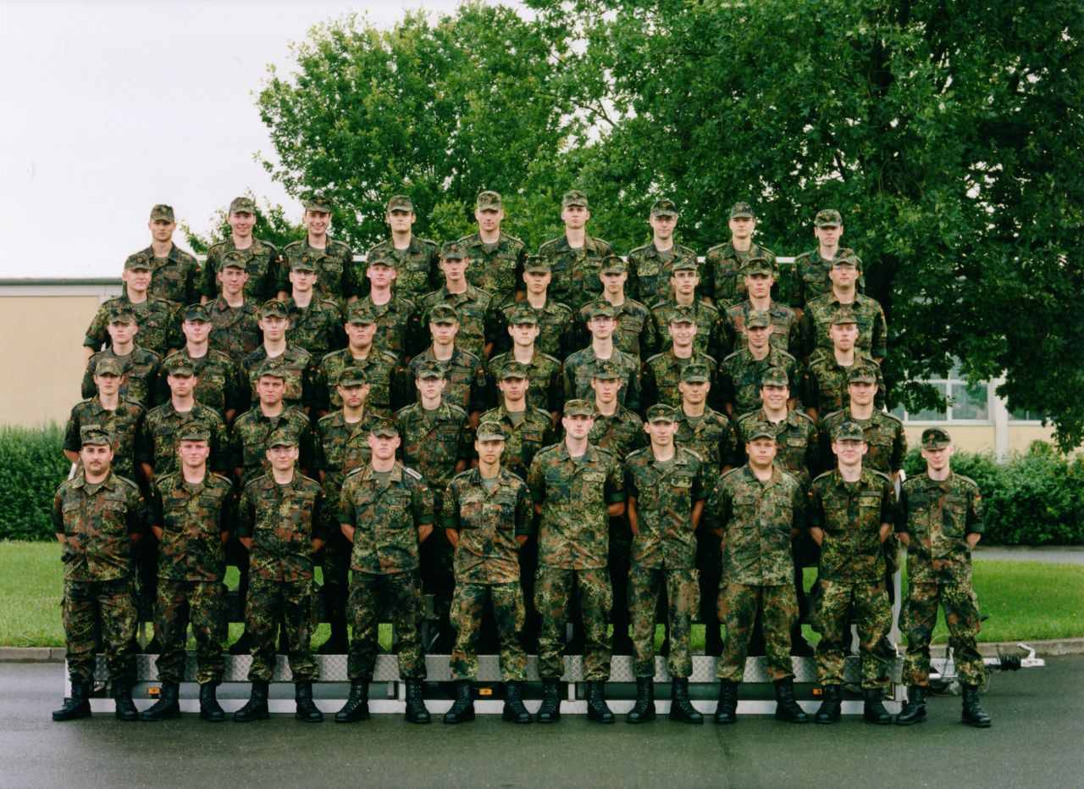
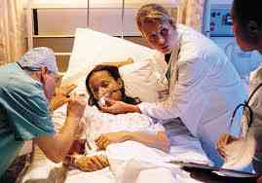
YOU SEE SOME PICTURES
Sonargaon
Iron
MEN
Army
THE ROSE
Illness

Slide 6
Noun: A Noun is a word which denotes the name of a person, thing, place, quality, condition etc.

Slide 7
Classification of Noun in a chart :
Concrete Noun
Abstract Noun
Proper Noun
Common Noun
Material Noun
Collective Noun

Slide 8
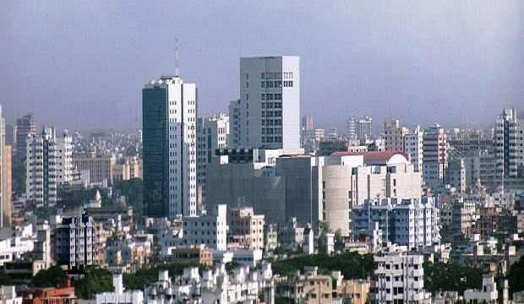
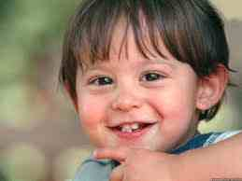
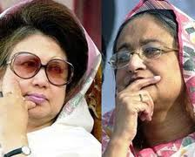
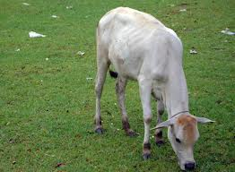
Proper Noun
Rahim
Common noun
Dhaka
Women
Cow

Slide 9
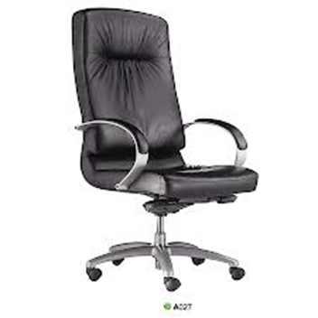
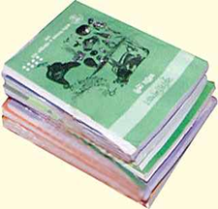
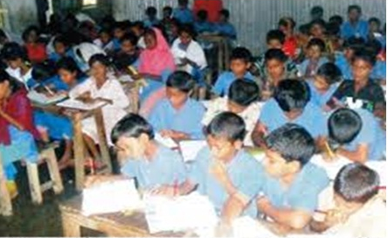
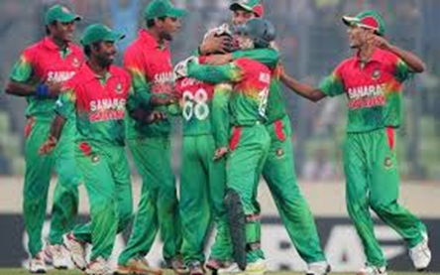
Material Noun
Books
Chair
Collective Noun
Team
Class

Slide 10
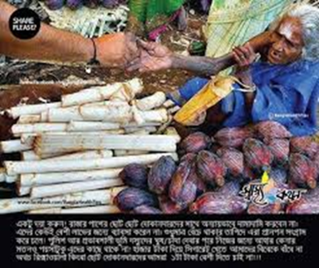
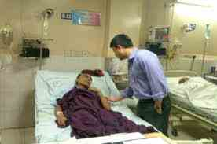
Abstract Noun
Kindness
Illness

Slide 11
CLASS WORK
You Identified the different kinds of Noun from these words below -----
Khulna , Nation , Padma City , Oil , Happiness ,Girl ,Club ,Gold , Boyhood ,Rakib ,Poet ,Police, Coal ,Friendship .

Slide 12
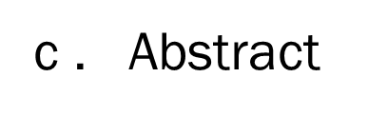
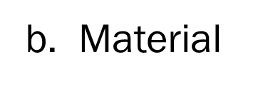
EVALUATION
Now You choose the correct answer from the Alternatives :
1.“Rony “ What kind of Noun ?
a. Common c. Abstract .
2. “ Kindness “, Which kind of Noun ?
a.Common b.Material.
3 .”Water” Which kind of Noun ?
a. Proper c .Collective .
b. Proper

Slide 13
HOME WORK
Some Example :Water , Gold ,Milk , Iron ,Coal , Crowd , Army , Family ,Perliament, City , Girl ,Meghna ,
You findout Material noun and Collective noun from the Box .

Slide 14

Ok ,See you next class.
Thank you all .

