Slide 1
MD. RAFIQUL ISLAM
Head Teacher
Taher Secondary School rafiqul990@gmail.com
Class : Six
SUB :Eng 2nd paper

Slide 2
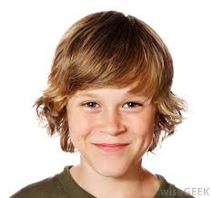
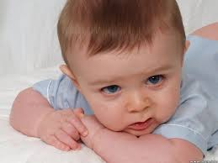
Pitcure
Girl
Boy

Slide 3


Book and Pen

Slide 4
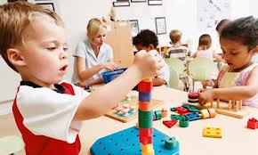
Children

Slide 5
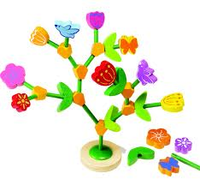
Tropics Name
Gender

Slide 6
Objectives-
Will be match gender with picture Will be change gender
Will be fill in the blanks with gender.

Slide 7
Presentation
What kinds of gender ?
What are they ?
Choose the best answer
1. One
2. Two
3. Three
4. Four
1. masculine
2. feminine
3. neuter
4. common
5. Proper
6. Material

Slide 8

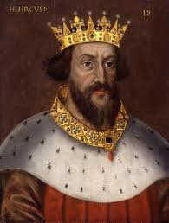
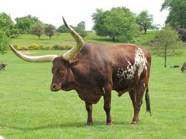
Group Work
Match the gender with picture
Dog
Queen
Son
Cow
Drake
Fox

Slide 9
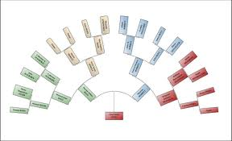
FAMILY
CHART

Slide 10
INDIVISUL
WORK
CHANGE THE
GENDER
JEW
HOST
POET
HORSE
DEER

Slide 11
PAIR WORK
FILL IN THE BLANK
WITH THE FOLLOWING CLUES.
SHE IS A ----.
HE IS A----.
-----GIVES US MILK.
-----LAYS EGG.
BABOR IS A------.
KING, COW, GIRL,HEN HERO
BOY, NIECE.

Slide 12
Evaluation
Wife (hira)
Husband (karim)
Son
Grandmother
mala
Karim is hira's ____.
Daughter
Grandfather
Hira's mother- in law
is___ .

Slide 13
Home work
Writ e some name of common gender

Slide 14
Thank you

