Slide 1


3
2
4
1
5

Slide 2
Presented by:
Masuma Akter
Oskhali Aliya Model Government Primary School.
Hatiya, Noakhali.

Slide 3

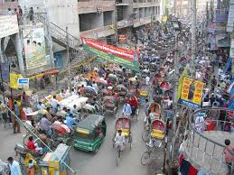
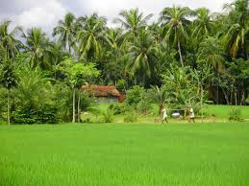
সমুদ্র
Lesson Identity:
Class-Two
Subject: English
Lesson-4
Lesson unit: How many? (number-1-----5 in figures & words)
Time: 45 minutes.

Slide 4
Objectives:
Students will be able…
to recognize & say the cardinal numbers 1-5.
to read & write cardinal numbers 1-5 both in figures and in words.

Slide 5




Emotion Create:
Picture &Video

Slide 6

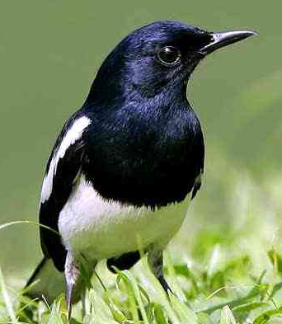
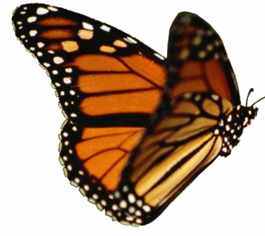



Slide 7
Let’s see the video

Slide 8





Declaration of the Title:
Numbers

Slide 9
Input
20 minutes

Slide 10

Look, listen and say:
1
one

Slide 11

Look, listen and say:
2
two

Slide 12

Look, listen and say:
3
three

Slide 13
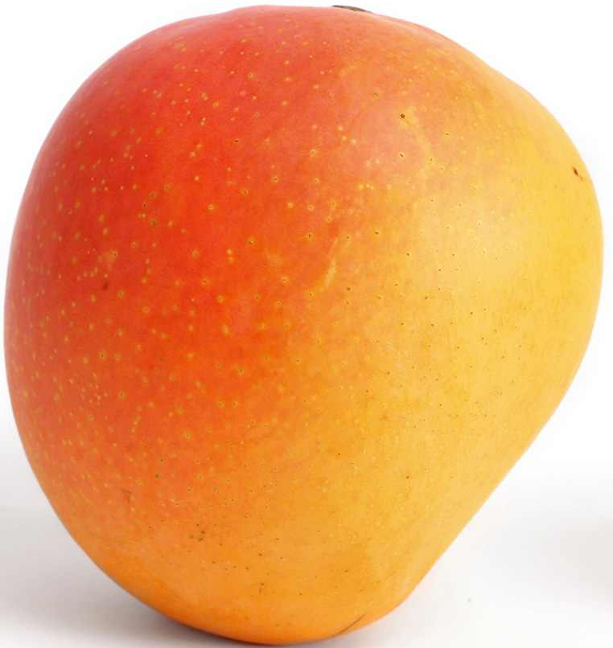
Look, listen and say:
4
four

Slide 14

Look, listen and say:
5
five

Slide 15
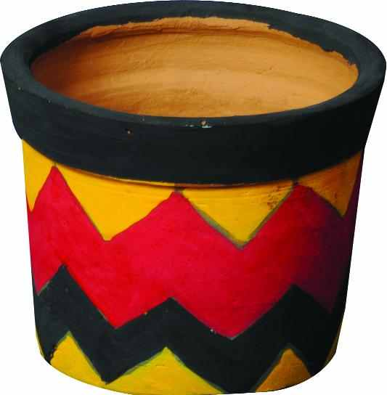

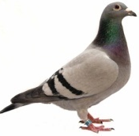

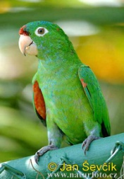
Look, listen and say:
Picture
Figure
Word
1
one
2
two
3
three
4
four
5
five

Slide 16
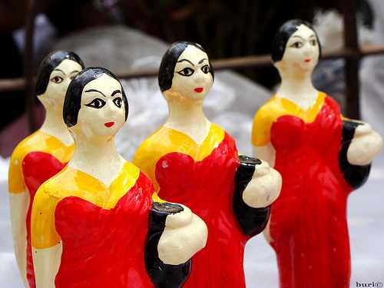
How many dolls?
four
3
5
4

Slide 17
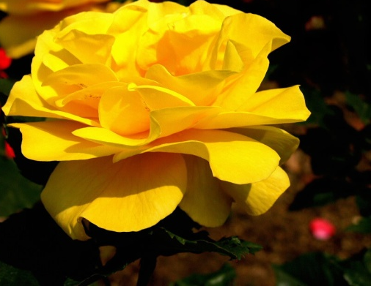
How many flowers?
3
three

Slide 18
Practice
15 minutes

Slide 19
Match the numbers with words:
P.W
Time: 5 minutes
Number
Word
4
three
2
one
3
two
1
five
5
four

Slide 20




Write the missing numbers by using pictures:
I.W
Time: 5 minutes
1
2
3
4
one
two
three
four
5
five

Slide 21
Write in words & re-arrange the numbers:
S.G.W
Time: 5 minutes
Numbers
Words
3
three
1
one
2
two
5
five
4
four

Slide 22
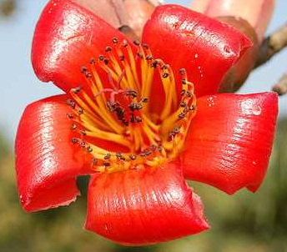
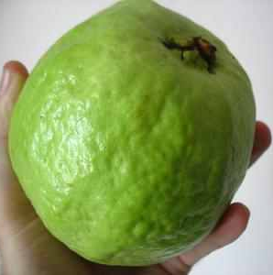
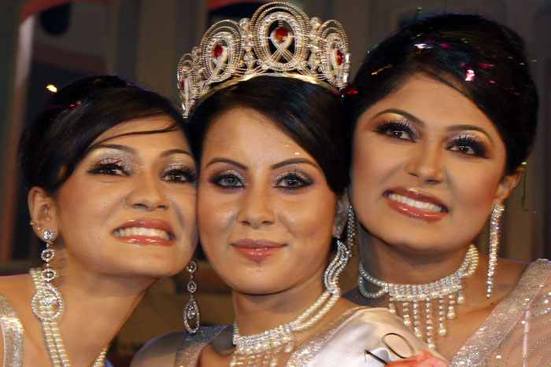

Rearrange the words with pictures:
W.C.W
one
three
Checking learning
two
four
five

Slide 23
Let’s play the number game:
1
5

Slide 24
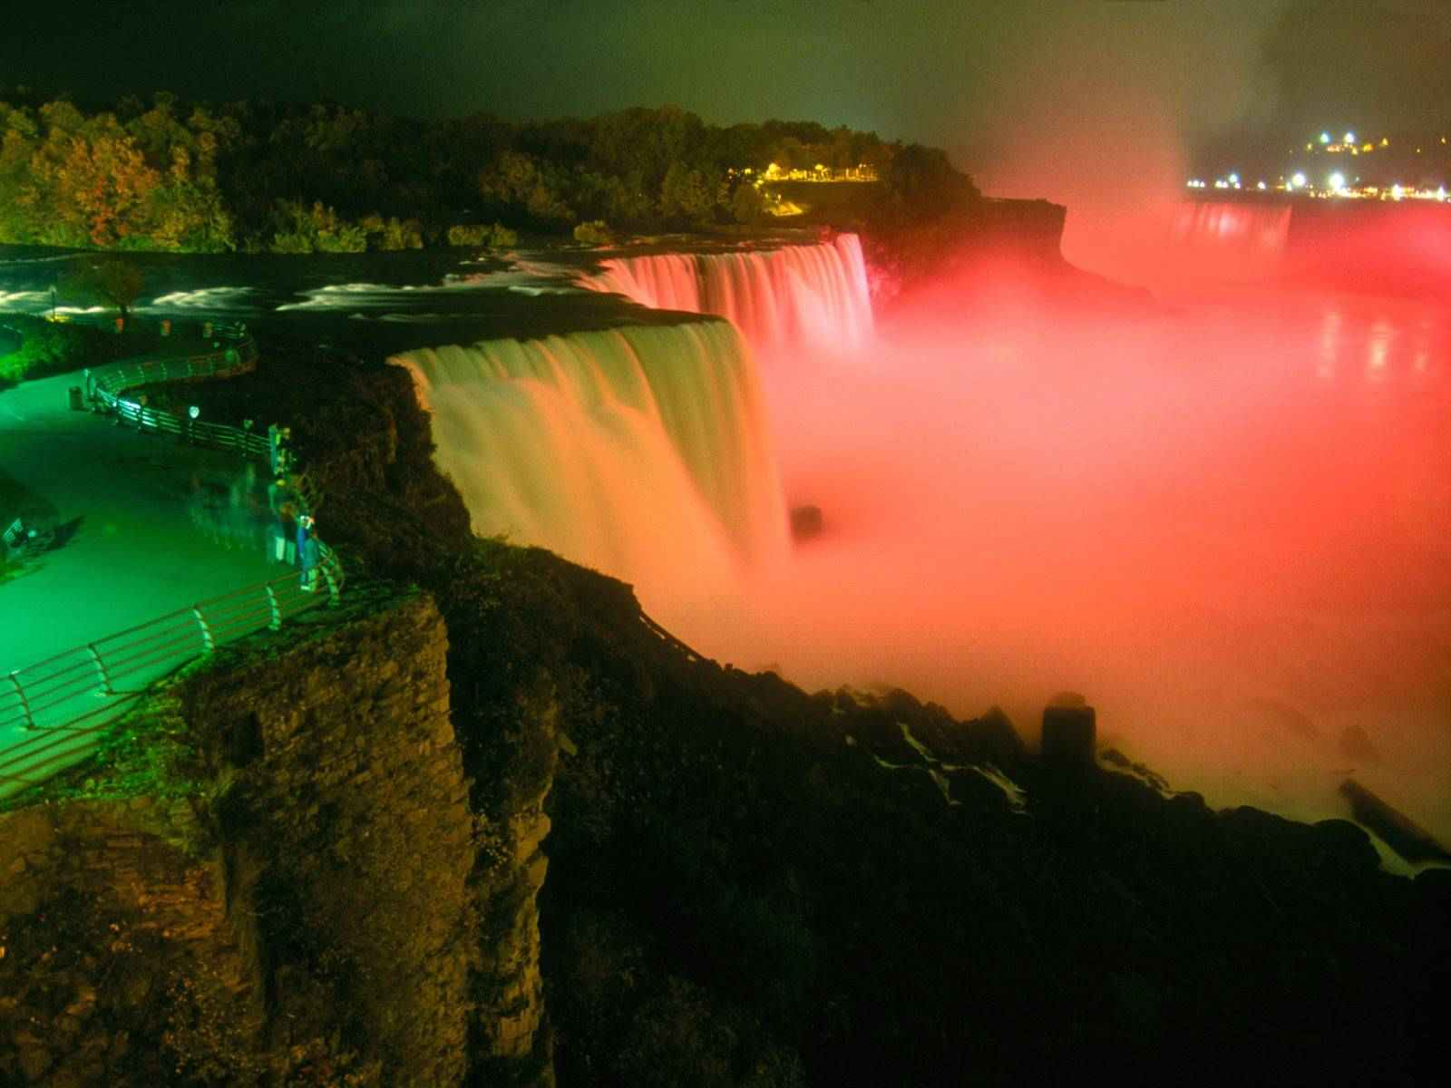



5
1
4
2
3

