Slide 1
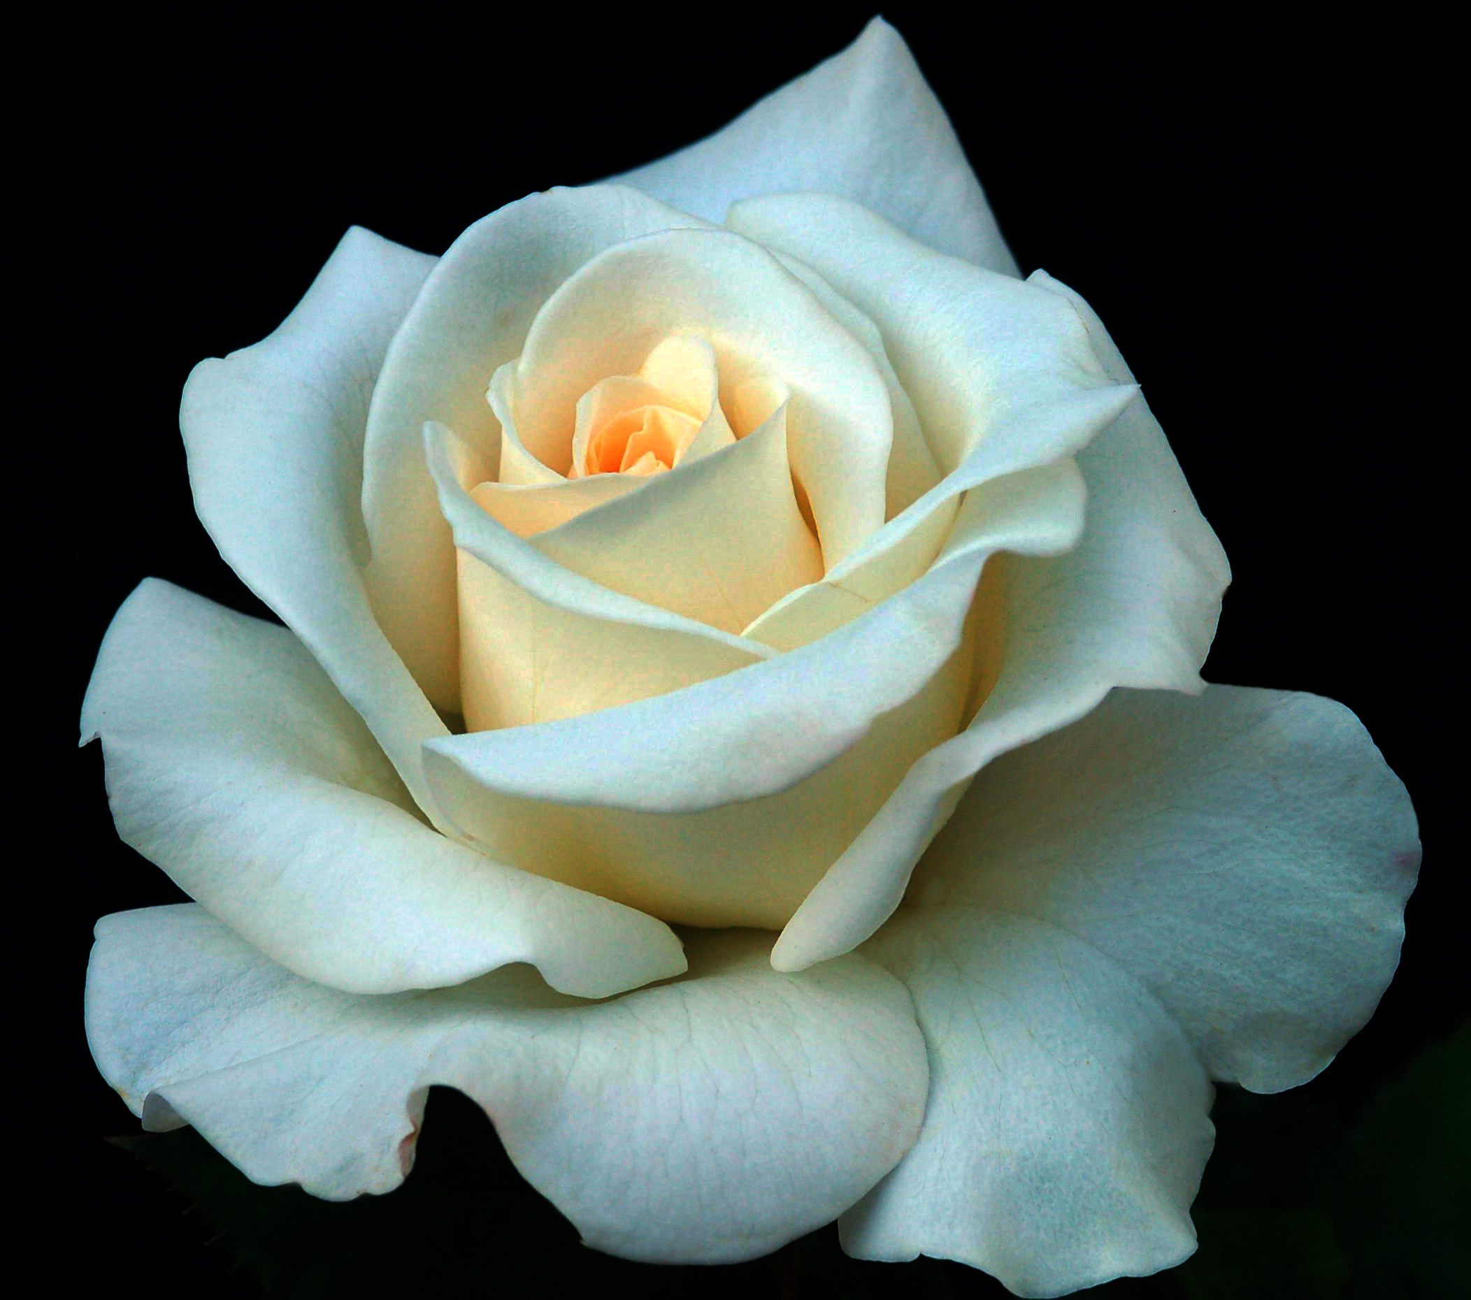
Well come
Well come
Wel
well come

Slide 2

INTRODUCTION
MD: RAFIQUL ISLAM
SENIOR TEACHER
CHAR CHANDRAIL A.H. HIGH SCHOOL
GALACHIPA,PATUAKHALI

Slide 3

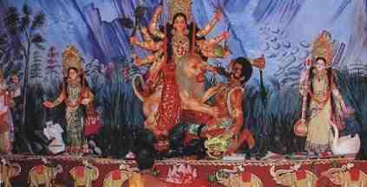
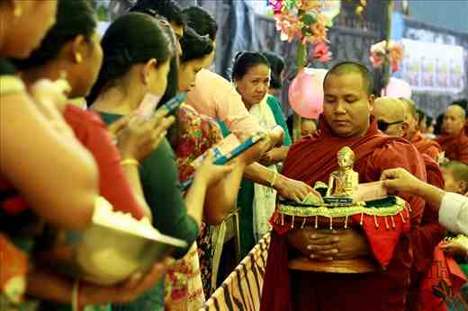

Slide 4

STUDENTS WILL TRY TO GUESS
WHAT ABOUT THE PICTURES?

Slide 5

TITLE

Slide 6
OBJECTIVES

Slide 7
BY THE END OF THE LESSON STUDENT WILL HAVE---
1)WRITTEN A DIALOGUE.
2)READ ANEWS PAPER ARTICLE ON EID’
3)SUPPLIED CORRECT INFORMATION ABOUT EID.
4)READ INTERVIEWS ABOUT EID.

Slide 8

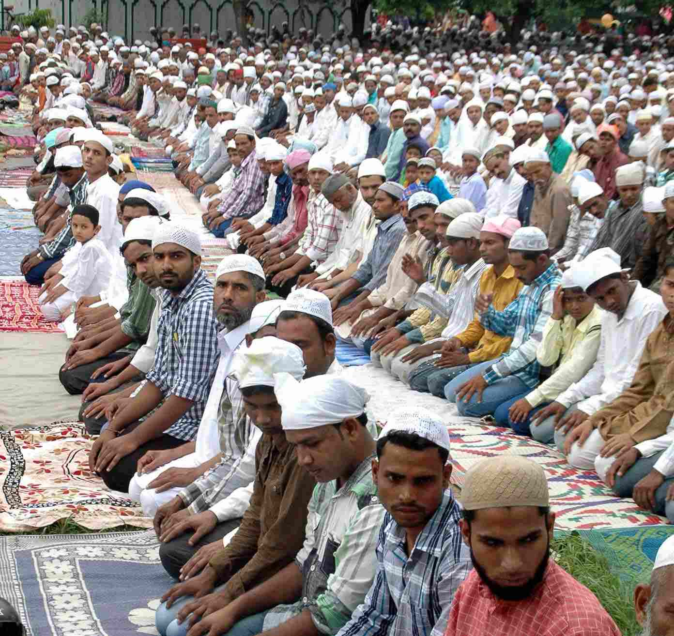

Slide 9
READ THE PASSAGE CAREFULLY

Slide 10
EID MOBAROK s
EID-UL-FITR is the biggest religious festival of the muslims . It comes at the end of the month of Ramadan.The month of self-analysis the muslims, and self-restraint, gives the muslim opportunity to reshape their life in accordence with the teaching of Islam. As an essential element of Islam,the month long fasting prohibit all wrong,inhuman and harmful acts. Faleshood,wrong doing, creating indicipline and anarchy in socity and all kinds of deceptions are sin in the eye of Islam. The glorious month of Ramadan comes to us as the month of self-judgement and purirification.

Slide 11
VOCABULARY
(OPEN)
1)Opportunity=Chance,Facility
2)Festival=Function of enjoyment
3)Essential=Very necessary
4)Fasting=STAY WITH out eating anything
5)purification=Bringing freshness

Slide 12

Personal work
1)What is EID-UL-FITR?
2)When does it come to us?
3)What about the month of Ramadan?
4)What is the essential part of Islam?

Slide 13
PAIR WORK
1)What kind of month Ramadan is?
2)What are the teaching of Islam?
3)What doeS Ramadan prohibit?
4)What are sin in the eye of Islam?

Slide 14
GROUP WORK
Write the passage with in five sentences

Slide 15

MATCHING ANSWER
1)Ramadan is a holy month.
2)The teaching of islam areself-analysis ,self-restraint and probhibiting all kinds of deception
3)Holy month of Ramadan prohibits faleshood,wrong doing and anarchy of the of the socity.
4)Faleshood wrongdoing ,harmful work and deception are sin in the eye of islam.

Slide 16
HOME TASK
WRITE THE SIGNiFICANCE OF THE MONTH OF RAMADAN

Slide 17

THANKS

