Slide 1

Welcome

Slide 2



  Md. Abu Sayem
(Assistant Teacher (Social scince)
. Doulatkhali High school
Doulatpur, Kushtia
Class: Seven
Subject: English(ii)

Slide 3


Look at picture

Slide 4

Where is the flower pot?

Slide 5
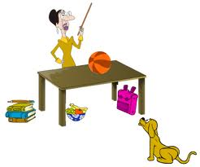
Where is the ball?

Slide 6

i-11

Slide 7
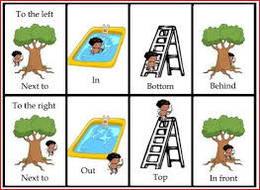
What you have to fine from this picture?

Slide 8


Today’s lesson
preposition

Slide 9

What you have to learn from this chapter?
What do you mean preposition?
The kinds of preposition?
Use of preposition?

Slide 10
Kinds of preposition
Simple preposition.
double preposition.
compound preposition.
Phrase preposition.
Participle preposition.
Disguised preposition.

Slide 11
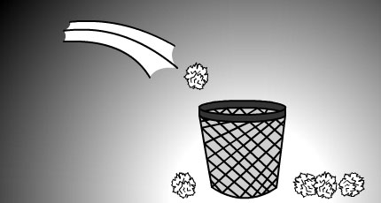
Simple preposition.
In, on, for, up, by, with, after , etc

Slide 12

double preposition.
Into(in+to) upon(up+on) without(with+out)
I can’t do nothing without you.

Slide 13
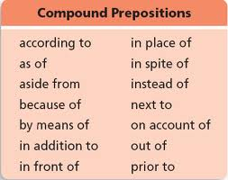
compound preposition.
About, behind, before,above along etc

Slide 14
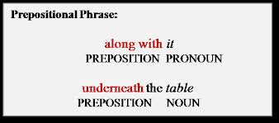
Phrase preposition.
In front of, look for, in spite of etc

Slide 15
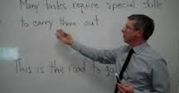
Participle preposition.
According, regarding , speaking etc

Slide 16
Disguised preposition.
EXAMPLE
He comes here twice a week.
It is ten o’clock,

Slide 17
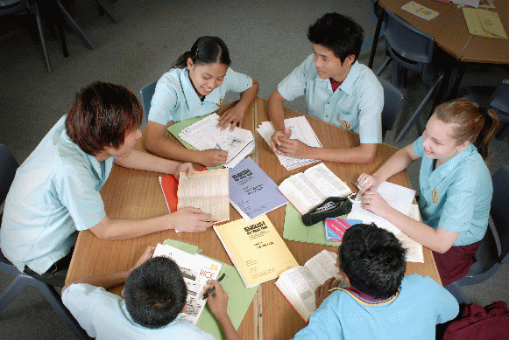
Group Work
How many kinds of preposition?
Give some example of preposition

Slide 18
Evaluation
Now fill in the blanks with suitable preposition a) This pen---- you
b) I want to go---you
c) Boys are --- the tree

Slide 19

Home Work
Preparation at home simpl &dauble preposition ?

Slide 20

Thanks

