Slide 1

welcome

Slide 2
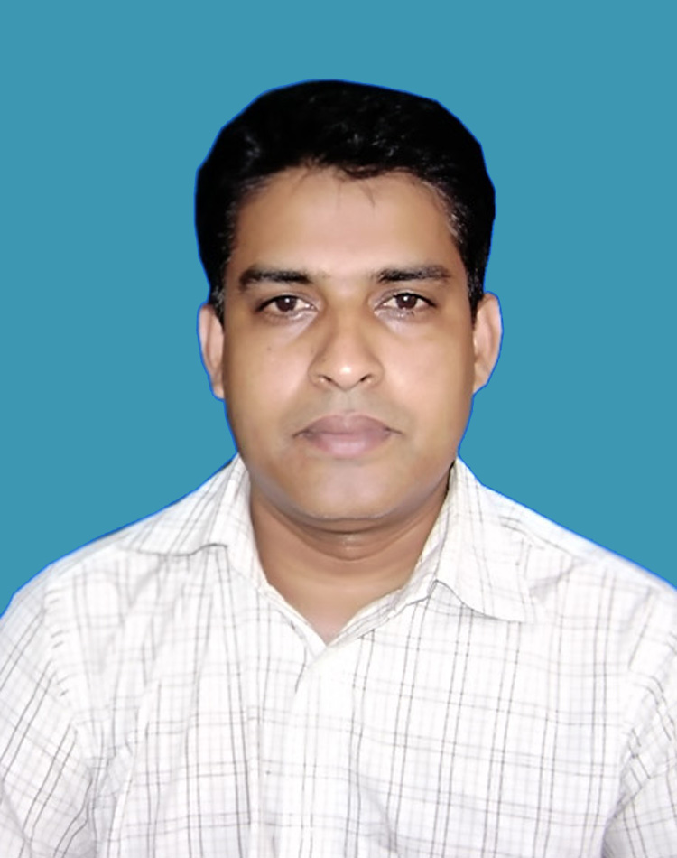


  Md. Abu Sayem
(Assistant Teacher (Social science)
. Doulatkhali High school
Doulatpur, Kushtia
Sub:- English(ii)
Class:-Six
Duration:4o mits

Slide 3

What do you understand from this picture?

Slide 4
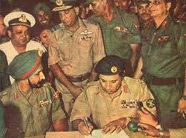
What you have to think about this picture?

Slide 5
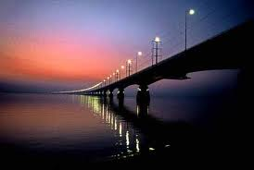
?
Is it

Slide 6
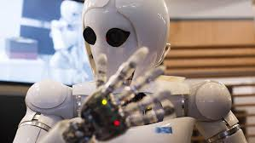
What we have to
think about
this picture?

Slide 7
Today’s Lesson
Tense

Slide 8
Learning out work
We learn about tense
kinds of tense
Also we can properly use the tense

Slide 9


Types of tense
Indefinite tense
Continuous tense
Perfect tense
Perfect continuous tense
Present tense
Past tense
Future tense

Slide 10

Present indefinite tense

Slide 11

Present Continuous tense
Mashrafi is playing cricket

Slide 12
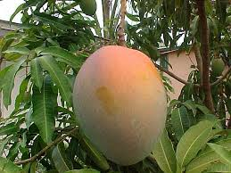
Present perfect tense
I have eaten the Mango

Slide 13
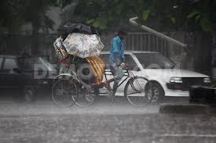
Present perfect Continuous tense

Slide 14
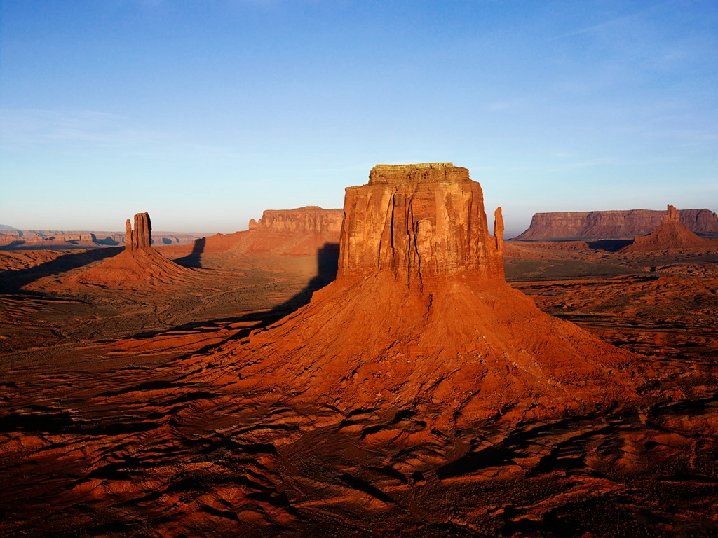
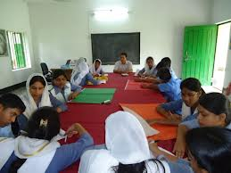
Group work
How many types of tense?
(I go to school) which kinds of tense?
Do you know how to make structure of present perfect tense?

Slide 15

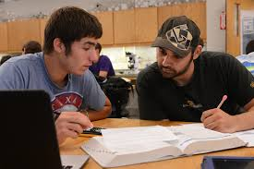
Pier works
Answer to the following quistion.
What do you mean present tense?
He does the work (which tense)
He is go to play ( what’s the correct answer)

Slide 16
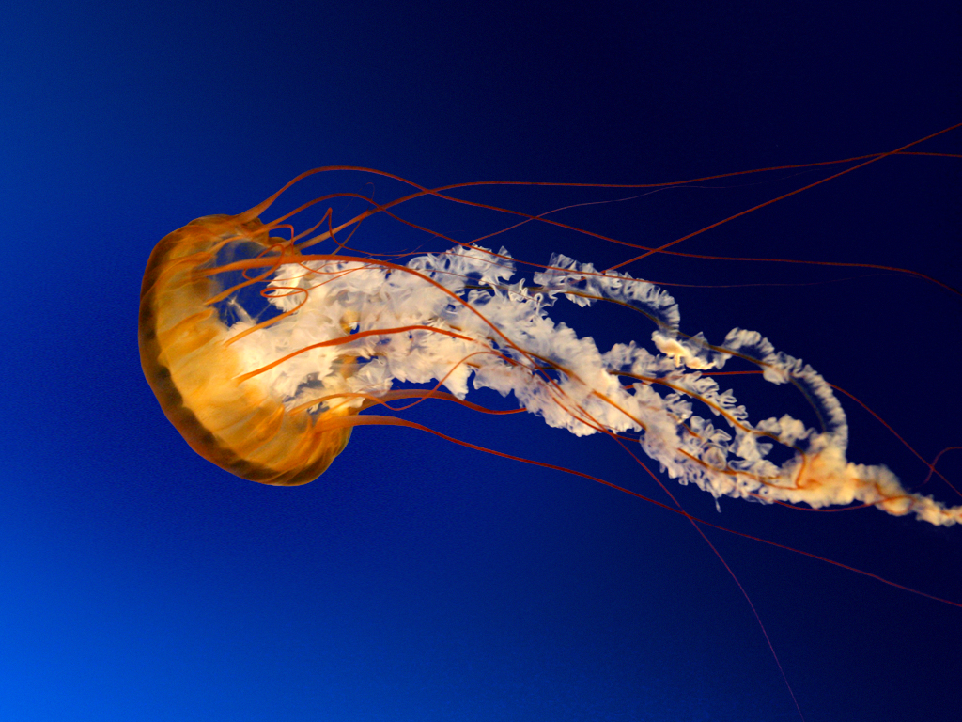
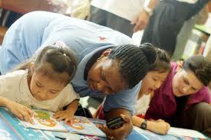
Home work
Read the following table and make five sentences
I | is | talking
he | Am | raining
You | Does | the work
It | Has been | the sum
karim | do | working in the field

Slide 17
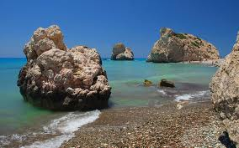
Thanks to all

