Slide 1
Welcome
W E L L C O M E

Slide 3
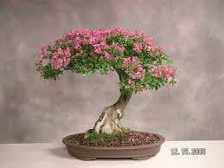
Class-Two
Subject-English
Lesson-3
Lesson Unit:-What’s This ?
Time-40 Minutes.

Slide 4
LearningOutcomes:
By the end of the lesson student will be able to:
to write non cursive capital letter.
to write non cursive small letter.

Slide 6
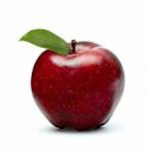
Look at the picture.
Apple

Slide 7
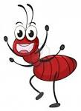
Look at the picture
Ant

Slide 8
Look at the picture
ball

Slide 9
Look at the picture
cap

Slide 10
Look at the picture
cup

Slide 11
Presentation

Slide 12
Look and say.
A
Apple
a
apple

Slide 13
LOOK AND SAY.
B
Ball
b
ball

Slide 14
Look and say.
Cap
C
c
cap

Slide 15
Group work
Match the capital and small letters
A
B
C
b
ca

Slide 16
Writing Practice in Text Book

Slide 17
Checking Learning:
Write the capital and small letters three times

Slide 18
Thanks For All

