Slide 1

Good Morning

Slide 2

Presented by
Bakul Chandra Das
Asst. Teacher(Computer)
Sonapur High School
Tazumaddin ,Bhola.

Slide 3
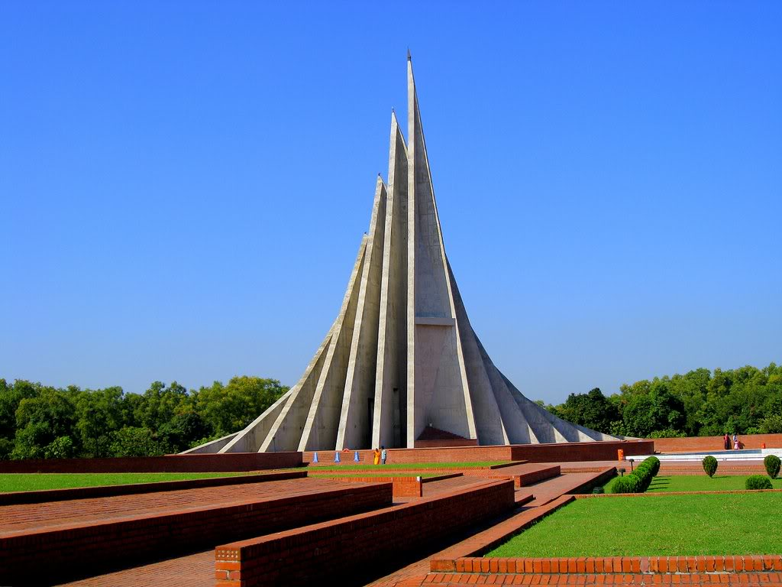

Slide 4
The National Memorial

Slide 5
English First Paper
Class: 10
Unit:14
Lesson: 1
Time : 45 Minutes

Slide 6
Objectives :
By the end of the lesson students will have -
Looked at a picture and asked answered questions
2. Read a text and completed a table
3. Completed a conversation
4.Answered questions

Slide 7
Vocabulary
1.Respect
2.Liberation
3.Upright
4.Anniversary
Answer
1.Honour
2.Freedom
3.High
4.Annual

Slide 8
Model reading
Page No:142

Slide 9
Pair Work
1.What do the 7 towers stand for?
2. What is the total area ?

Slide 10
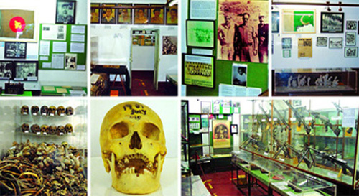

Slide 11
More Work
1.What will the memorial remind its visitor of ?
2.Why is the museum built near the monument ?

Slide 12
Group work
1.What dose the monument symbolize ? 2.What dose the author mean the national memorial was built with concrete but made of blood ?

Slide 13
Answer
1.The monument symbolize of the nation’s respect for the martyrs of the War of Liberation .
2.The author means the national memorial was built with concrete but made of blood because millions of martyrs laid down their lives for the country .

Slide 14
Evaluation
1.Which day is our independence day?
2.Which day is our victory day?
3.What do you understand by the national memorial ?
4.Have you seen the national memorial ? If you have where, when ? What was?

Slide 15
Home work
Write an essay about our Liberation War .

Slide 16
Thanks to all .

