Slide 1
Good morning

Slide 2
Presented by
Moshtaq Ahammad
Assistant teacher
Ashkamta Govt. Primary School
Laksam , Comilla.

Slide 3
Class: Two
Subject : English For Today
Unit 9:Life every day
Time:40 min

Slide 4
Unit:9
Lesson1 : Raihan’s routine in the morning

Slide 5
I see rainbows
………………………….
………………………….
……………………………

Slide 6
Learning Outcomes:
SS will be able to:
1.ask and answer simple questions about every day life

Slide 7
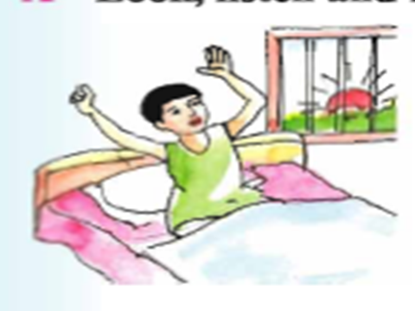
Get up early in the morning

Slide 8
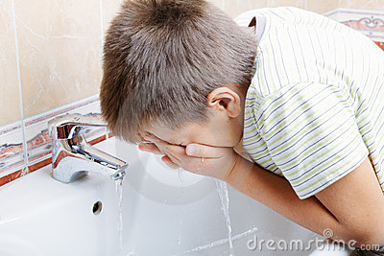
Washing face

Slide 9
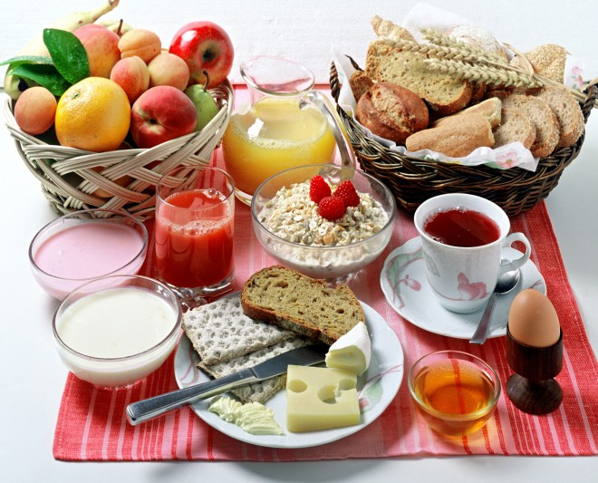
Breakfast

Slide 10
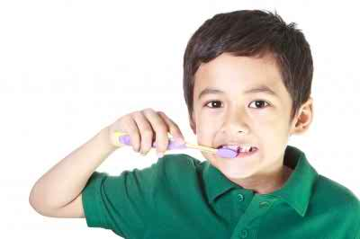
Brushing teeth

Slide 11
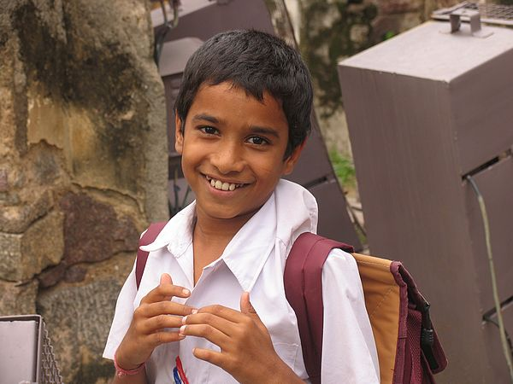
Going to school

Slide 12
Routine in the morning

Slide 13
Teacher reading

Slide 14
Student reading

Slide 15
Pair work
Every student ask one another
*What do you do in the morning?

Slide 16
Evaluation
Q1.When does Raihan get up?
A:Raihan gets up……………………………………………
Q2:How many things does he do in the morning?
A:He washes …………………………………………………..
…………………………………………………..

Slide 17
Thank You

