Slide 1


welcome

Slide 2

Information
Goutom Kumar Ghosh
Assistattnt Teacher
Ahsania High School
Debhata, Satkhira.
Class- Nine
Subject- English
Unit- Four
Lesson- One
Time- 45 minutes
Date- 18/01/2015.

Slide 3

Learning Outcomes
By the end of the Lesson learners will be able to----
-- ask and tell about problems.
-- narrate something in writing.

Slide 4
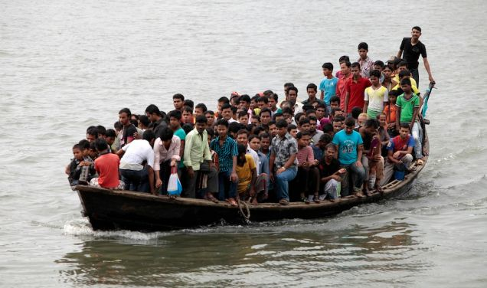

Slide 5
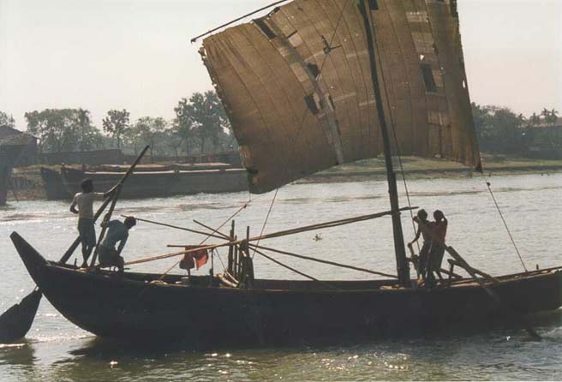

Slide 6
Where can you find this kind of boat?
Why do people use country boats?
Why does the boatman carry passengers across a river?

Slide 7

Title
The ferry boat

Slide 8
Vocabulary

Slide 9

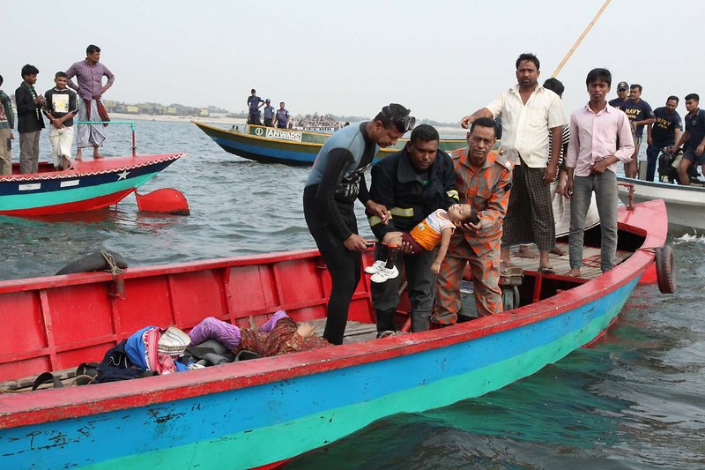
fatal
meaning---- bringing death.
Part of speech--- adjective
Sentence– It was a fatal accident.

Slide 10

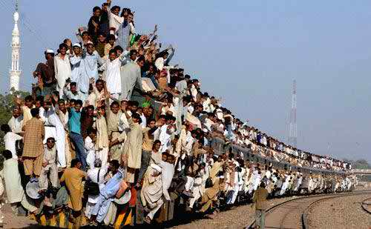
overcrowded
meaning--- crowd together too much.
Part of speech--- adjective.
sentence--- The train was overcrowded.

Slide 11

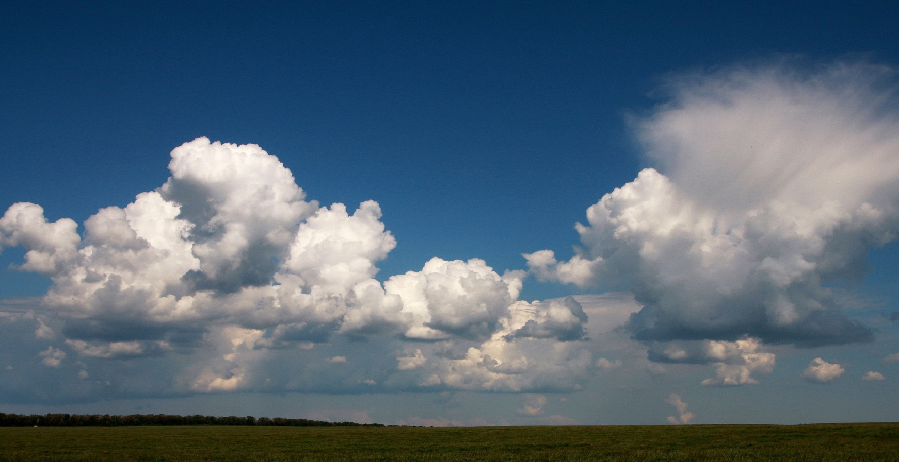
move
meaning– change position.
part of speech--- verb
sentence--- Black clouds are moving fast in the sky.

Slide 12
Read the Text in B individually and silently then discuss in pair and Tick the best answer.

Slide 13
1. People were coming back with their----------------.
a) Cows.
b) Shopping bags and baskets.
c) Baskets.
d)Shopping bags.
2. The boat could cross the river in----------
a) 8 minutes.
b)10 minutes.
c) 8-10 minutes.
d) 6-8 minutes.
3.Who shouted ” No more, no more, please wait”
a) The boatman.
b)The teacher.
c) Jamil.
d) Passengers.
4. “With too many people on board, the boat---------
a) Stood still.
b) Crossed the river.
c)Sank on the bank of the river.
d) Sank in the middle of the river.

Slide 14

Fill in the blanks with appropriate preposition
There was a boat plying------ the river.
It was just ------ sunset.
The wind started blowing ------- the north-west.
Black cloud were moving fast --- the sky.
Everybody was trying to get ---- the boat.

Slide 15
Group Work
1. Why do many people have little or no patience with this kind of situations as in the ferry boat?
2. If we have too many buyers in the market, what is likely to happen?
3. If we have too many people in a village/town, what will happen?

Slide 16
Home Work
Write ten sentences about the problems of a large family.

Slide 17

Thank you

