Slide 1
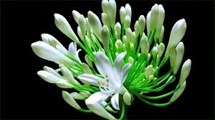
Welcome Everybody

Slide 2
Sub: English-1st paper
Class: X
Unit: 6
Date: 25 Feb, 2015.
Time: 50 min.
Ratan Ch Barman,
Asst Teacher(English)
Jawawr High School,
Tarail, Kishoreganj.

Slide 3
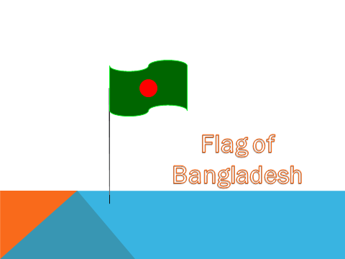

Slide 4
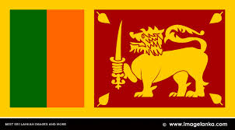
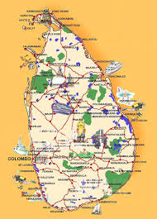
A Flag of Sri Lanka
A map of Sri Lanka

Slide 5
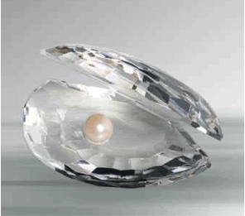
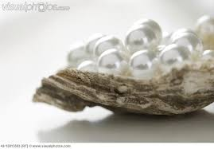
Lesson: 2 (para A to D)
Sri Lanka: The pearl of the Indian Ocean.

Slide 6
After this lesson, learners will be able to
say about Sri Lanka,
ask questions on a country,
Write a short description on Sri Lanka.

Slide 7
Vocabularies:
Traditional = conventional.
Mariner = sailor, seaman.
Astronaut = traveller through outer space.
Multi lingual = speaking many languages.

Slide 8
In Sri Lanka, visitors are welcome with the word_
Ayubowan
Means ‘may you have the gift of long life’

Slide 9
Nick name of Sri Lanka:
Sri Lanka
Serendip
Ceylon
Pearl of Indian Ocean
Tear Drop of India
Notes:
Reading out 1st Paragraph

Slide 10
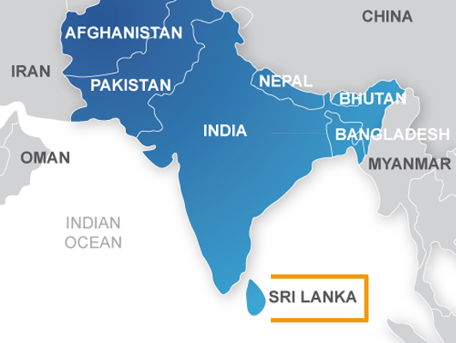

Slide 11
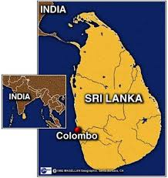
Pop: 20 million
415 km
Coastline
1340km
Land area:
65600 sq km
220 km

Slide 12
Sri Lanka is a land of multi_
Religious
Lingual
Racial

Slide 13
People of Sri Lanka
Sinhallese
Lankan Tamils
Indian Tamils
Lankan Moors/Muslims
The Veddhas

Slide 14
The Veddhas are a root nation of Sri Lanka.

Slide 15
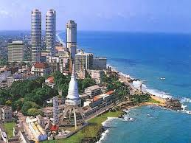
Colombo: The Capital City.
Notes:
Para C

Slide 16
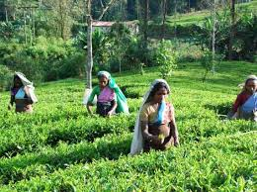
Tea: the largest exporting crop.

Slide 17
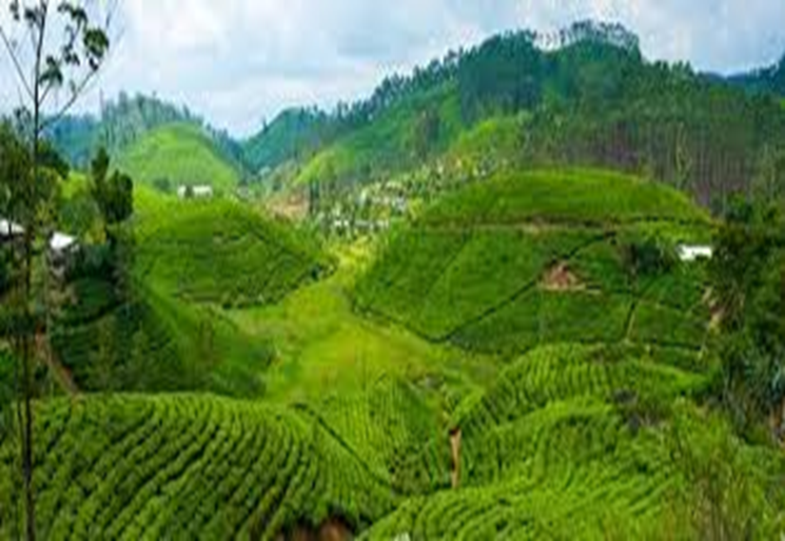

Slide 18
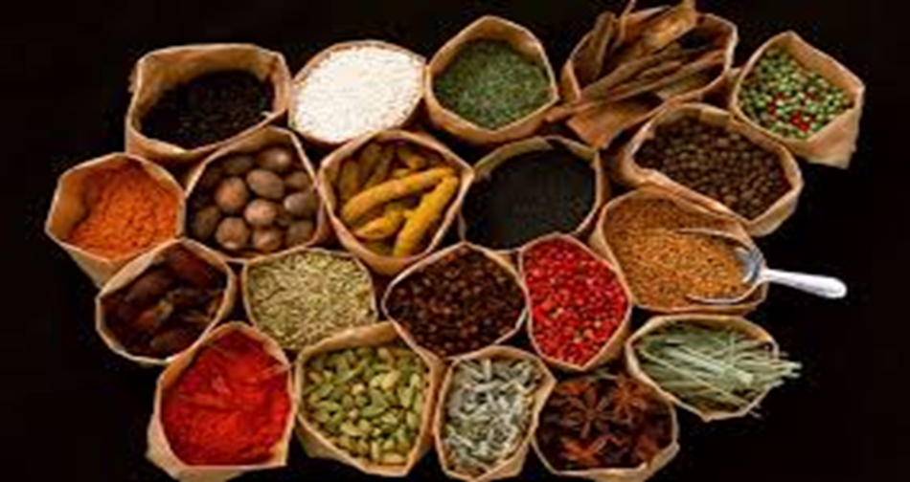
Spices

Slide 19
Group work:
Write down 8-10 sentences in your own words on the Teardrop of India.
Mention the agri-products which are grown up in Sri Lanka.

Slide 20
Evaluation
Which country did the spice cinnamon originate from?
What is Colombo?
For which Sri Lanka is considered the largest exporter country of the world?
What is Lankan’s land area?

Slide 21
Home Task:
Write down the similarities and differences between Sri Lanka and Bangladesh.

Slide 22
Thanks for the kind attention!!

