Slide 1

Welcome

Slide 2

Jasim uddin
Assistant teacher
Mugarchar Govt. primary school
Mehgna-Comilla.

Slide 3
Class: Three
Sub: English
Unit: 8
Lesson: 1
Time: 45 minutes

Slide 4

Two little black birds
Sitting on a wall
One called peter
One called paul

Slide 5
Preposition
Lesson: Over, in, On, under,
between and near

Slide 6
Learning outcomes:-
By the end of the lesson students will be able –
to recognize the preposition
to know the preposition
to say the preposition
to use the preposition

Slide 7
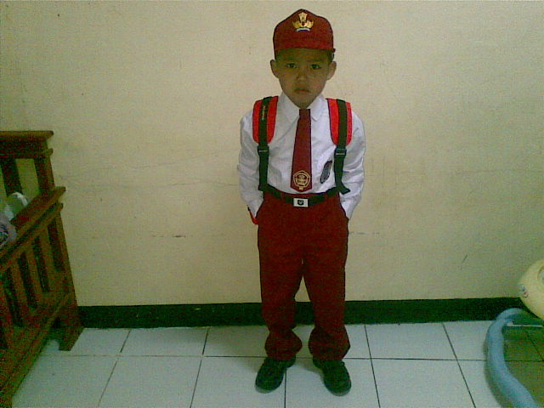
Mamun
Mamun is a student.
He goes to school.

Slide 8
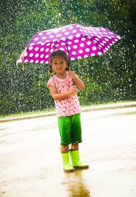
Over
The umbrella is over his head

Slide 9
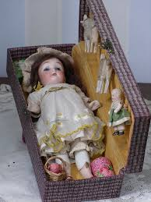
In
The doll in the box

Slide 10
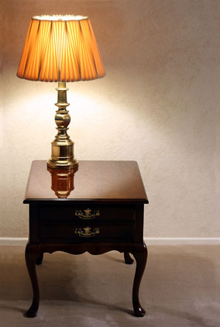

On
The lamp on the table

Slide 11
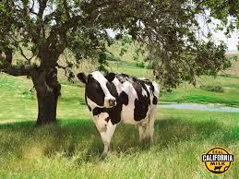

Under
The cow is under the tree.

Slide 12
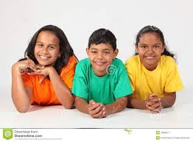

between
The boy is between the two girl.

Slide 13
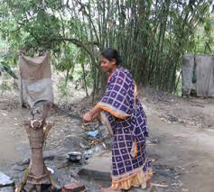
near
The woman is near the tubewell.

Slide 14
Group work
Near
between
Fill in the gaps
1. The lamp is ………near.
2. The cow is…..........the
tree.
Put the tick mark
1. The doll is over/in the box
2. The woman is
over/near the table
on
under

Slide 15

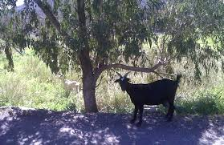
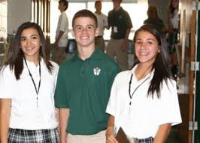

Evaluation
on
under
between
Fill in the gaps
  The umbrella is ……….. …the head.
  The woman is ………..….the tubewell
over
near

Slide 16

Thanks to all.

