Slide 2
Teacher’s Identity
Md. Jasim Madbar
Assistant Teacher (English)
Shibchar Nanda Kumar Model Instituion

Slide 3
Class Identity
Class: Viii
Subject: English
Unit: Two
Lesson: One
Time: 40 Minutes
Date: 07 January, 2015

Slide 4
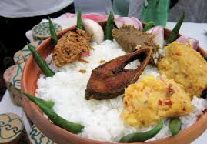
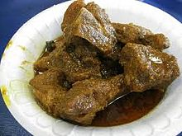
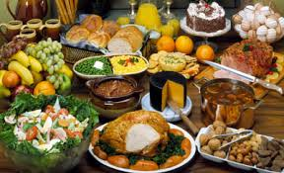
What do you see in the photos?

Slide 5
Todays Topic
Good Food

Slide 6
Objectives:
Students will be able to ask and answer questions.
2. They will be able to read and understand the text through Silent reading.
3. They will be able to complete some sentences.
4. They will able to make sentences with new words.

Slide 7
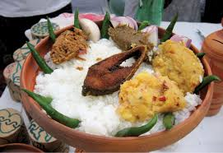
Pair Work
Discuss with your partner about the two pictures. Which one is more valuable for our health?

Slide 8
Individual Work
Read the text in your book silently and mark the unknown words.
If you fail, take my help.

Slide 9
Individual
Now answer the questions in your text Section-B

Slide 10
Pair Work
Discuss with your partner and complete the following sentences:
We should eat good food to …………………………
We should not eat more than ………………………
Eating too much food is not …………………………
Good food means ………………………………………..

Slide 11
Group Work
Make sentences with the new words given below:
Contain, Remember, Amount, Quantity, Physical

Slide 12
Home Work
Write a paragraph about good food.

Slide 13
Thanks

