Slide 1
Assalamualaikum

Slide 2
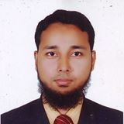
Introduction
Muhammad Nurul Mustafa
Assistant Teacher
Chittagong Cantonment Public College.
ID: 1424266
Mobile : 01812-578223

Slide 3
Introduction to Lesson
Class: Nine
Sub: Islamic Studies
Chap: Three
Lesson: Salat (2)

Slide 4
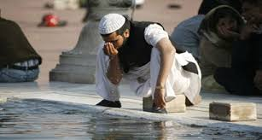
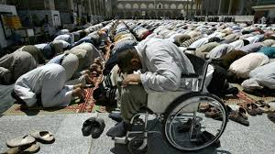
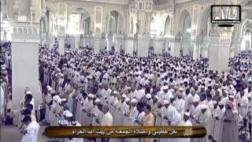
Look the following pictures
Doing Ablution
Performing Sijdah
Mosque
(Devotee)
Perfoming Salat

Slide 5
Today`s Topic
Salat (Namaz)

Slide 6
Aim of leanring
At the end of lesson students will able -----
To know what is Salat.
To write why the Muslims perform Salat daily five times.
Describe the importance of Salat.

Slide 7
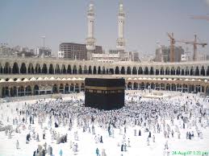
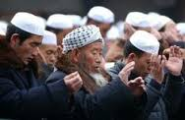
Look the following pictures
Mosque
Performing salat
The Holy Qaba
Starting salat

Slide 8
Individual Work
1) What is the meaning Salat?
2) What did Allah say about performing Salat?
3) Which Ibadat man restrain from evil deeds?

Slide 9
Look the following pictures

Slide 10
Look the following picture
Performing Zuma Salat

Slide 11
Group Work
Describe the importance and significance of Salat.

Slide 12
Evaluation
What is Salat?
What is the timing of Zohar Salat?

Slide 13
Home Work
“Surely Salat restrains man from obsence and evil deeds” Explain this statement.

Slide 14
Thank You

