Slide 1
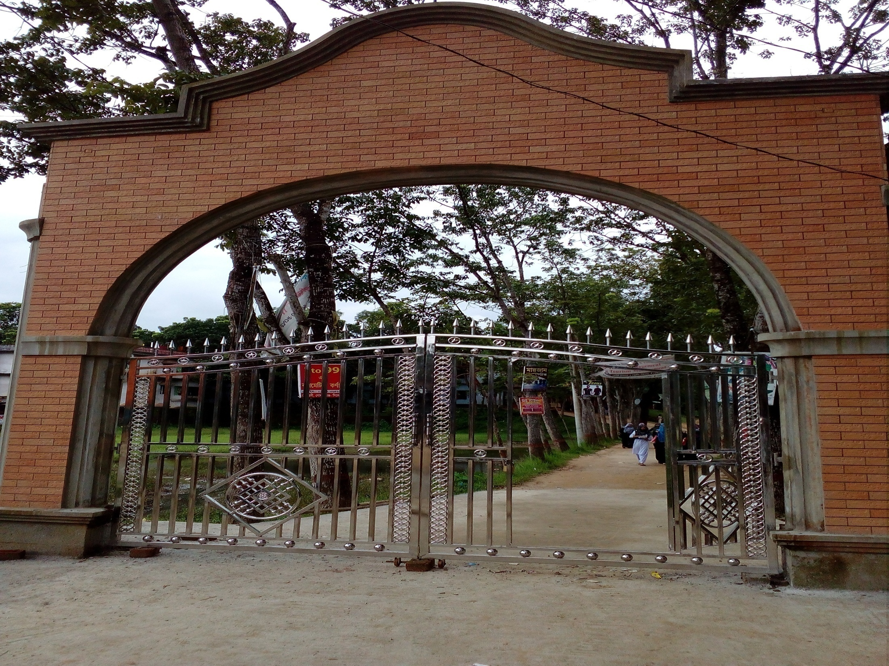

WELCOME
To my Class

Slide 2

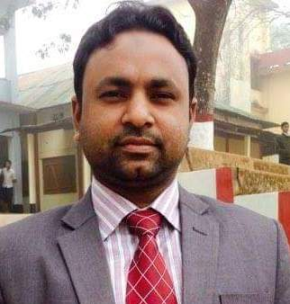

Presented By,
SHAHIDUL ISLAM
Lecturer (English)
Dhakadakshin ML H/S & College, Sylhet.

Slide 3
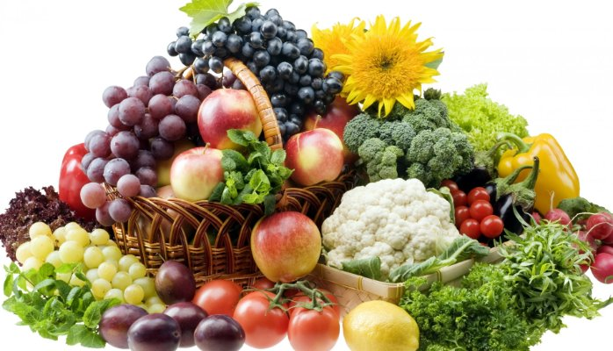
Who doesn’t want to eat and feed such kind of fresh fruits & vegetables?

Slide 4
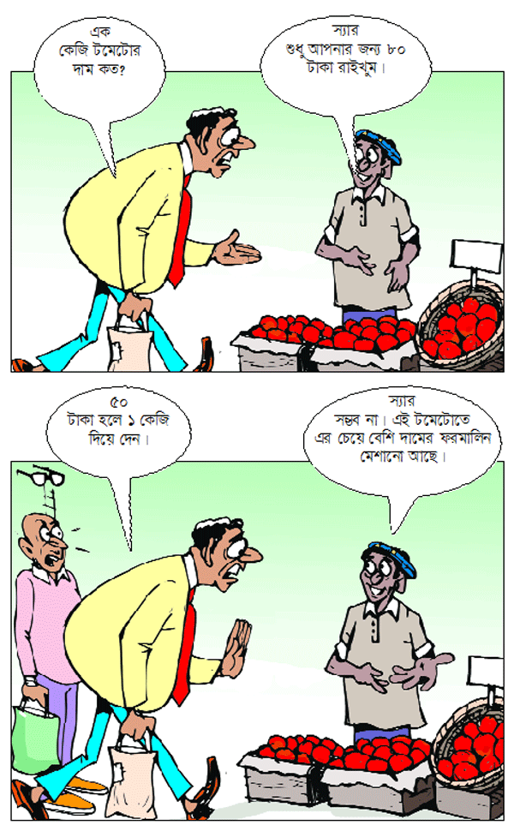
Let’s ILLUSTRATE a jokes

Slide 5

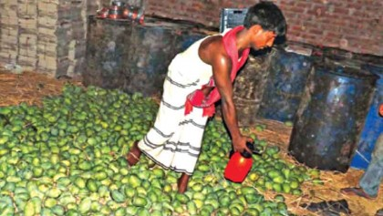
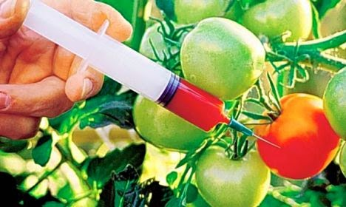
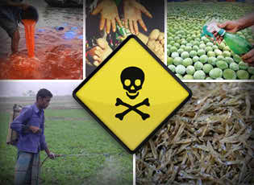
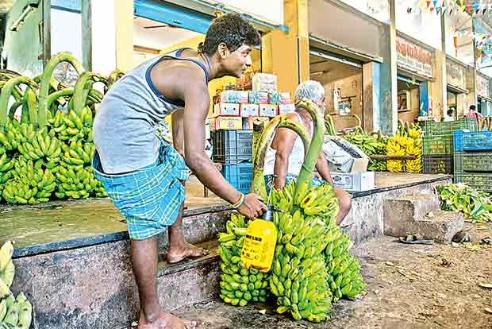
Now watch more pictures and surmise today’s lesson about.
Notes:
What are the silent killers doing…….?

Slide 6


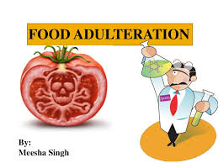

Today’s Lesson
Time : 50 minutes
UNIT-03, LESSON -01
Food Adulteration Reaches New Height

Slide 7

Learning outcomes
At the end of the lesson students will be able to ___
Identify the causes and bad effects of food adulteration.
Mark out the chemical pesticides used in foods/fruits.

Slide 8

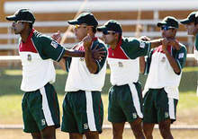
Warm up activity :
a. What is food adulteration?
b. Have you heard the name of a pesticide called formalin which is used as a preservative?
c. Who, do you think, uses chemical pesticides on food/fruits?

Slide 9
Let’s watch a video

Slide 10
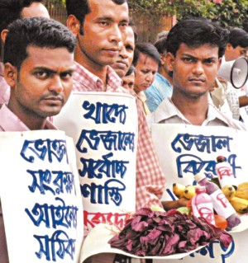
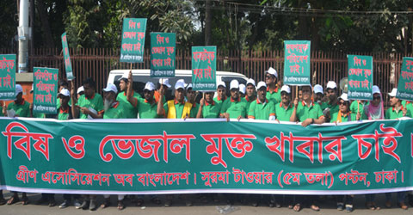
Rally on against food adulteration

Slide 11
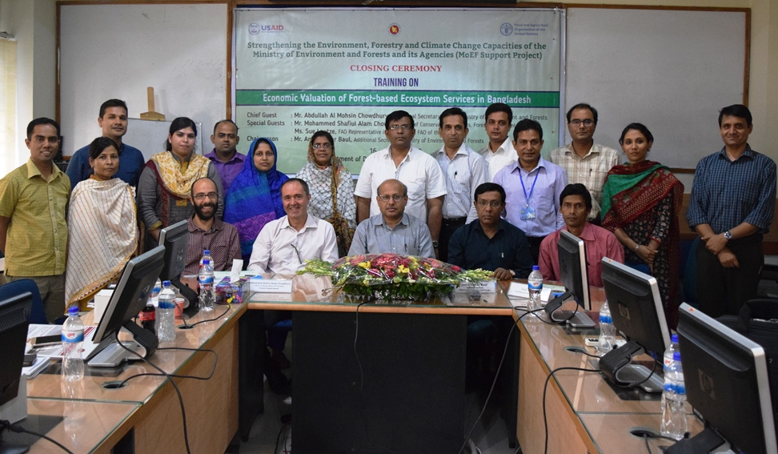
A 15-member team of the National Food Safety Laboratory, with (FAO), collecting and testing food samples from Dhaka.

Slide 12
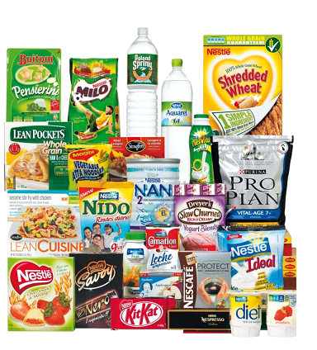
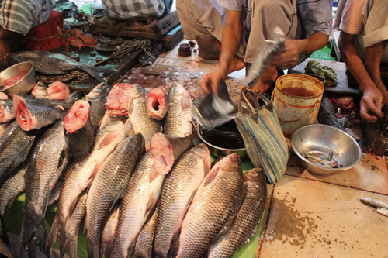
Picture of Food Adulteration in Dhaka:
Nearly 40% of 82 samples of milk, milk products, fish, fruits and vegetables contained banned pesticides.

Slide 13
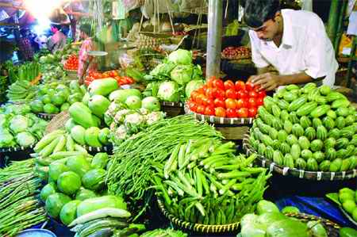
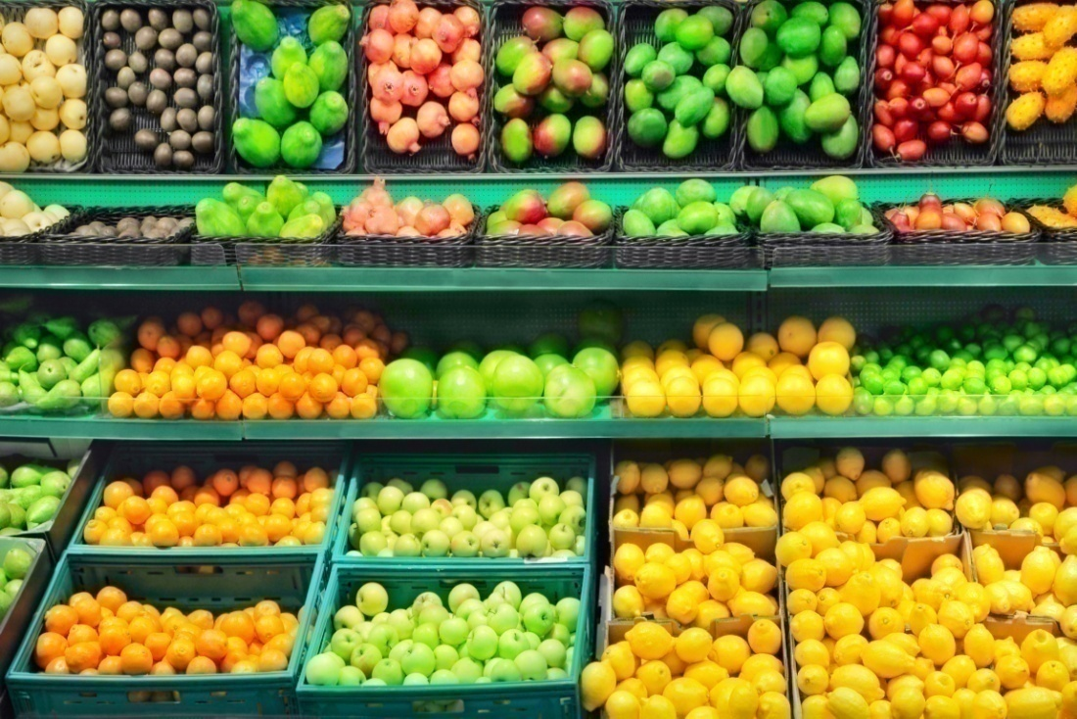

Around 50% vegetables and 35% fruits were found to be contaminated with unsafe level of pesticides.

Slide 14
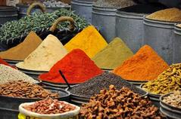
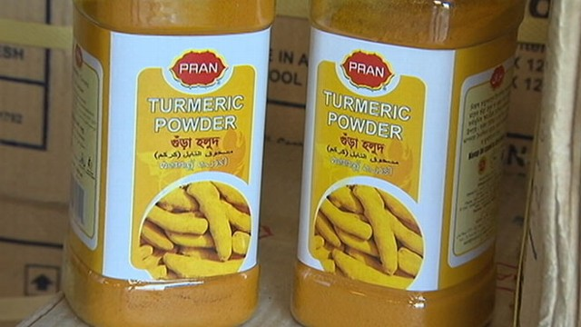
Turmeric powder(branded, packaged and open), 30% out of 30 samples.

Slide 15
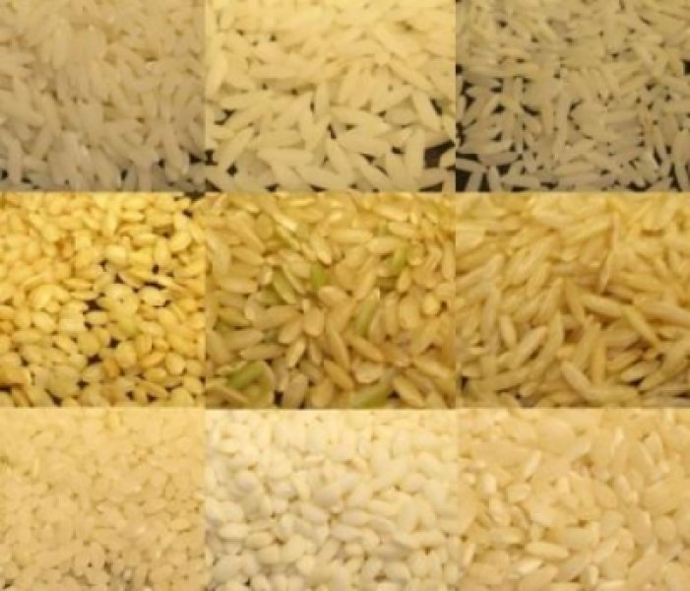
Rice is contaminated 5 out of 13 samples.

Slide 16
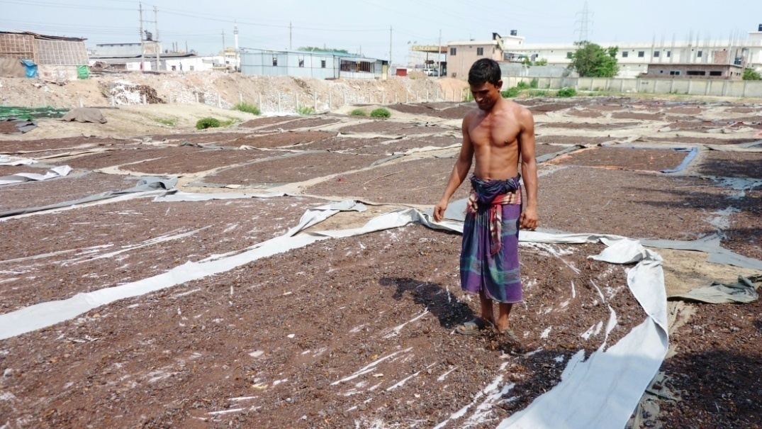
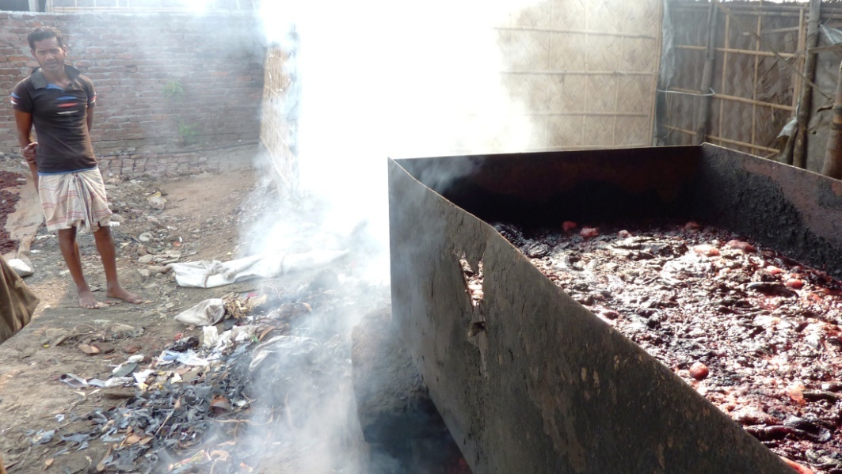
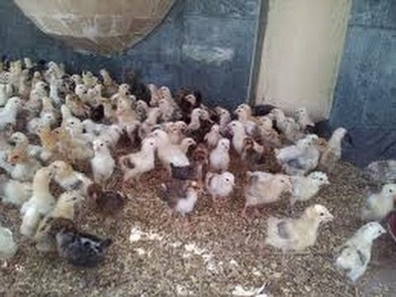
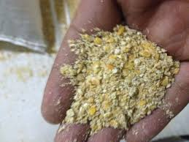
Poultry feed are also made from toxic elements

Slide 17
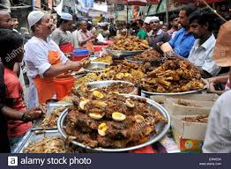
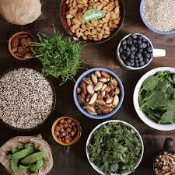
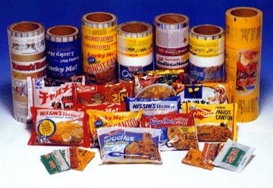
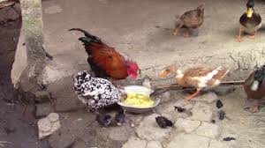
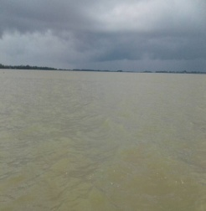
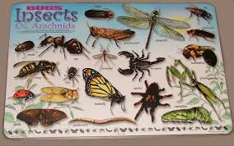
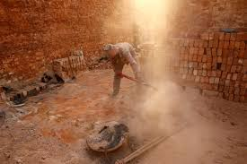
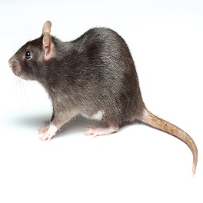
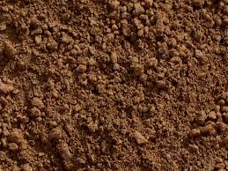
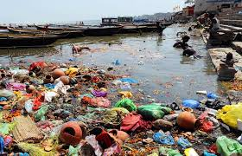
Sources/causes of Food Contamination
Raw materials/
ingredients
Food handlers
Packaging materials
Animals and birds
water
Sources of food contamination
insects
Dust/ air
rodents
soil
Garbage sewage

Slide 18
What kind of pesticides they use?
Food poison
Chlordane
Heptachlor
Arsenic
Chromium
Aldrin
DDT
Antibiotics
Formaldehyde

Slide 19
Effects of Food Adulteration
Effect
Cancer
Kidney failure
Heart Problem
Skin Diseases

Slide 20
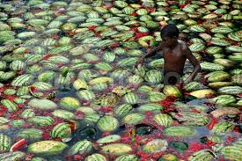
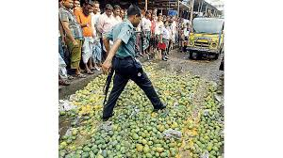
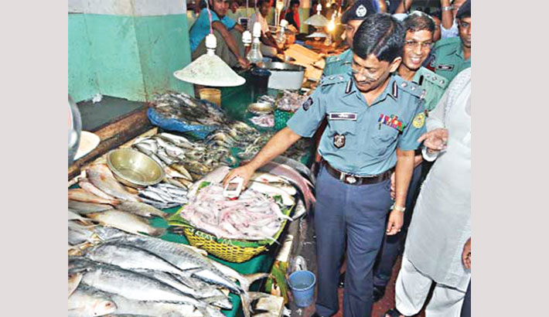
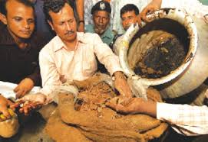
Government’s step against Food Adulteration

Slide 21
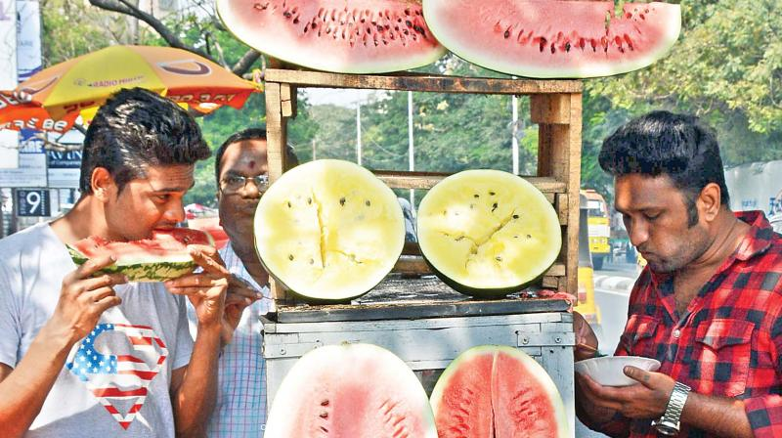
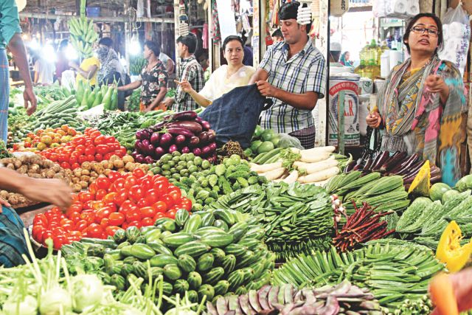

How much are we aware of eating and buying?

Slide 22
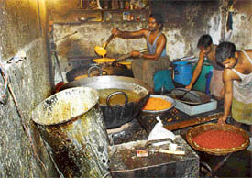
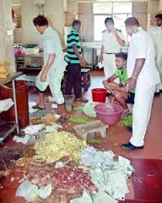
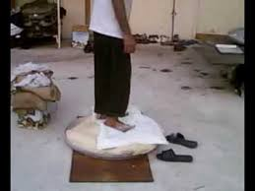
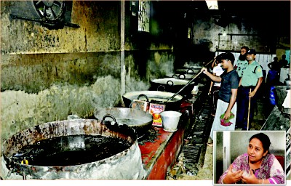
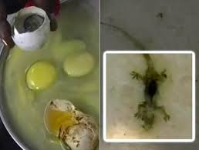
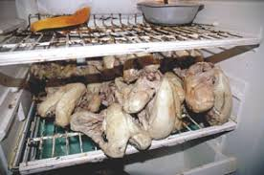
Do we know about the poor processing procedures by the manufacturers?

Slide 23
Let’s watch another video

Slide 24
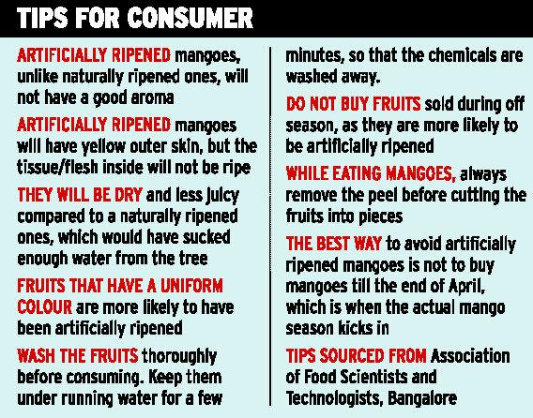

Slide 25
Let’s be familiar with some new words
Food Adulteration
Change in food

Slide 26
BSTI
Bangladesh standard Testing Institute

Slide 27
Pesticide
Harmful Chemical

Slide 28
FAO
Food and Agricultural Organization

Slide 29
EU
European Union

Slide 30
Individual work
Make a list of things that you can do to monitor and supervise the production process.

Slide 31

Group work
Pointing out the problems of food
adulteration in your locality.

Slide 32

Home work
Write a letter to the editor of a national daily pointing out the problems of food adulteration in your locality.

Slide 33


Thank you dear students from the core of my heart.
Good bye

