Slide 1
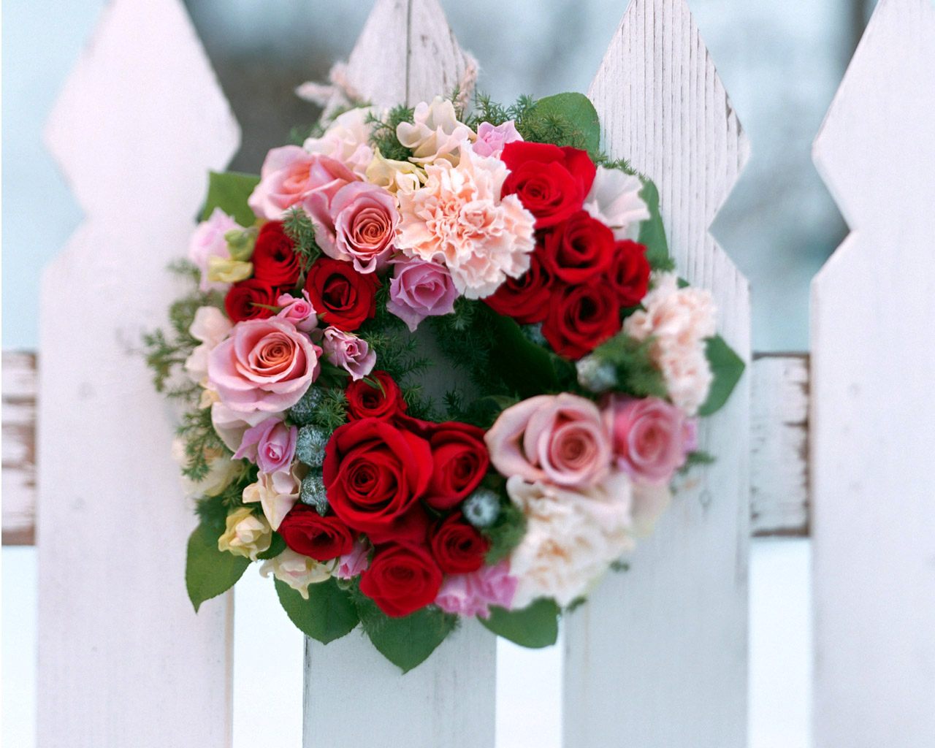
Good Morning

Slide 2
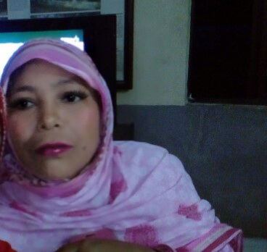
Prepared
by
Laila Nazmun naher
Birol Gov. Degree Callage
Professor (ICT) Dinajpur
Phone: 01728867898
Email:lailanazmunaoya@
gmail.com

Slide 3
Class Six
English 1st Paper
Date: 25/06/12

Slide 4
Read the Passage.

Slide 5
To Days Lesson is
Shahanara Begum’s Daily Routine

Slide 6
Talk it in turns to ask and answer questions about Shahanara’s daily routine like this:
A. What does Shahanara do first every day ?
B. She gets up early. What does she do then ?
A.Then she collects the drinking water from the village tubewell.
What does she do next ?

Slide 7
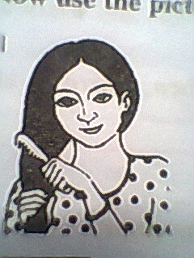
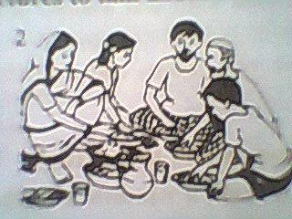
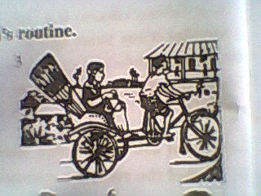
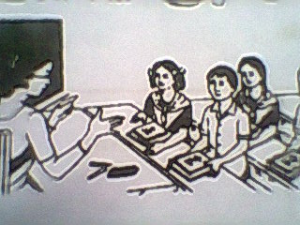
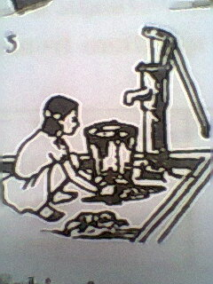
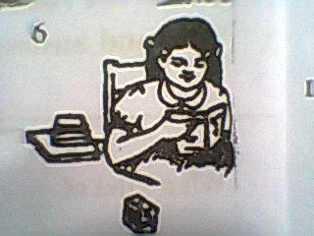
What do you see in this pictures ?

Slide 8
Now use the pictures to write about Sabina’s daily routine. Start like this:
Sabina gets up early everyday. Then---------------------------.

Slide 9
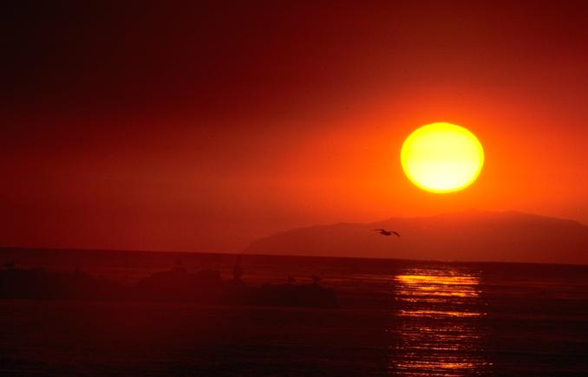
Thanks For All

