Slide 1
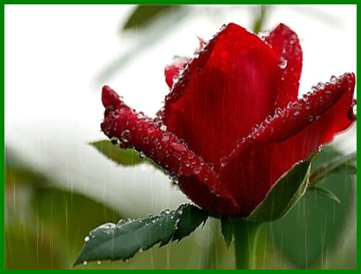
Welcome
to
English class 8

Slide 2
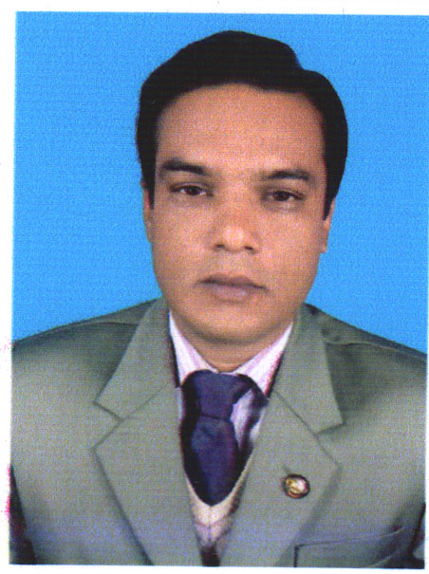
Md.Firoj Hossain
B.S.S(Horns),M.S.S(Economics)
B.Ed.(OU)
Assistant Teacher(Social Science)
Subrajpur High School
Subrajpur,Patnitola,Naogaon
E-m:firojpatnitola@gmail.com
Mobail No:01716-697972
Subject:English 1st paper
Class: Eight
Unit: Seven
Date: 01-06-’17
Time: 50 m.

Slide 3
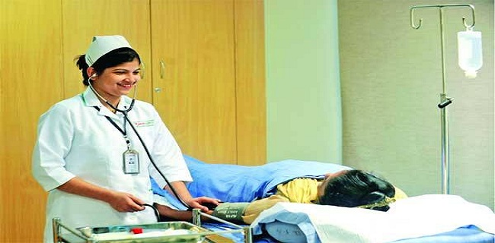
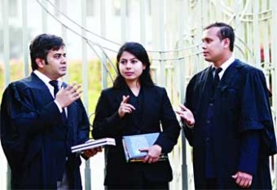
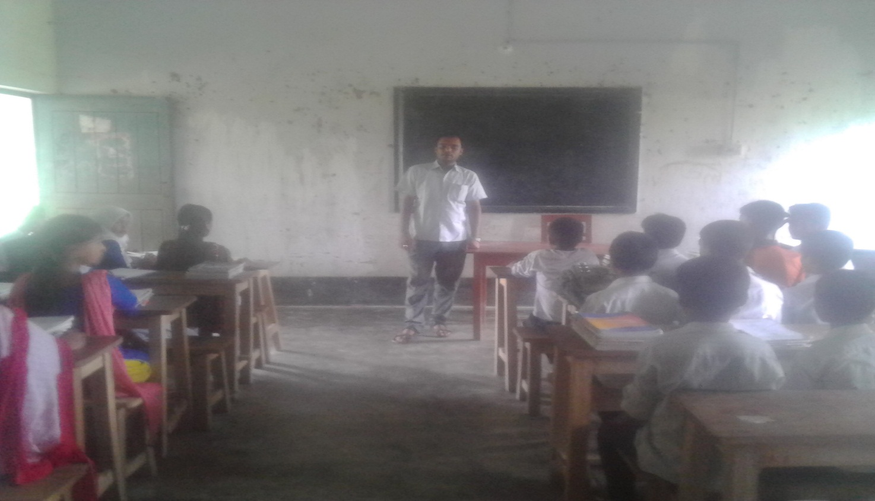
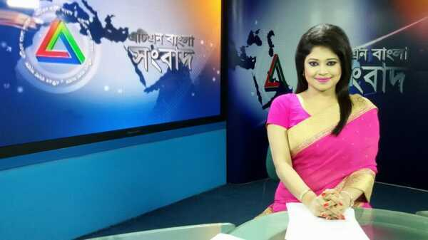
Look at the picture
Doctor
Lawyer
Teacher
News presenter

Slide 4
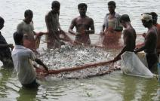
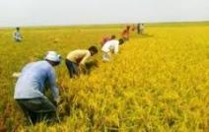
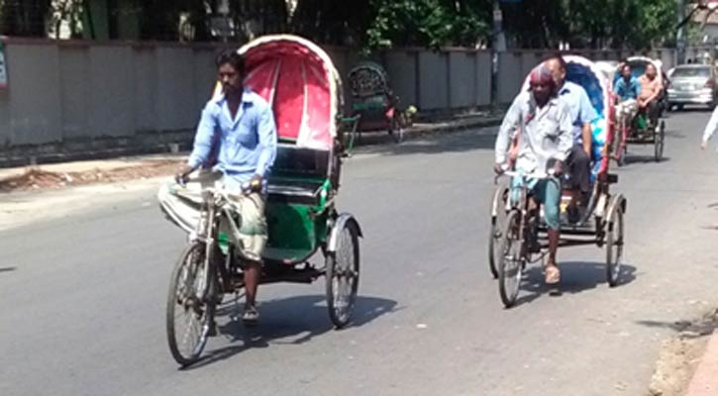
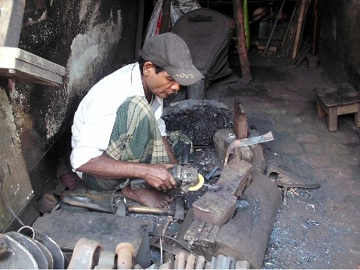
Fisher man
Farmer
Ricksha pollar
blacksmith

Slide 5
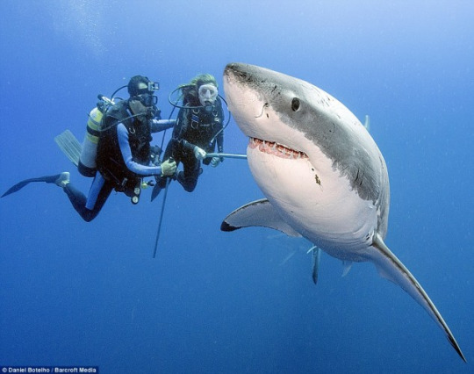
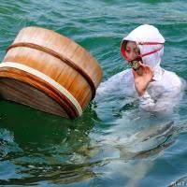
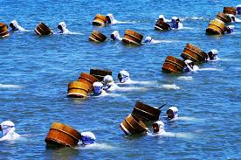
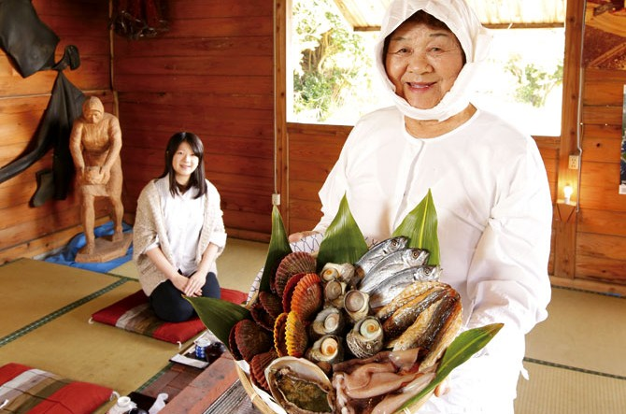

Slide 6
Let’s go a vedio and tell us

Slide 7
The Ama divers

Slide 8
After we have studied this unit,we will be able to---
Loud reading and silent reading the text
Write a new word meaning(vocabulary)
Write the Fill in the gaps
Ask and answer to questions
Summarise the text

Slide 9
Look at your book & silent reading

Slide 10
Word meaning coast- surface- equipment-
Beach
Float up
Tools

Slide 11
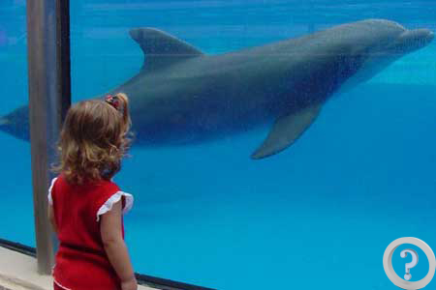
Obtain-
Acquire
Ama-
Sea women
Watch-
Search

Slide 12
Fill in the blank below In some fishing villages along the coast of Japan,there are amazing groups of women known as’ ‘.These women---------- and are still working an Ama.The word ’Ama’ means’ --------------.They are -------------------divers.They make their living and diving.They can dive to the depth of the sea up to----- metres.And they dive without using----------tanks or other-------- equipment.The Ama divers ------on their own -------- and breathing -------------.
worked
Ama
Sea women
independent
25
oxygen
breathing
rely
skills
techniques

Slide 13
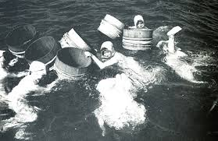
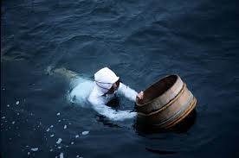
Ama divers

Slide 14
Individual work
Why are the ama divers amazing ?
What techniques and skills do the Ama divers use in diving ?

Slide 15
Ans.to the Ind.W.
The Ama divers are amazing because they dive without using oxygen tanks or other breathing equipment to the depth of
the sea up to 25 metres.
b)The Ama have careful watching,lung capacity and hunter instiners in diving.

Slide 16
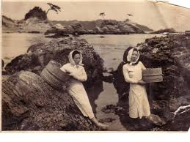
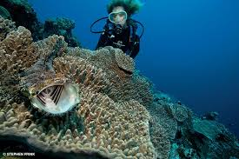
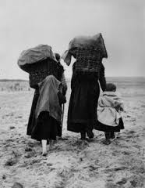
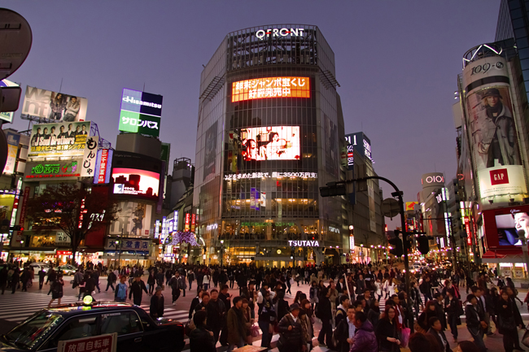

Slide 17
Pair Work
What is the text about ?
Where did the people get the pearls from ?
Why do you think the young villagers are going to the city ?

Slide 18
Answer of the p.w
The text is about pearls.
The people got the pearls from sea shore and from the bottom of ocean,lake or river.
I thank the young villagers are going to the city for other jobs.

Slide 19
Evalution
Choose the best answer from the alternative.
Before the 20th century, the pearls were of ------- quality.
a) bad b) various c) lower d) the same
2. Diving so deep was extremely ---------- to divers.
a) comfortable b) dangerous c) difficult d) easy
3. Ama divers live on the --------- of Japan.
a) beach b) bank c) sea d) plain land
4. Ama women make their living by -----------
a) working b) driving c) diving d) catching fish

Slide 20
Home Work
Write 12 sentences in your own words about“the Ama divers”.

Slide 21
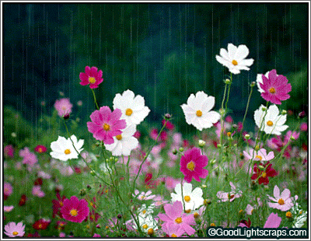
Thanks
everybody

