Slide 1
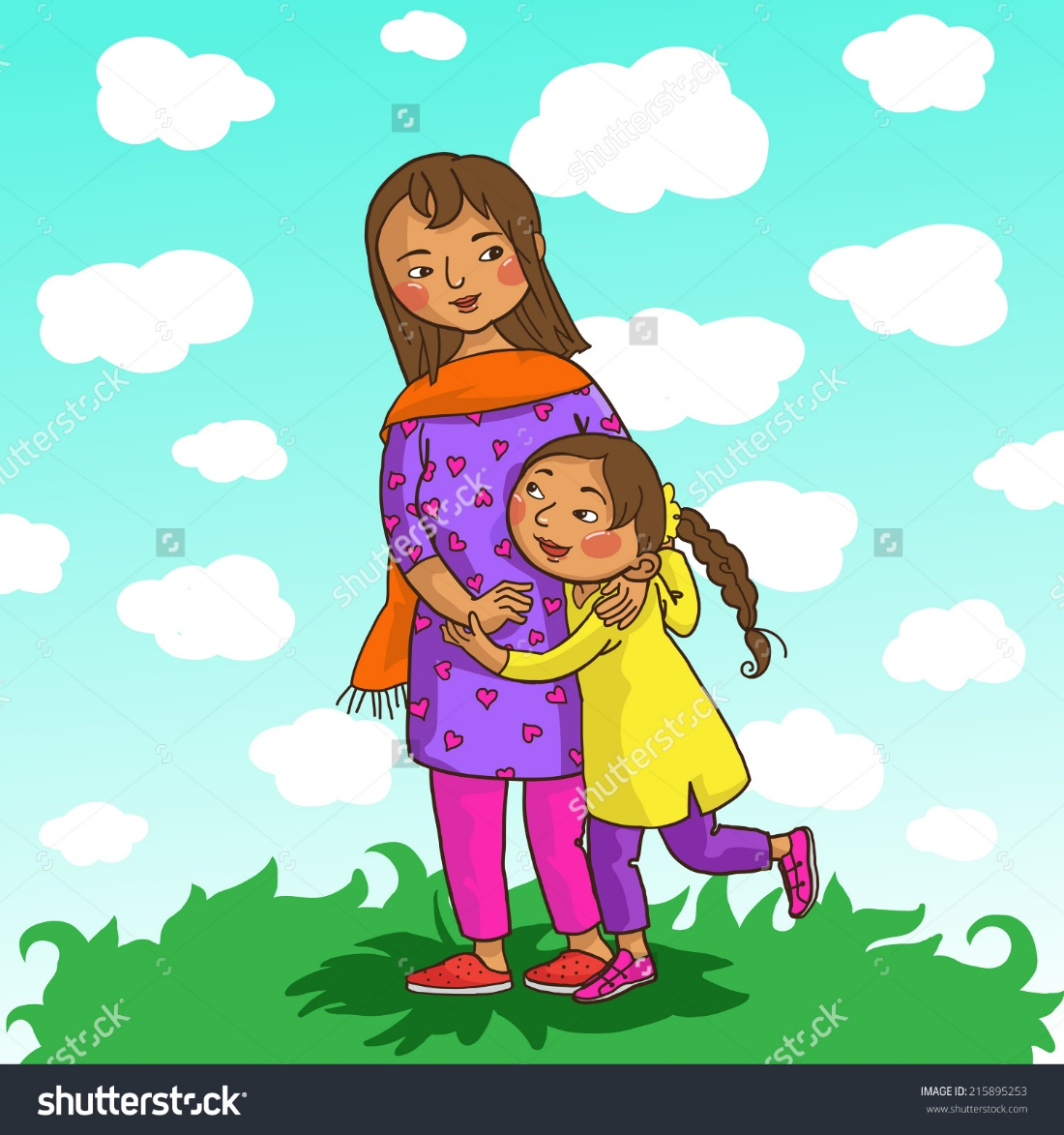

Slide 2
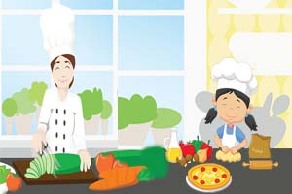
What are they doing?
What is their relation between them?

Slide 3
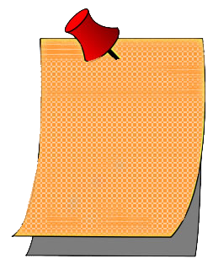
Introduction
Presented by:
Today’s Lesson:
Skills-
L,S
Mahfuz Ara Sultana
Assistant Teacher
Carmichael College Govt. Primary School. Sadar, Rangpur
Class- Four
Subject-English
Unit 20:
Food and meal 2.
Lesson 1-2
Page-40
Time: 45 minutes

Slide 4
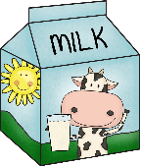
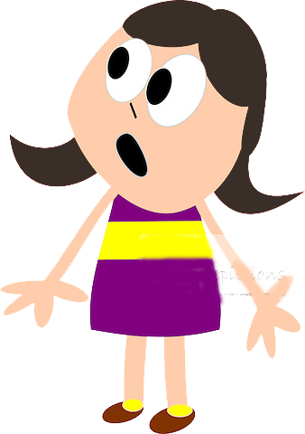
You can have some
Sorry, dear. We don’t have any
Mom, do you have any ?

Slide 5
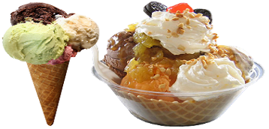
Well, we have some
How about ice-cream? Do you have any ?

Slide 6
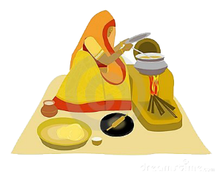
But I’m cooking dinner now. You can have some ice-cream after dinner.
OK, What’s for dinner?

Slide 7
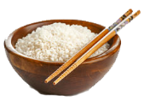
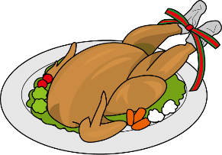
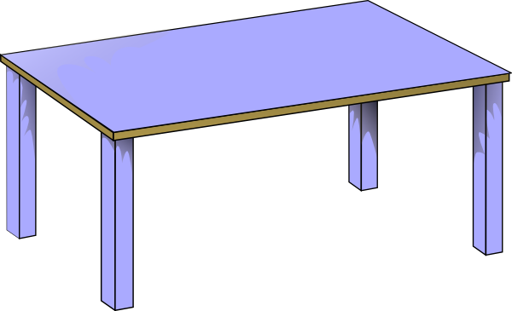
Chicken and rice.

Slide 8
Model reading
Input
Click here
Questions chart:
Is there milk in the fridge? Does Mita want juice? What can mum make for Mita?

Slide 9
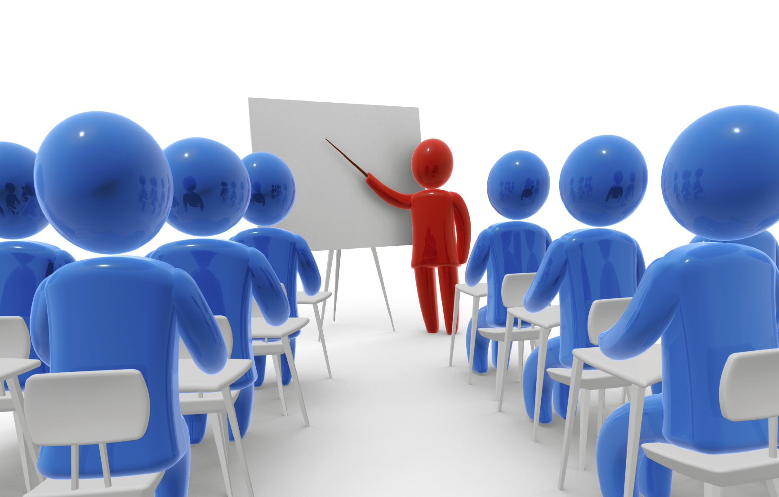
GW
Practice
Open your EFT book page no 40 and read the dialogues out
Mita Group
Mum Group

Slide 10
Language focus
Input

Slide 11
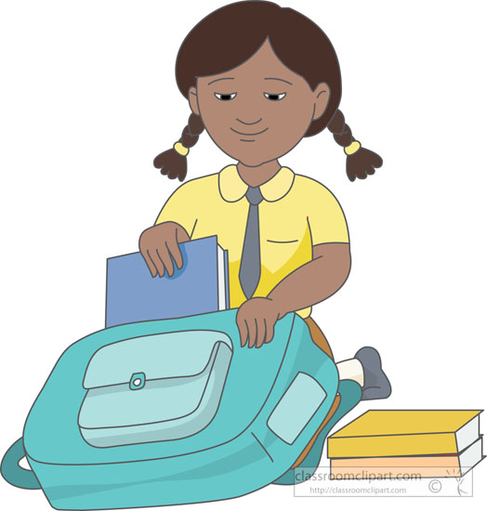
One student voluntarily come in front of the class
Practice
Do you have any water/ pen/ pencil/books…….. In your bag?

Slide 12
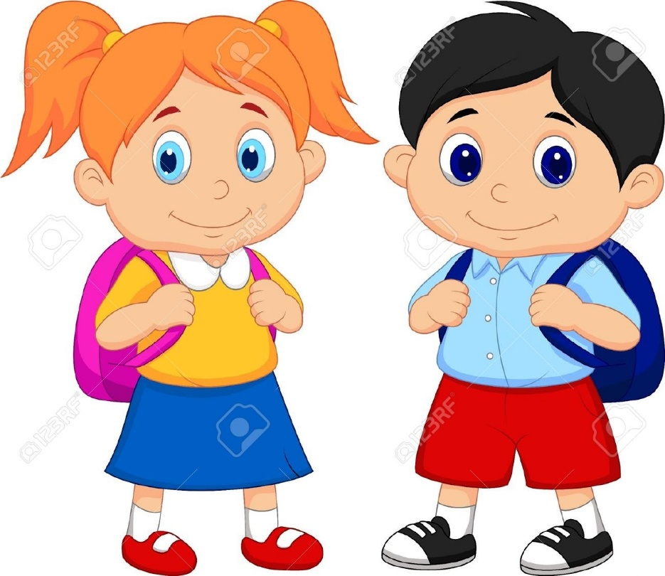
Pair work
Practice
Do you have any water/ pen/ pencil/books…….. In your bag?
Do you have any water/ pen/ pencil/books…….. In your bag?

Slide 13
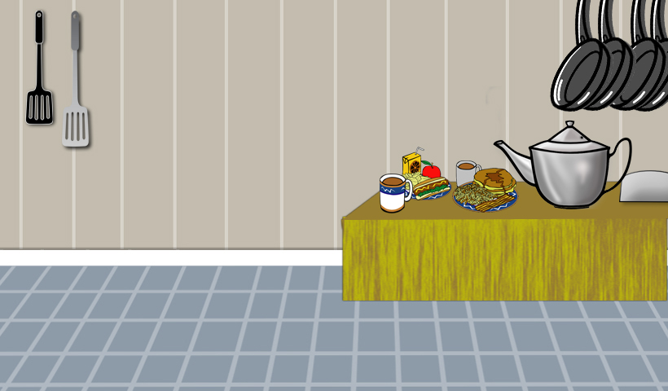
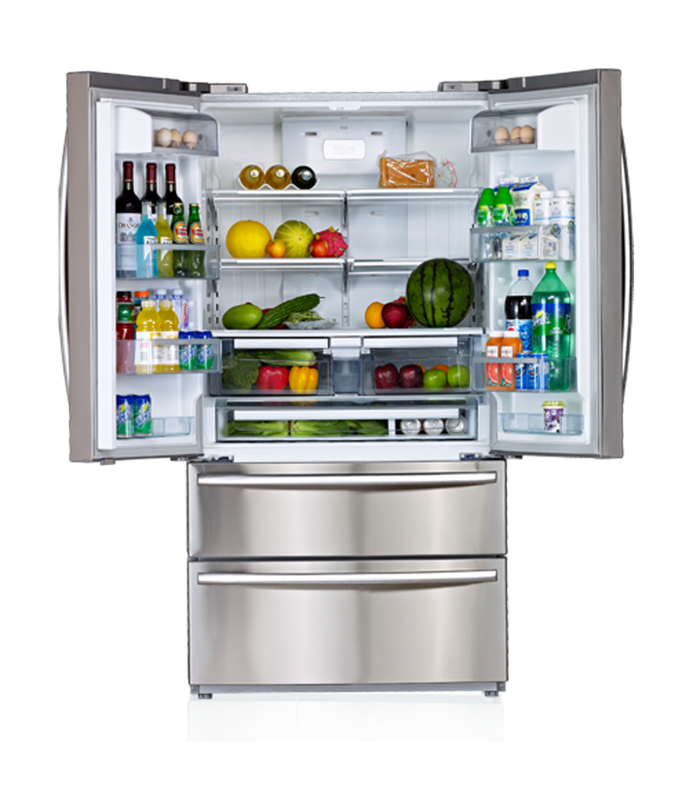
Task
Suppose, you need to go shopping. Now look in the fridge and ask your partner “ Are there any/ some……..?

