Slide 1
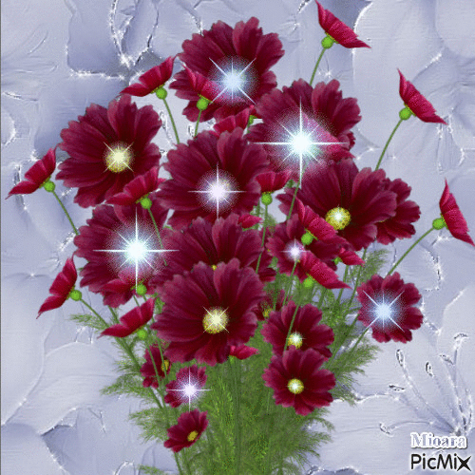
Welcome to my MMC

Slide 2
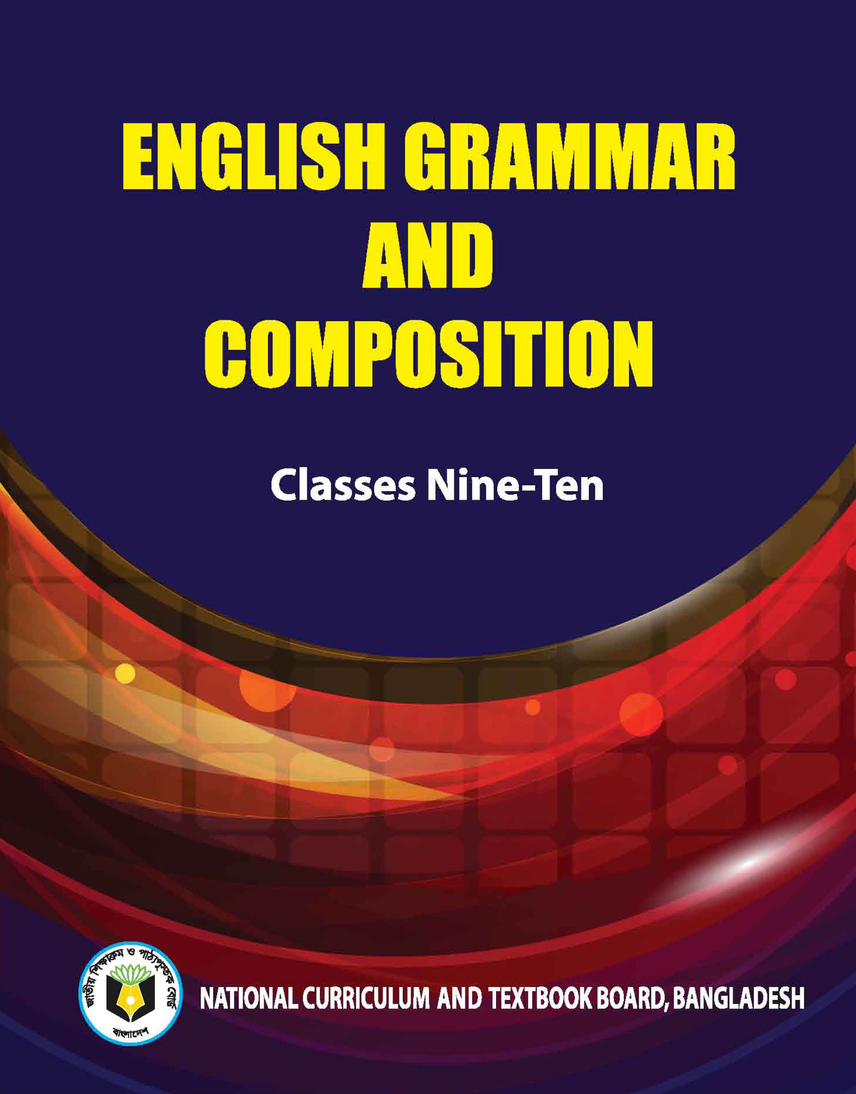
Identity
Teacher’s Identity
Lesson Introduction
Jahangir Alam
Assistant Headmaster
Dighulia Shahid Mizanur Rahman High School, Tangail.
E-mail: Jahangir.icttang@gmail.com
Cell : 01710500769.
Class : VII
Section : A
Sub : English Second Paper
Topic : Transformation of Sentence (Ass-Excl)

Slide 3
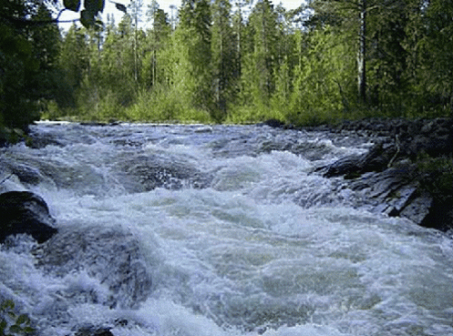
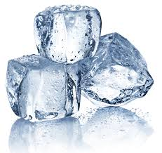
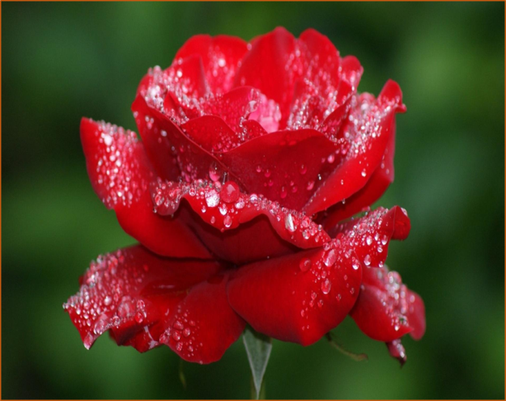
Turns into
Water
Ice
This is called ‘Transformation’.
The rose is very beautiful.
How beautiful the rose is!
This is ‘Transformation of Sentence’.
The rose

Slide 4
Transformation of Sentences
Today’s Lesson
Assertive to Exclamatory; Vice- versa

Slide 5
Learning outcomes:
By the end of the lesson students will be able to…
1. define Assertive and Exclamatory sentences.
2. give examples of the sentences.
3. change sentences from Assertive to Exclamatory and vice-versa.

Slide 6
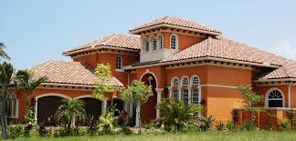
Assertive
It is a very nice house.
Exlamatory
What is the difference between the two sentences?
What a nice house it is!

Slide 7
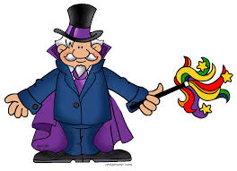
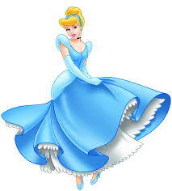
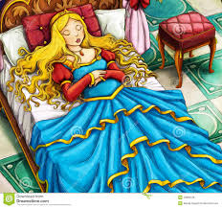
Abra ka debra
Sleeping princess
Gets up from sleep

Slide 8
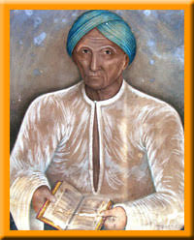
a very= What a/an
Very= How
At the end of the sentence use (!)
Haji Md. Mohsin was
a very kind man
.
Golden Stick
Silver Stick
a very kind man Haji Md. Mohsin was
A very
What a kind man Mr. Mohsin was !
Use of article
Haji Md. Mohsin

Slide 9
More examples:
Assertive : The cuckoo sings very sweetly.
Exclamatory : How sweetly the cuckoo sings!
Assertive : The fox is a very cunning animal.
Exclamatory: What a cunning animal the fox is!
Exception:
Assertive : Mafij is a great fool.
Exclamatory : What a fool Mafij is!

Slide 10
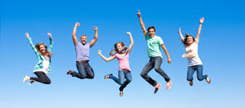
Hurrah!
More rules:
Assertive: It is a matter of joy that we have won the game.
Exclamatory: Hurrah! We have won the game.
It is a matter of joy that
Hurrah!
Assertive: It is a matter of sorrow that his father is no more.
Exclamatory: Alas! His father is no more.
It is a matter of sorrow that
Alas!

Slide 11
Group Work
Write five Assertive sentences same as above.
Now
Make them Exclamatory sentences in groups.

Slide 12
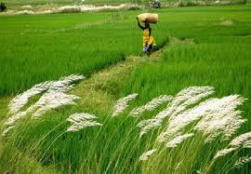
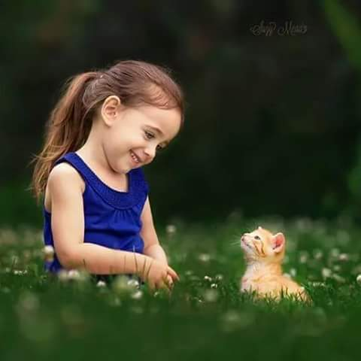
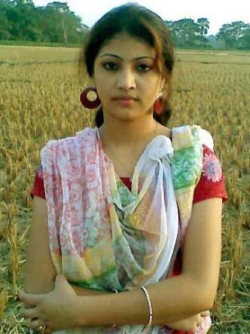
Evaluation
Transform the sentences into exclamatory:
Shefali is a very beautiful girl.
The scenery is very charming.
The baby looks very cute.

Slide 13
Homework
Write five Exclamatory sentences using What &How.
Then,
Transform them into Assertive.

Slide 14
Thank you all.

