Slide 1


Slide 2
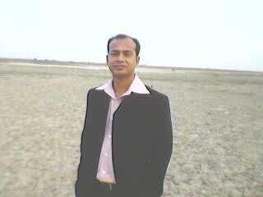
Teacher’s Introduction
MD. SAHMSUDDAWHA
Assistant Teacher(English)
Gangore High School
Niamatpur, Naogaon
Mobile no. 01717-516353
E-mail: shamshzoha@gmail.com

Slide 3
Lesson Introduction
English First Paper
Class: Eight
Unit: Six
Lesson: One
Time: 50 min.
Date: 30.05.16

Slide 4
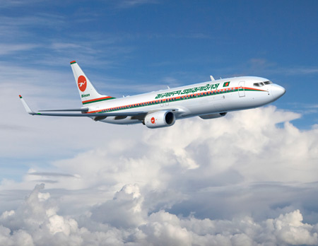
A plane
What do you see in the picture?

Slide 5
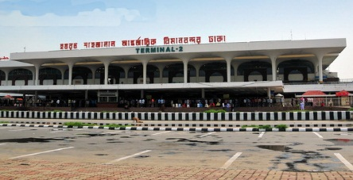
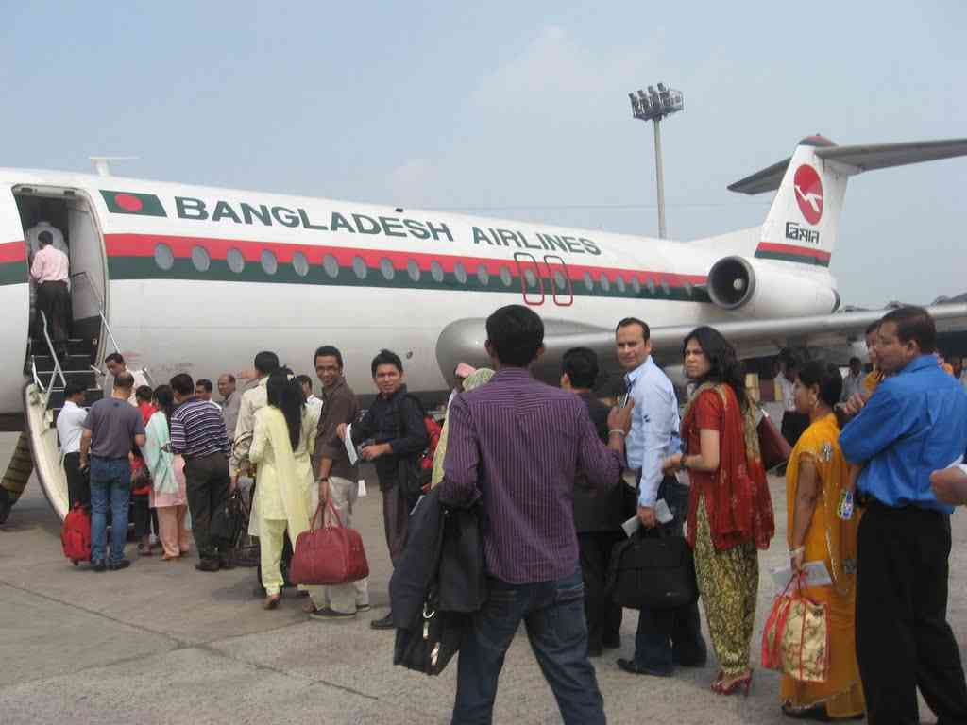
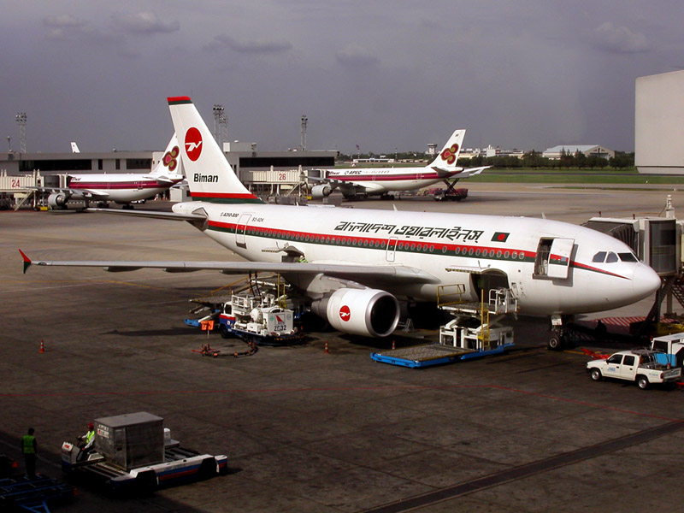
Airport
What is the name of the place?

Slide 6
Today’s Topic
So, Today’s Lesson is…..
At The Airport

Slide 7
Objectives of The Lesson
At the end of the lesson students will be able…..….
to talk about the pictures.
to read and understand the text.
to write answer to the questions.
to write a short paragraph on it.

Slide 8
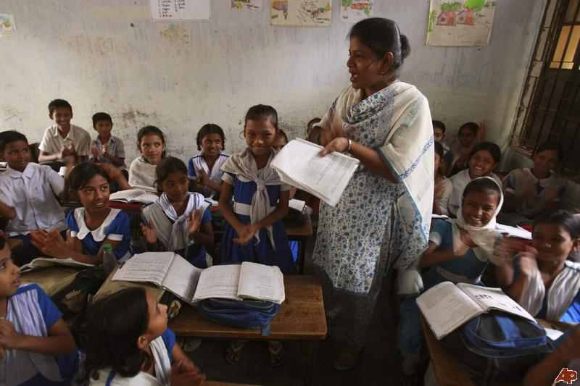
Teacher’s Reading
Teacher will read the text from the book frequently
and student will listen.

Slide 9
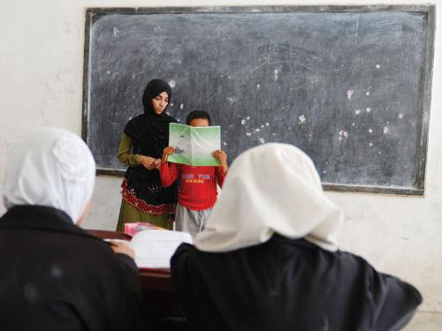
Student’s Reading
Student will read the selected text and teacher will listen and also make correction their mistake.

Slide 10
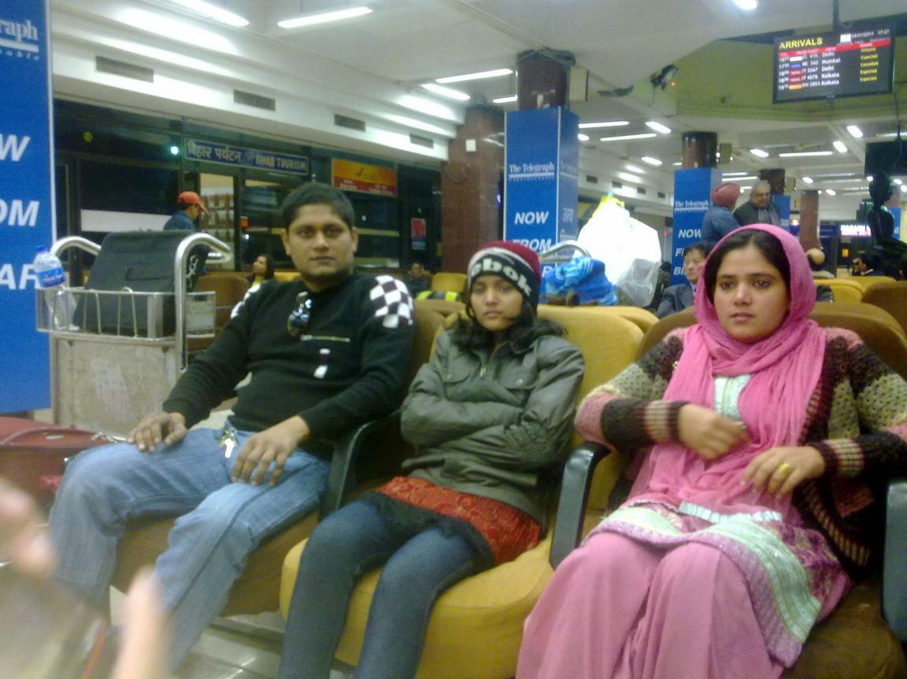
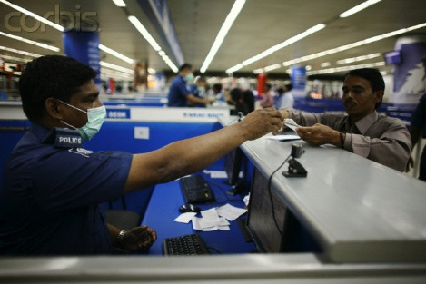
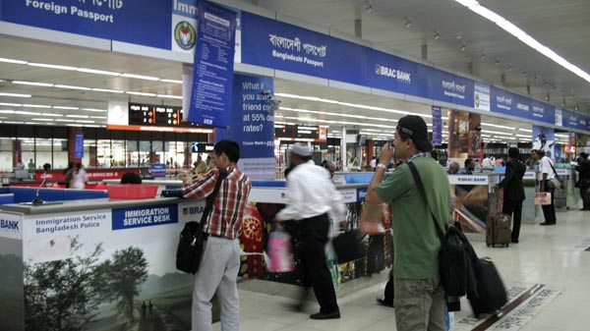
Lounge
Immigration
Boarding
At the airport
What do you see in the picture?
Can you guess where the place is?

Slide 11
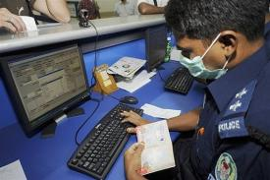
Mita and Zara with her parents
at the airport.
Immigration officer is checking passport.

Slide 12
Individual Question: (2min.)
What does immigration officer do at the airport?
Ans. Immigration officer checks passport and stamps it.

Slide 13
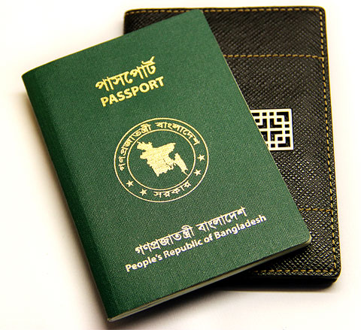
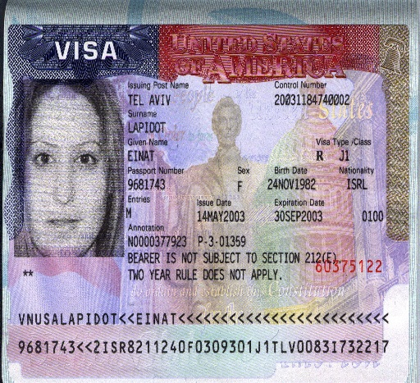
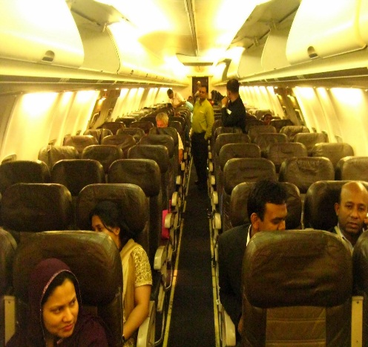
Pair work: (5min.)
Identify the following pictures:
A
B
C
D
Passport
Visa
Boarding to plane
Having seat

Slide 14
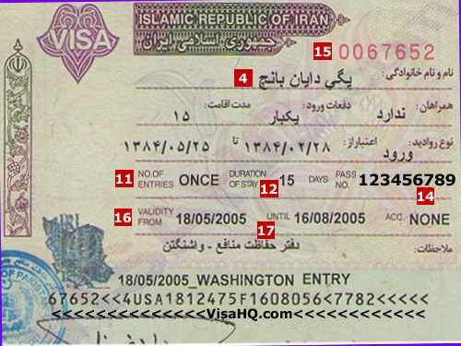
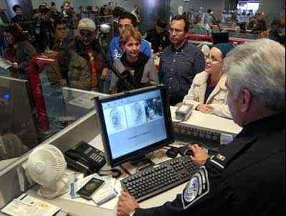

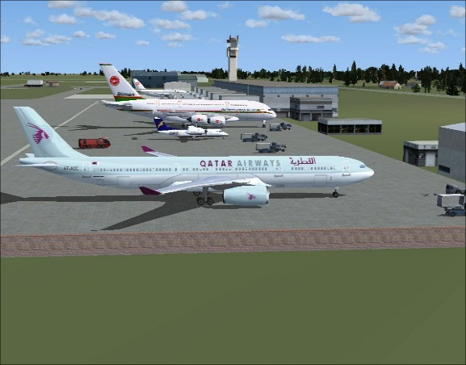
Preparation for travelling:

Slide 15
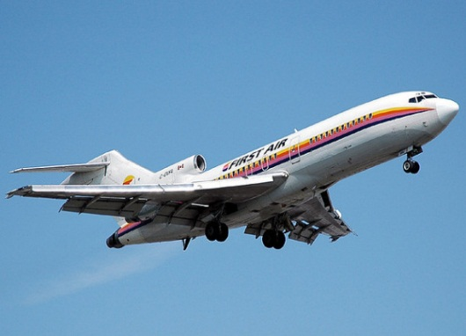
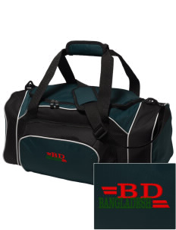
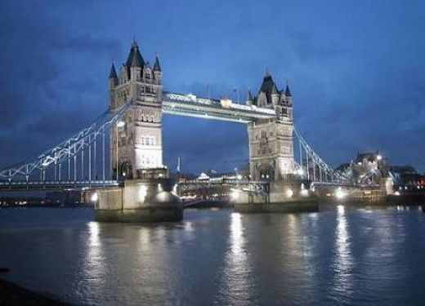
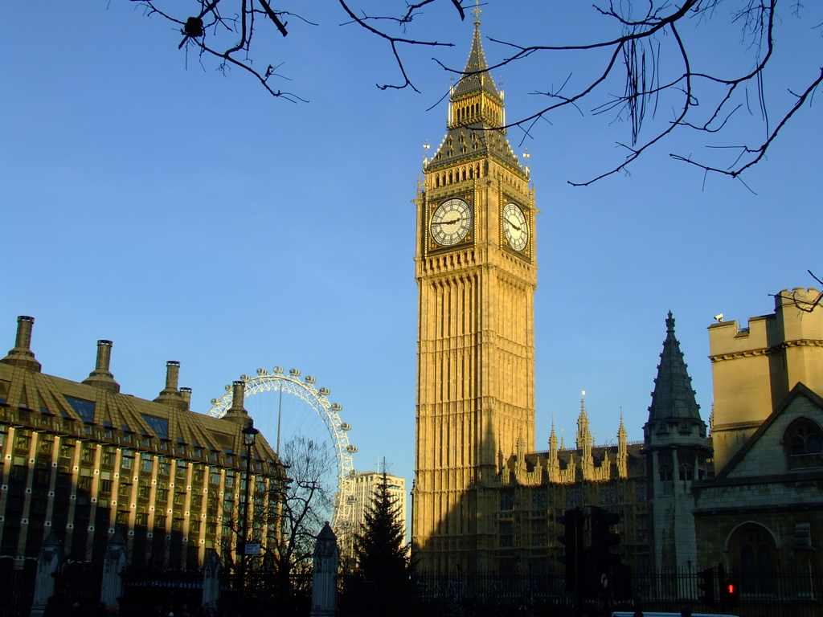
Group work: (10min.)
Think you are going to London -
Now, write a paragraph about your preparation before travelling.

Slide 16
Evaluation
Who is excited?
(a) Zara (b) Mina (c) Mita (d) Karim
√
2. You need visa to go to___.
(a) Dhaka (b) Sylhet (c) Khulna (d) London
√
3. The immigration officer will check___.
(a) Visa (b) Luggage (c) Forms (d) Hand bag
√

Slide 17
Home work
Write a short composition on about a journey by Train.

Slide 18


