Slide 1
Good morning

Slide 2
Mental Preparation

Slide 3
Which season do you like most?
How is the weather today?
Do you like your School?
Ackowledge

Slide 4
Class : Five
Subject : English
Unit : 20
Lesson : 1-2

Slide 5
Students will be able to :
1.5.1 read words, phrases and sentences in the text
with proper pronunciation, stress and intonation.
3.3.1understand questions about objects around them.
3.4.1 understand statements made by the teacher and
Students.
5.1.1 read silently with understanding paragraph.
3.1.2 write, words, phrases and sentences using
non-cursive small letters..

Slide 6
Look at the following picture and discuss with your partner what you can see.

Slide 7
Today we are going to read –
Life is beautiful.

Slide 8
New words- Spring,Warm,Fill,Smell,Dressed,Ready
Spring----name of a season.
Warm----hot.
Fill--------load/put into.
Smell-----flavor.
Dressed---put on.
Ready------prepared.

Slide 9
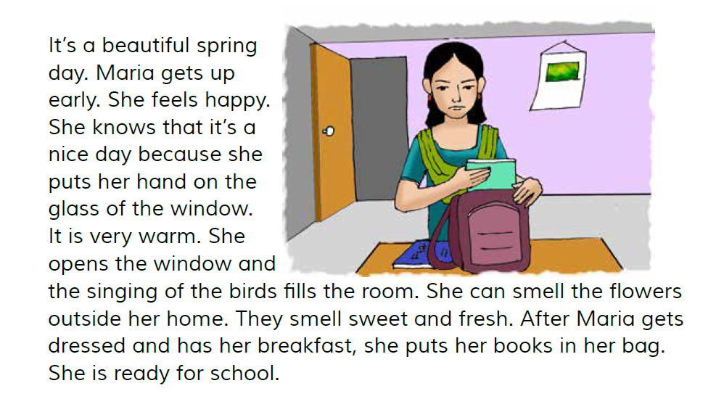
Listen to me carefully and read after me

Slide 10
Open your book at page 78
Find out the new words

Slide 11
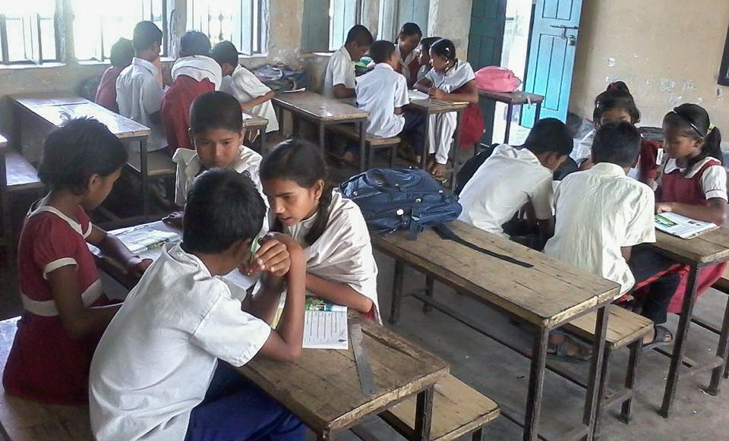
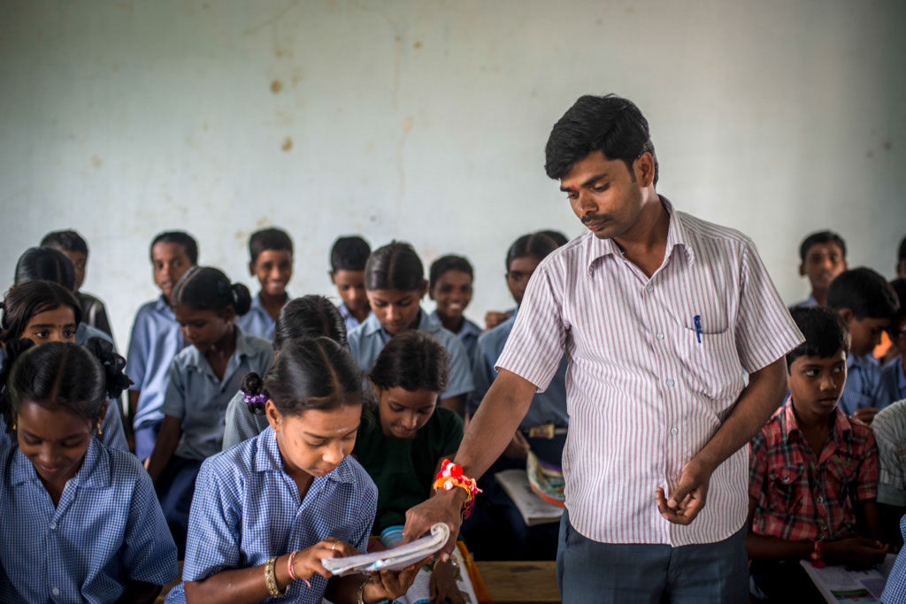
Group Reading
Pair Reading
Indivitual Reading

Slide 12
Read the text silently

Slide 13
Match column A with column B
column A | column B
Beautiful | 1.First meal of the day
Early | 2.Nice
3. Breakfast | 3.Good scent
Smell | 4.An open space in a room
5. Window | 5.Quick
Write the following questions.
1.What is the season?
2.When does Maria get up?
3.How does she know that it’s a nice day?
4.When does she have her breakfast?
5.Why is she ready?

