Slide 3
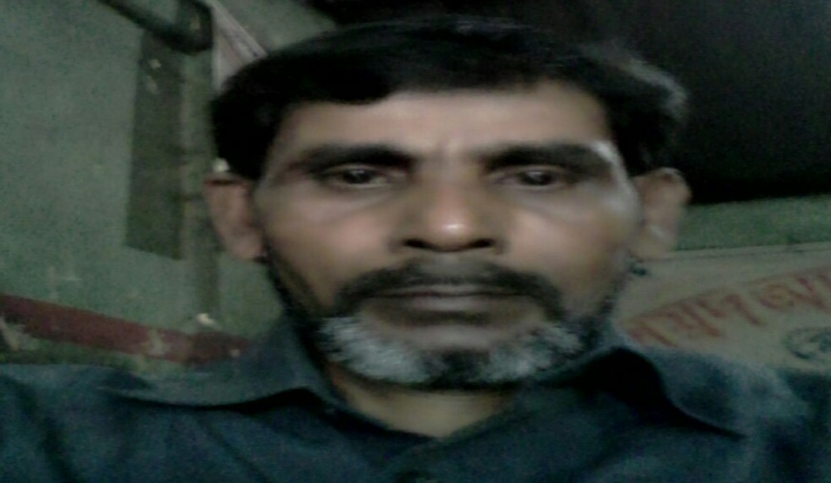
Md Abul Kashem
Assistant teacher
Lakeshor dakhil madrasa
Chatak Sunamgonj
Mobile 01786498922

Slide 4
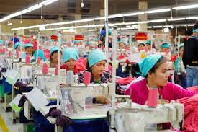
A garment worker’s day
Lesson-1/2
Unit-40
Class-Four
Time:50 Minute
Date:10/12/2019

Slide 5
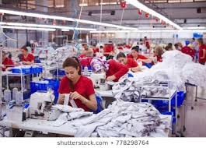
Look at the picture and say
Garment workers

Slide 6
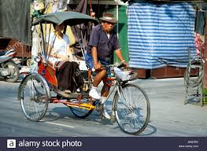
See and say
Ricksha driver

Slide 7
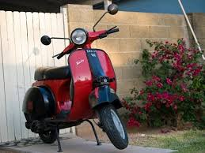
Look at the picture
Scooter

Slide 8
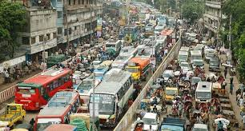
What did you see in the picture ?
Dhaka city

Slide 9
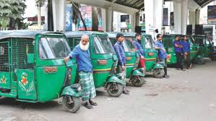
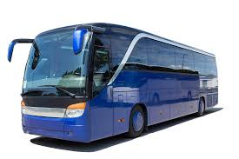
Look at the picture and say the name
Rickshaw
CNG
Bus

Slide 10
Bus
বাস
Garment worker
গার্মেন্ট কর্মী
Rikshaw
রিক্সা
Scooter
স্কুটার

Slide 11
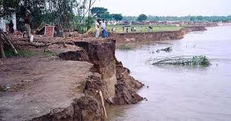
Read loudly
Reshma’s family came to Dhaka from a village eight years ago. There was river erosion in her village. They lost their home.So the family came to Dhaka.

Slide 12
CNG
Bus
Garment
Rickshaw

Slide 13
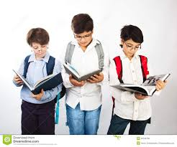
Group work
1.Where did Reshma work ?
2.How does Reshma go to work ?
3.Where is the factory ?

Slide 14
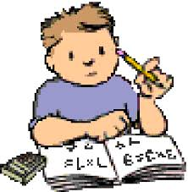
Evaluation
1.What does Reshma do ?
2.Who is Babul ?
3. How does Reshma go to work ?

Slide 15
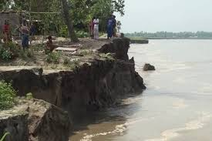
Home work
Which was the river in her village ?

