Slide 1
Welcome

Slide 2
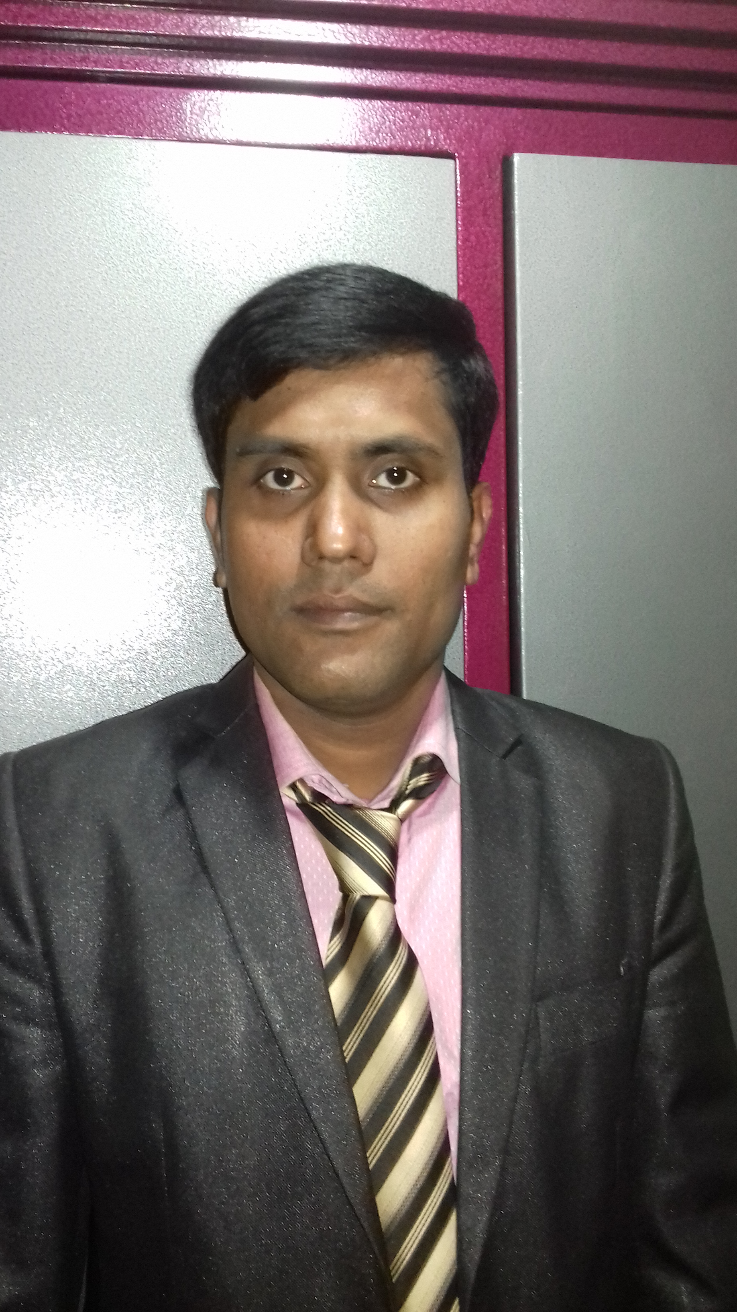
Sajal Kanti Paul
Assistant Teacher
Olipur Govt. Primary School
Hajigonj, Chandpur

Slide 3
Lesson Introducing
Class: Four
Subject: English
Unit: 35
Lesson’s Name: My trip

Slide 4
Warm up Activities

Slide 5
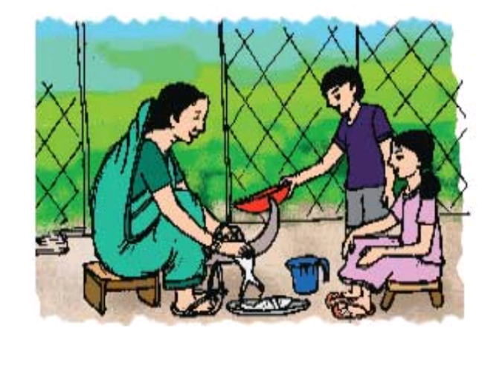
Lesson’s Declaration
Look at the picture and say what is the picture about?
My trip

Slide 6
Finding new words meaning
Trip-ভ্রমণ
History-ইতিহাস
Fish- মাছ
White- সাদা

Slide 7
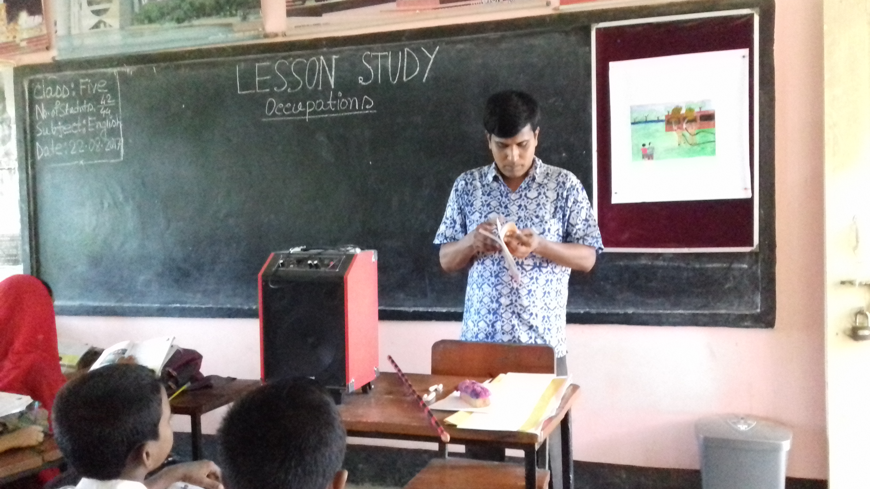
Teacher’s Reading

Slide 8
Student’s Reading

Slide 9
1. Match the words in column A with their meaning in column B.
Fisherman | Enjoyment
b. So much | 2 events of the past time.
c. Fun | 3. A thin, white fish.
d. History | 4. A man who catches fish.
e. Chapila | 5. A lot of
 | 6. Tiny
 | 7. small

Slide 10
Ans. To the Q. No. 1
Fisherman-4. who man catches fish.
b. So much-5. a lot of.
c. Fun-1. enjoyment.
d.History-2. events of the past time.
e.Chapila- 3. a thin white fish.

Slide 11
1.Fill in the blanks with the best words from the box.
Favourite, opposite, uncle, delicious, fish, relatives, cousins
Alvi’s____ is a fisherman.
b. He caught a lot of ______ .
c. Alvi”s ____ fish is Chapila.
d. It is very ______ .
e. Alvi talked with her _______ .

Slide 12
Ans. To the Q. No. 1
Alvi’s uncle is a fisherman.
b. He caught a lot of fish.
c. Alvi’s favourite fish is Chapila.
d. It is very delicious .
e. Alvi talked with her relatives.

Slide 13
2. Write ‘ True’ for the correct information and “ False” for the incorrect information.
Alvi’s family is from Chilmari in Kurigram.
b. Alvi’s uncle is a farmer.
c. His grandmother told stories about their family and the history of Bangladesh.
d. Alvi’s favourite fish is catfish.
e. It was a very special trip.
f. Alvi talked to his grandfather.

Slide 14
Ans. To the Q No. - 2
True
b. False
c. True
d. False
e. True
F. False

Slide 15
3. Answer the following questions in sentence.
Where does Alvi live?
b. Where did Alvi go ?
c. Who did he see there?
d. Who did he go with?
e. What did he do there?
f. What was special about this trip?

Slide 16
Answer to the Q No. 3
Alvi lives in Dhaka.
b. Alvi went to visit his grandmother in Chilmari.
c. He saw his grandmother, uncle and cousins there.
d. He went with his sister.
e. He had so much fun there.
f. It was a special trip because they talked with their relatives and learned about their family and their country.

Slide 17
Creativity work
4. Write a short composition about “Your trip”.

Slide 18
Good-bye

