Slide 1
Welcome
To Multimedia
class

Slide 2
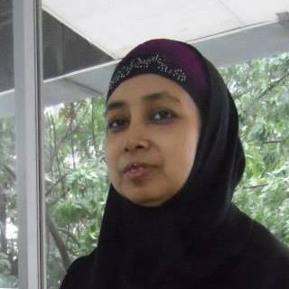
Introduction
Name : Amina Afroze
Title : Assistant teacher
Institution : Foundation School
Block- F, Lalmatia
Muhammadpur Thana
Class : Nine
Subject : Biology
Time : 35 minutes

Slide 3
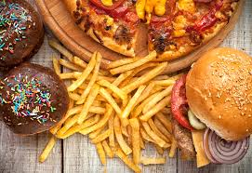
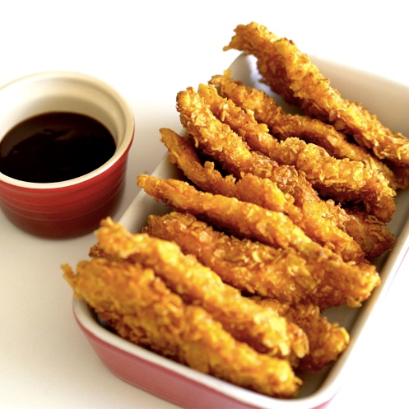
Observe the following pictures. Do you know what are these? Do you know how these will be digested in our body?

Slide 4
Today’s topic
Digestive system
1.Alimentary canal 2. Digestive gland

Slide 5
What will the students will learn from this chapter?
1. They will be able to know the organs of the digestive system
of human being.
2. They will be able to draw a labeled diagram of digestive system.
3. They will be able to know the parts of teeth and the names of the
parts.
4. They will know about digestion of food in human body.
5. They will know about digestive glands and enzymes.

Slide 6
1. Alimentary system or Alimentary canal
Mouth
Buccal cavity
Tooth: a) Incisor b) Canine c) Premolar d) Molar
Pharynx
Oesophagus
Stomach
Intestine: a) small intestine b) large intestine

Slide 7
2.Digestive glands
Salivary glands
Liver
Pancreatic glands
Gastric glands
Intestinal glands

Slide 8
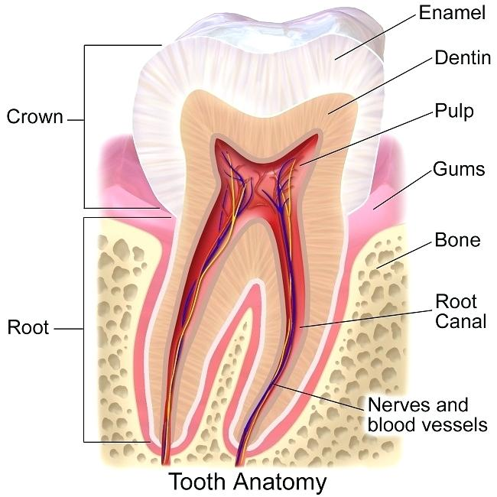
Teeth are needed to break down food
Teeth

Slide 9
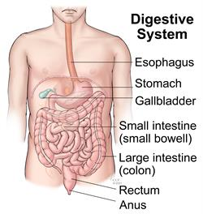
Digestive system

Slide 10
Digestion in mouth

Slide 11
Digestion in stomach

Slide 12
Digestion in duodenum

Slide 13
Digestion in small intestine

Slide 14
Digestion in large intestine

Slide 15
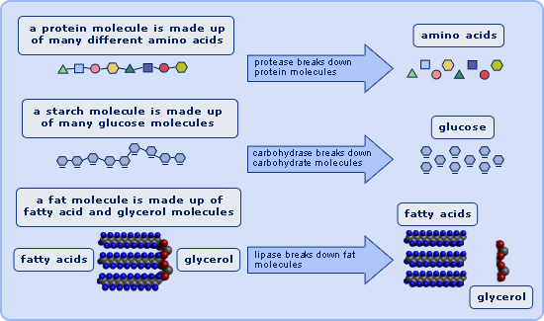
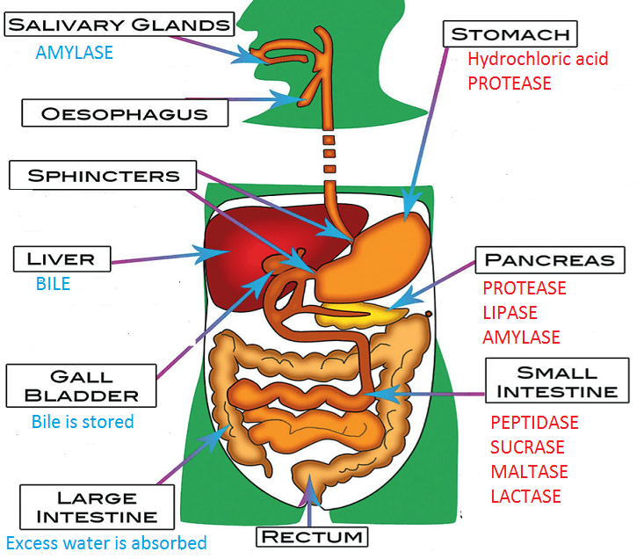
Enzymes needed for digestion

Slide 16
Digestion in Human body
Video

Slide 17
Pair work
1. Discuss digestion in stomach.
2. Discuss the glands.
3. Discuss digestion in intestine.
4. Discuss about the teeth.

Slide 18
Evaluation
What do you mean by digestive system?

Slide 19
Home work
Draw the organs of the digestive system and label them.
Describe digestion in stomach.

Slide 20
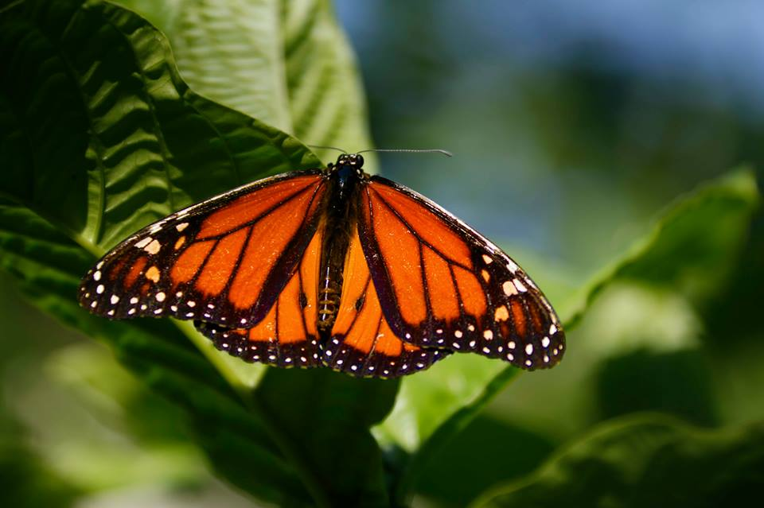
Thanks to all

