Slide 1
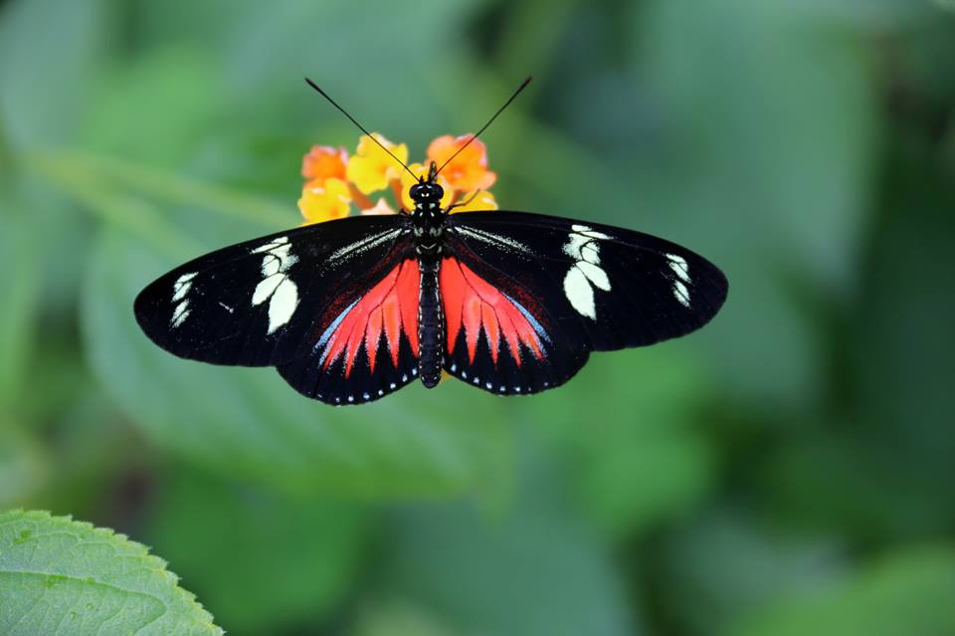
WELCOME

Slide 2
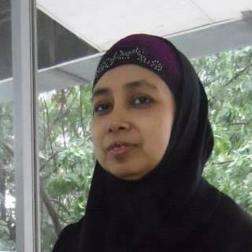
Introduction
Name : Amina Afroze
Title : Assistant teacher
Institution : Foundation School
6/6 Block-F, Lalmatia
Muhammadpur Thana
Class : Nine
Subject : Biology
Time : 40 minutes

Slide 3
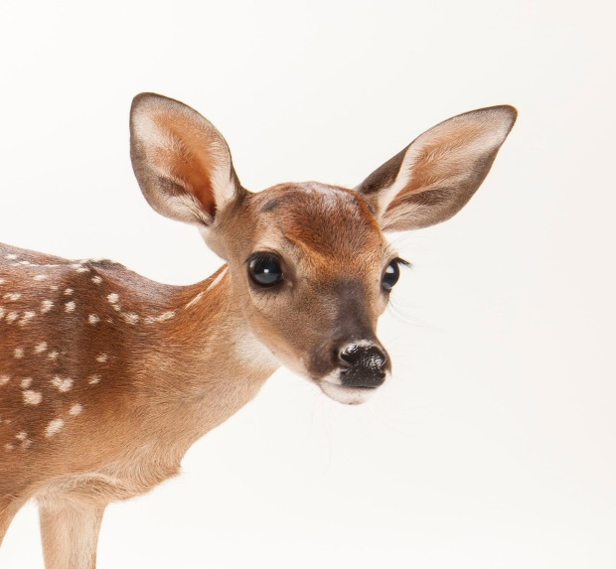
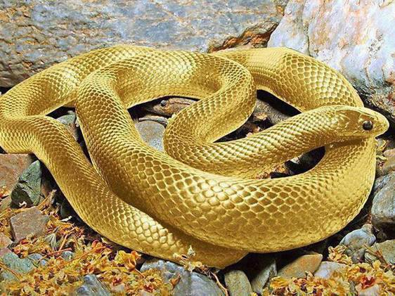
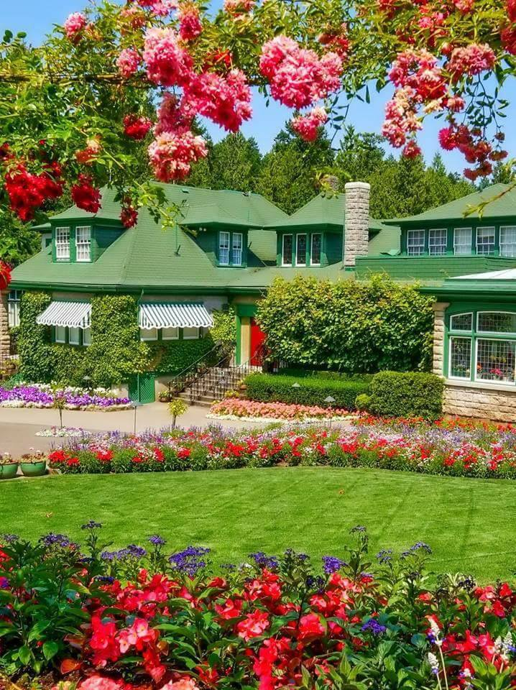
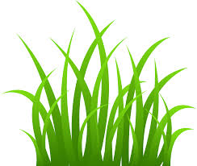
Observe the following pictures
Can you guess anything?

Slide 4
Today’s topic
Classification of Living beings

Slide 5
What will the students will learn
from this chapter?
They will be able to know about the names of the animals and plants around us.
2. They will be able to know about the characteristics about
the animals and plants around us.
3. They will be able to know the classification of the living
things in the world.

Slide 6
Whole living world Margulis
1. Super kingdom-1: Prokaryota 2. Super kingdom-2: Eukaryota
a) kingdom-1:Monera a) kingdom-2: Protista
b) kingdom-3: Fungi
c) kingdom-4: Plantea
d) kingdom-5: Animalia

Slide 7
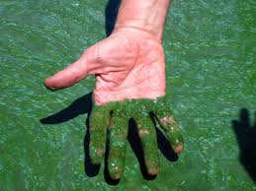
kingdom-1:Monera
Blue green Algae
Bacteria cell

Slide 8
kingdom-2: Protista
Amoeba
Diatom

Slide 9
kingdom-3: Fungi
Penicillium
Mashroom

Slide 10
kingdom-4: Plantea
Jackfruit Tree

Slide 11
kingdom-5: Animalia
Tiger
Albert Einstein

Slide 12
Group work
Discuss about the characteristics of the
living things of the world.

Slide 13
Home work
1.Learn the characteristics of the organism of the groups.
2. Write the characteristics of the kingdom -3.

Slide 14
Thanks to all

