Slide 1
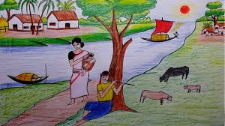
Welcome

Slide 2
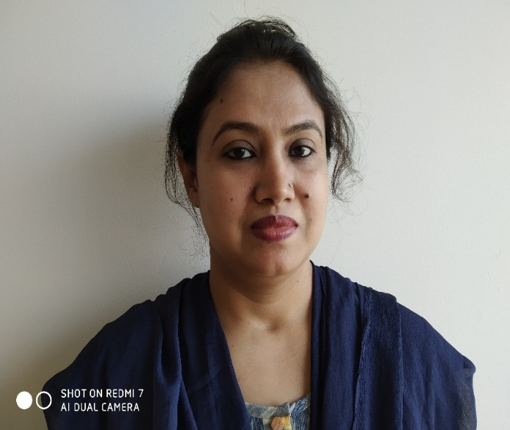
Class: Eight
Subject: BGS
Date:
Nazmun Nahar
Assistant Teacher(English)
B.A.(Hons.) M.A(English ) B.Ed. M. Ed.
Foundation School
Lalmatia, Dhaka

Slide 3
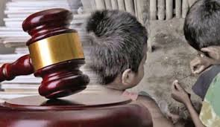
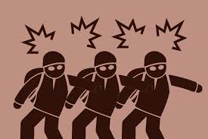
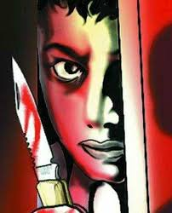
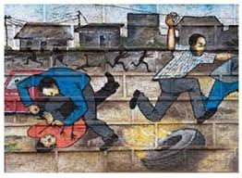
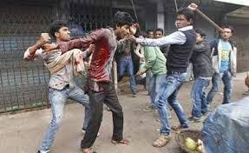
Observe the following pictures carefully:

Slide 4
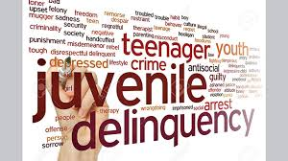
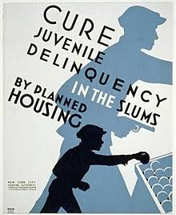
Chapter -10 Social Problems of Bangladesh
Juvenile Delinquency
Causes of Juvenile offence
Preventive Measures

Slide 5
After finishing this chapter students will be :
able to explain juvenile delinquency,
able to identify the causes and effects
able to find out the ways of preventing juvenile delinquency
aware of the impacts of juvenile delinquency

Slide 6
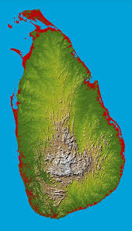
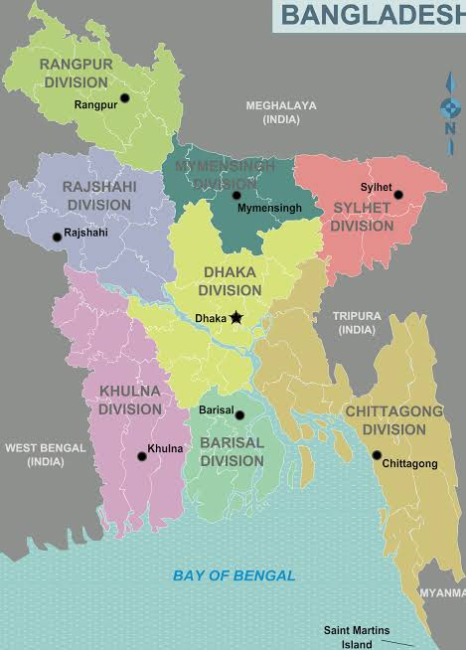
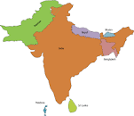
What is Juvenile offence?
Different offences committed either by immature boys and girls or the juvenile are called juvenile delinquency.
In Bangladesh, India and Srilanka boys and girls of age 7 to 16 years are called juvenile offenders.

Slide 7
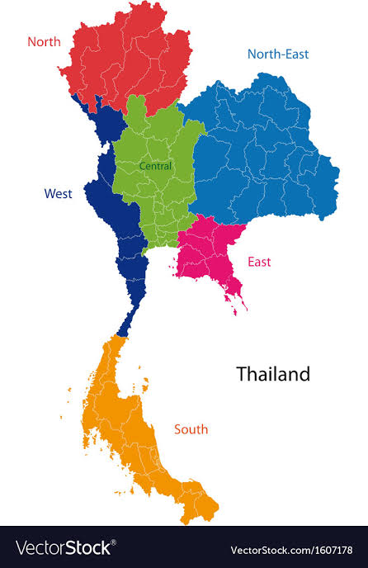
In Pakistan and Thailand boys and girls of age 7 to 18 years are called Juvenile offenders.

Slide 8
Some causes of Juvenile offence:
Poverty is the main cause
Frustration
Bad company
Family disturbance
Influence of bad culture
Unemployment
Loneliness

Slide 9
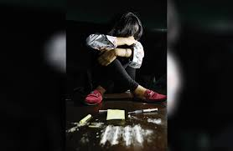
Some other reasons of Juvenile offences:
Betrayal in love
Death of dear ones
Instigation of friends
Deprived of parental affection
Excessive use of internet

Slide 10
Preventive Measures:
Responsibility of guardians
Socio-economic programme
Education Opportunity
Remain conscious
Create healthy atmosphere
Mental flourishment
Movement should be watched over
Easy and normal relationship should be built with offspring
Employment opportunity
Government & Non government organizations' activities
All children should be brought under the primary and secondary education.
Lead healthy and sound life.
Keep away from committing any offence

Slide 11
Group Work: Find out more causes of Juvenile offence

Slide 12
Evaluation: Asking short questions
What is the age of juvenile offenders in Bangladesh, Japan and India?
2. What is the main cause of juvenile offence?
3. Say one step or measure to prevent juvenile offence.

Slide 13
H.W. Read the chapter properly and find out more causes and preventive measures of juvenile offences.

Slide 14
Thanks to all.

