Slide 1
স্বাগতম
শুভেচ্ছা

Slide 2
Presented by
Lesson Introduction
Sub:English 2nd part
Assertive to interrogative
Class: Eight
Unit: 5
Time: 50 min.
Date: 20/12/2019
Md. Alamgir Hossain
Assistant Teacher(ICT)
Rahimapur Fazil Madrasha,
Patnitala, Naogaon.
e-mail-alamgirchz@gmail.com
Mobail No - 01723626108

Slide 3
Lookat the picture

Slide 4
Lookat the picture

Slide 5
OBJECTIVES
By the end of this lesson students will be able to:
describe the structure of assertive, affirmative and interrogative sentence.
write the structure affirmative sentence .
use the structure of interrogative.
identify the difference of affirmative and interrogative.
make sentences of assertive to interrogative sentence.

Slide 6
Rule 1:
Assertive to interrogative
শর্ত - Assertive বাক্যটি affirmative (হাঁ বধোক) হলে interrogative করার সময় interrogative+ Negative (প্রশ্নবধোক+না বধোক) করতে হয় – গঠন - শুরুতে Auxiliary verb + not এর সংক্ষিপ্ত + subject + বাকী + ?
Note - Auxiliary verb + not এর সংক্ষিপ্ত = Ain`t, Aren`t, Isn`t, Wasn`t, Weren`t, Haven`t Hasn`t
Note- assertive এ will, can, shall, am থাকলে interrogative এ রুপান্তর করার সময় won’t, can’t, shan’t, ain’t হয়.
Assertive – He is in the school.
Interrogative – Isn’t he in the school ?
Assertive – You can do the work.
Interrogative – Can’t you do the work ?

Slide 7
Rule 2:
Auxiliary verb যুক্ত negative অর্থবোধক Assertive sentence কে interrogative এ রুপান্তর করার সময় negative উঠে যায়। এবং -----------------
সাহায্যকারী verb প্রথমে বসে + শেষে প্রশ্নবোধক চিহ্ন বসে +বাঁকী সব ঠিক থাকে
Assertive – He is not in the school.
Interrogative – Is he in the school ?
Assertive – I shall not go to Dhaka tomorrow.
Interrogative – Shall I go to Dhaka tomorrow ?

Slide 8
Rule 3:
Auxiliary verb বিহীন Assertive sentence interrogative এ রুপান্তর করার সময় –
Subject and tense অনুযায়ী don’t/ didn’t/ doesn’t বসে + subject + v1 + verb এর পরের অংশ +?
Assertive – He play ed good football.
Interrogative – Didn’t he play good football?
Assertive – He like s ice-cream.
Assertive – He like s ice-cream.
Interrogative – Doesn’t he like ice-cream?

Slide 9
Rule 5:
Everybody/ everyone/all যুক্ত Assertive sentence কে interrogative এ রুপান্তর করার সময় Everybody/ everyone/all এর পরিবর্তে who বসে +
Subject and tense অনুযায়ী don’t/ didn’t/ doesn’t বসে + v1 + verb এর পরের অংশ +?
Assertive – Everybody wants to be win.
Interrogative – Who doesn’t wish to be win?
Assertive – Everybody/All loves flowers.
Interrogative – Who doesn’t love flower?

Slide 10
Rule 6:
Assertive Sentence এর শুরুতে যদি Nobody/none/no one থাকে তাহলে interrogative এ রুপান্তর করার সময় –
Nobody/none/no one এর পরিবর্তে who বসে + বাকী অংশ + ?
Assertive – Nobody could ever count my love for you.
Interrogative – Who could ever count my love for you?
Assertive – No one can beat him.
Interrogative – Who can beat him ?

Slide 11
Individual work
1. What is the transformation ?

Slide 12
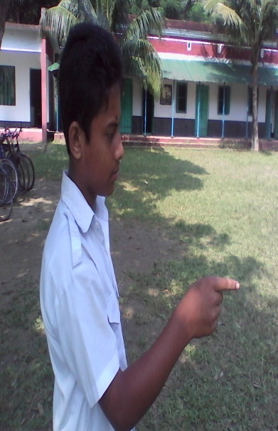
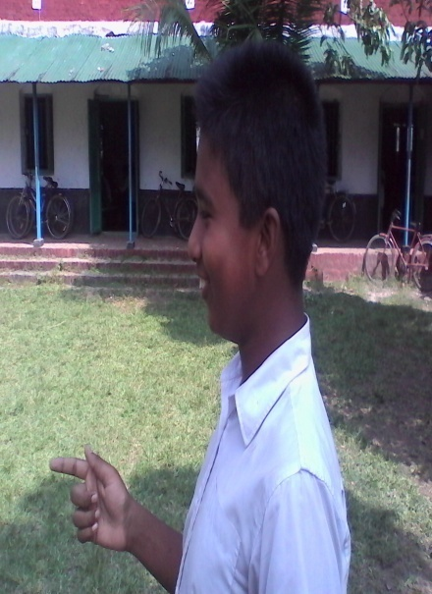
Pair work: Ask and answer.
Follow the conversation.
Who doesn’t wish to be win?
No one can beat him.
Everybody wants to be win.
Who can beat him ?
Now come a pair from you and make a dialogue using Assertive sentence.

Slide 13
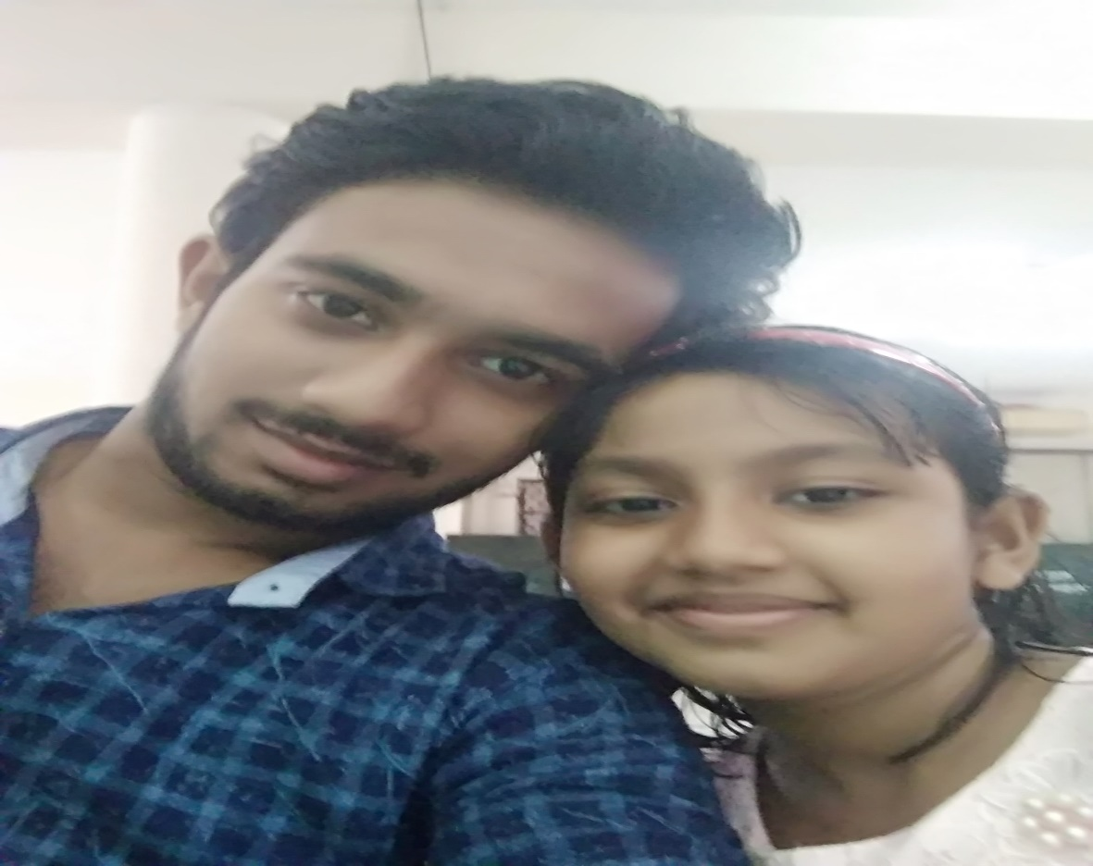
Group work
Make five assertive and interrogative sentence.

Slide 14
Ivaluation
1.What is assertive sentence ?
2.What is interrogative sentence ?

Slide 15
Thanks all

