Slide 1
To the digital content class

Slide 2
Presented by
Lesson Introduction
Sub:English 2nd part
Assertive to ixclamatory
Class: Eight
Unit: 5
Time: 50 min.
Date: 20/12/2019
Md. Alamgir Hossain
Assistant Teacher(ICT)
Rahimapur Fazil Madrasha,
Patnitala, Naogaon.
e-mail-alamgirchz@gmail.com
Mobail No - 01723626108

Slide 3
Lesson Introduction
Class : Six,Seven,Eight, NineTen.
Subject : English 2nd Paper.
Unit : 05
Lesson : 02
Total s’s : 80
Time : 45 minutes.
Date : 20/12/2019

Slide 4
Look at the pictures

Slide 5
Look at the pictures

Slide 6
Our today’s topic is-
Transformation of sentence
Assertive to Exclamatory
Notes:
Lesson declaration.

Slide 7
Learning outcomes
At the end of this lesson, we will be able to---
identify the structure of changing Assertive into Exclamatory
change Assertive into Exclamatory.
Notes:
Introducing the structure of changing from positive to comparative and solving problem about changing from one to another.

Slide 8
Assertive to Exclamatory
Rule 1: Assertive sentence এর মধ্যে A /An থাকলে Exclamatory করার সময় প্রথমে what বা how বসে + উক্ত sentence adjective বসে + subject + verb + বাকী অংশ( যদি থাকে) + ! (Very উঠে যায়) ।
Note – adjective এর পূর্বে a থাকলে what a বসে এবং a না থাকলে how বসে.
Assertive - It is a very beautiful place.
Exclamatory – What a beautiful place it is!
Assertive – The man is very honest.
Exclamatory – How honest the man is!

Slide 9
Rule 2:
Assertive sentence এ Sub +wish থাকলে Exclamatory করার সময় –Sub+wish উঠে যায় এবং উক্ত স্থানে if বসে + বাঁকী অংশ বসে + উক্ত ! চিহ্ন বসে । আর (had বসালে পরের Sub এর পরে আর had বসেনা + আর সব ঠিক থাকে ) ।
Assertive – I wish I had the wings of a bird.
Exclamatory If I had the wings of a bird!
Or – Had I the wings of bird!
Assertive – I wish I were a king.
Exclamatory – If I were a king!

Slide 10
Rule 3:
Assertive sentence এ sub+ wish/sub+desire থাকলে Exclamatory sentence করার সময় করার সময় sub+ wish/sub+desire উঠে যায় এবং উক্ত স্থানে If, had, o that, oh that বসে + বাকী সব ঠিক থাকে + উক্ত ! চিহ্ন বসে
Assertive – I desire I were a player.
Exclamatory – If I were a player!
Assertive – I desire I were young again.
Exclamatory – Oh that I were young again.

Slide 11
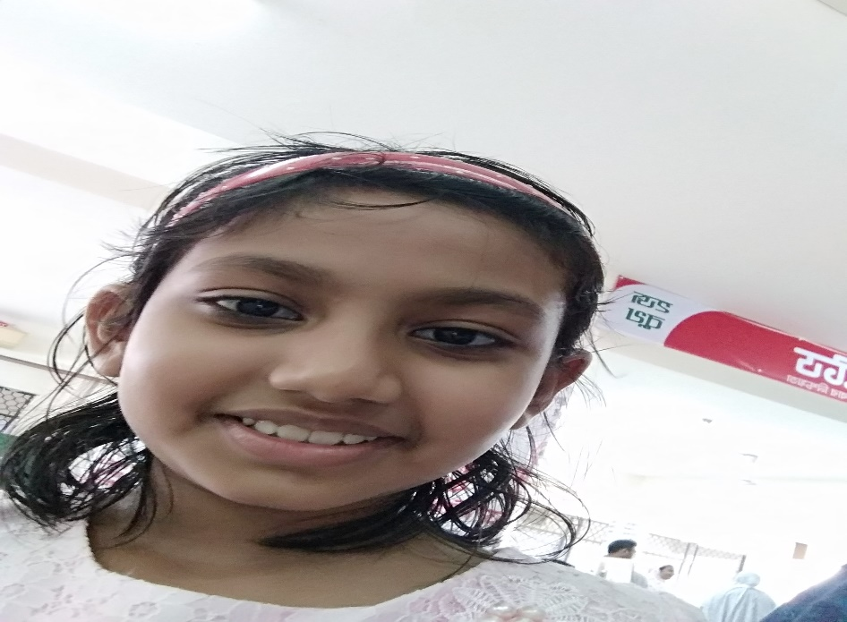
Individual work
1. What is the transformation ?

Slide 12
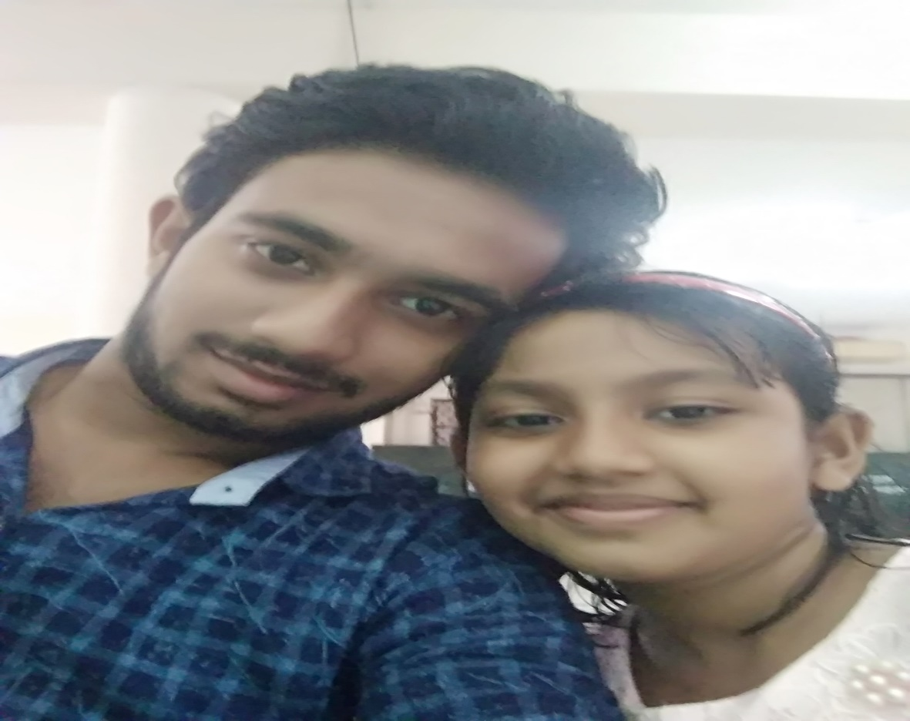
Group work
Make five assertive and exclamatory sentence.

Slide 13
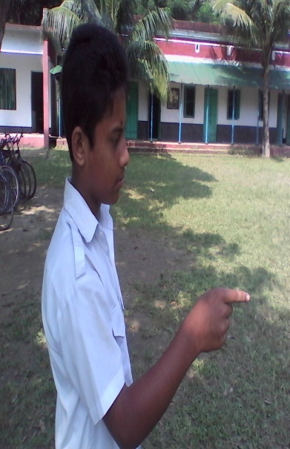
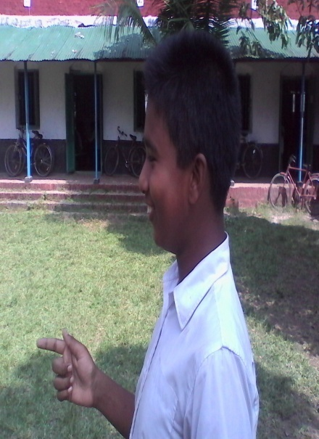
Pair work: Ask and answer.
Follow the conversation.
What a beautiful place it is !
- It is a very beautiful place.
– If I were a player !
I desire I were young again.
Now come a pair from you and make a dialogue using Assertive sentence.

Slide 14
Ivaluation
1.What is assertive sentence ?
2.What is exclamatory sentence ?

Slide 15
Home work
Make five assertive and exclamatory sentence.

Slide 16
Aallah Hafez
Notes:
Ending slide.

