Slide 2
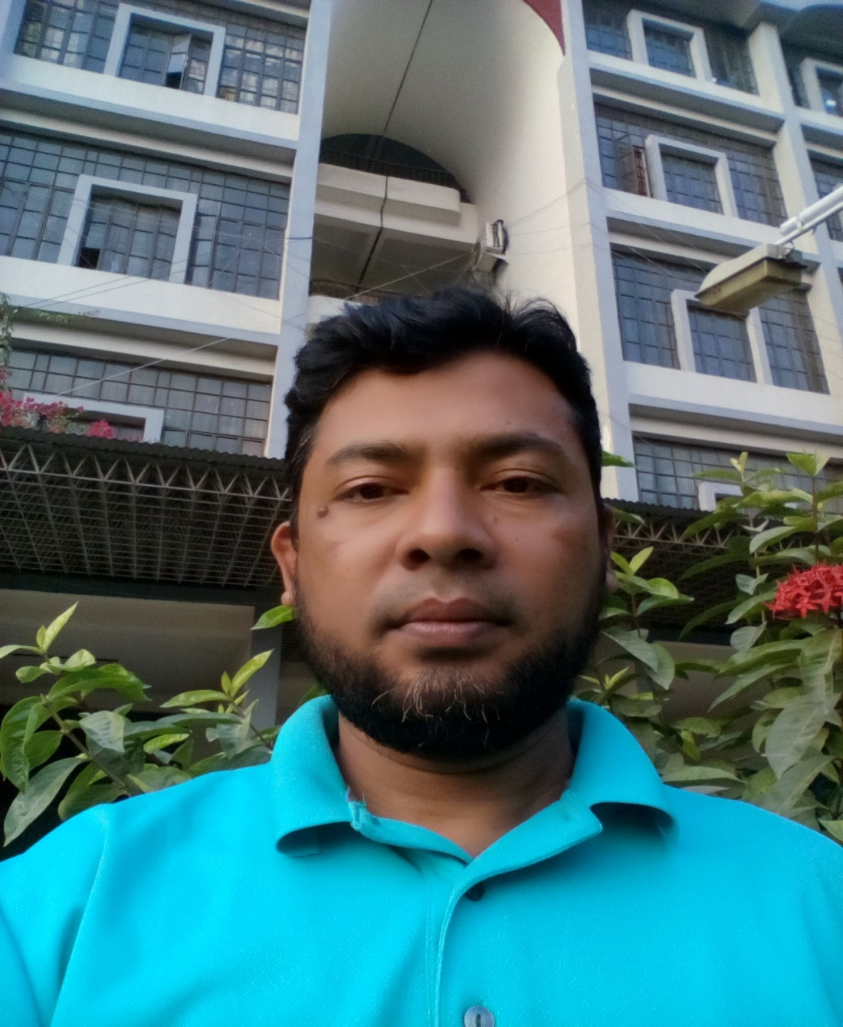
IDENTITY OF TEACHER
NAME:SHAMSUDDIN.
SENIOR ASST. TEACHER.
VEDURIA SERAJIA FAZIL MADRASAH.
LALMOHAN,BHOLA

Slide 3
Lesson’s identity
Class : Nine.
Subject : English Grammar .
Unit:08
Time:45 minutes.

Slide 4
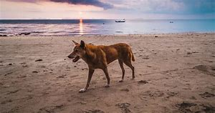
A DOG IS WALKING BESIDE A RIVER.

Slide 5
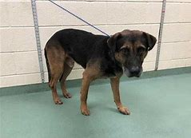
A DOG IS HOLDING WITH A CHAIN.

Slide 6
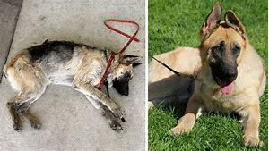
TWO DOGS ARE ON THE GROUND.

Slide 7
THE LESSON OF TODAY

Slide 9
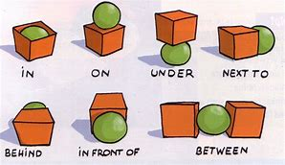

Slide 10
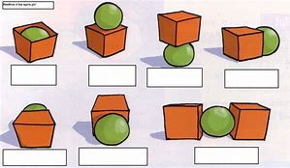
NOW ANSWER THE QUESTIONS

Slide 12
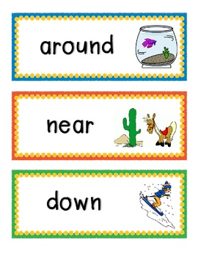

Slide 13
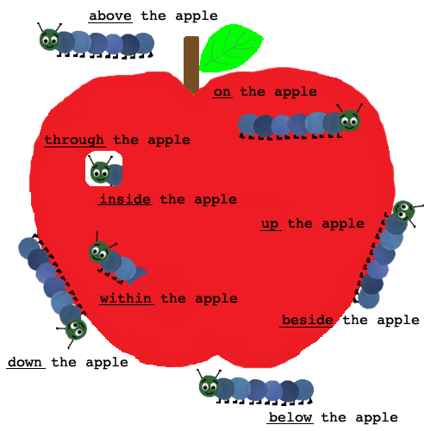

Slide 14
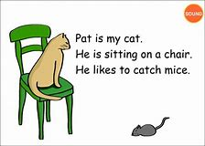

Slide 15
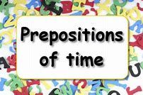
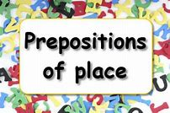
Our school starts at 10 o’clock and breaks up at 4 o’clock.In summer,it is difficult for us to stay at school for so long time.
He lives at new market in Dhaka.Dhaka is in Bangladesh.

Slide 16
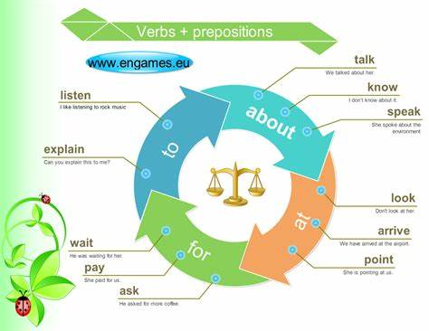

Slide 17
1.Whom do you takling----?
2.He ask---money.
3.Listen---me what I say.
4.I am waiting—you.
5.When does he arrive---the station?
6.I am looking---a good job.
7.Point---the window.
8.Do you know much ---him?
9.I paid---the bill.
10.Look ---the picture.

Slide 18
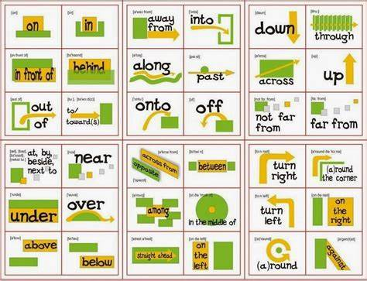

Slide 20
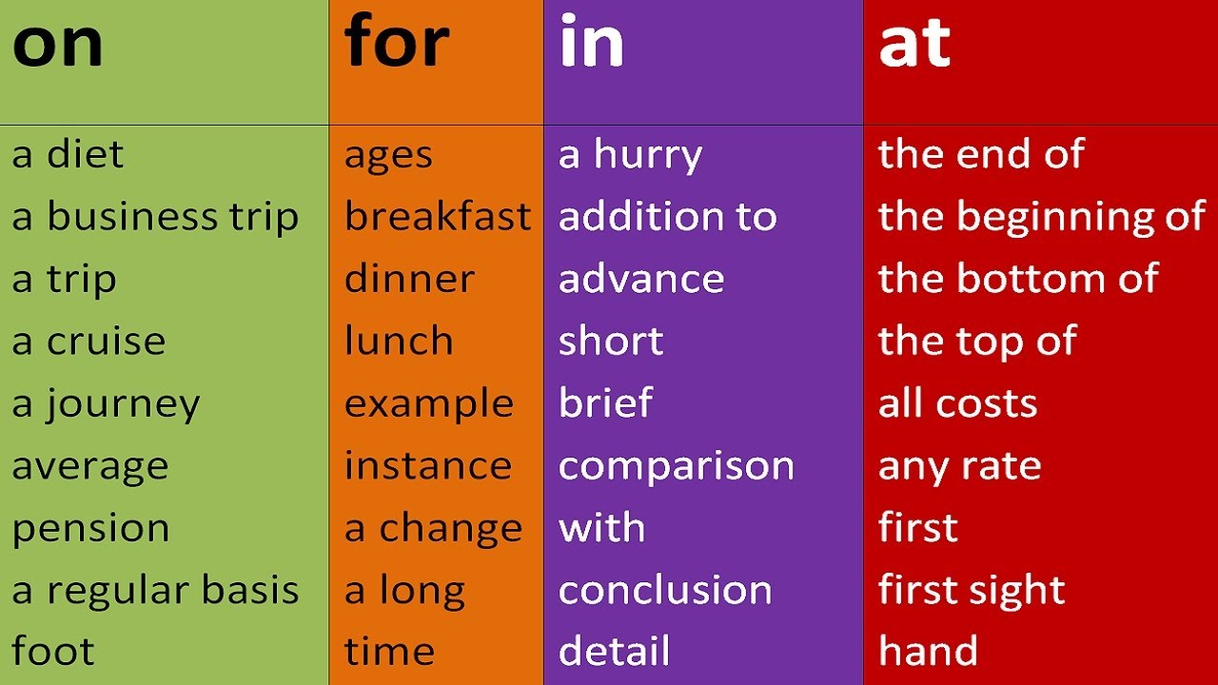

Slide 21
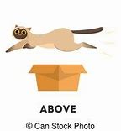
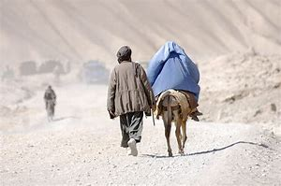
Which is the best among those phone?
The man is flying above high.
They were walking through a forest.

Slide 22
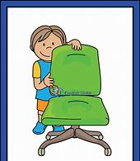
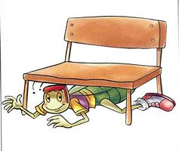
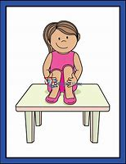
The baby is-----the chair.
The boy is -----the bench.
The girl is ---the table.

Slide 23
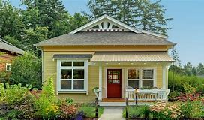
Homework
Read through the given Appropriate preposition.Those will asked in the next classes.

