Slide 1
-
-
-
-
c
c
c
l
c
l
l
l
o
o
o
o
e
e
e
e
m
m
m
m
w
w
w
w
e
e
e
e
To
All are students

Slide 2
Introduce
t
Teacher Lesson
Md. Saidul hoque English for Today
Assistant Teacher Dakhil- class seven
Enayetpur Rohomotia Alim Madrash Unit- 4, Lesson- 1o
Senbag, Noakhali. Time- 45 minute.
Contact- 01822885490. Date- 21/12/2019. E-mail- saidul305844@gmail.com

Slide 3
Look at these picture?
2.What is the work of a person who is engaged in the welfare of all?
1.What do you things about these picture?
3.Now you say name of two such persons?

Slide 4
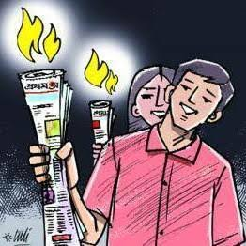
So dear, Our Todays lesson is--
Waiting for a torch- bearer.

Slide 5
Learning outcome
After we have completing this lesson, about we will be able to---
The work and importance of a person engaged in the welfare of all.
Plan to implement a great initiative of a doctor.
Motivation to work to solve a particular problem in society.

Slide 6
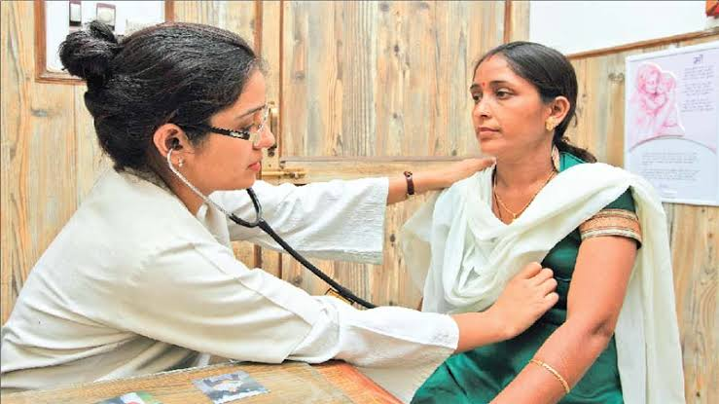
vocabulary
words | image | meaning
duty
Take charge of

Slide 7
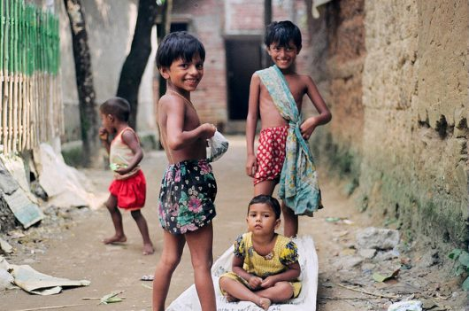
Words | Image | Meaning
The situation of being poor
Poverty

Slide 8
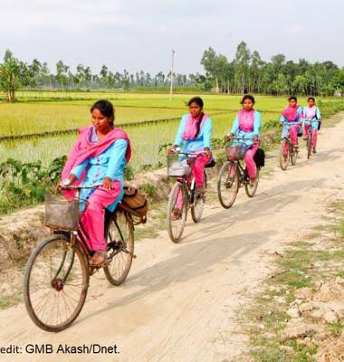
words | image | meaning
The feelings of happiness
Pleasure

Slide 9
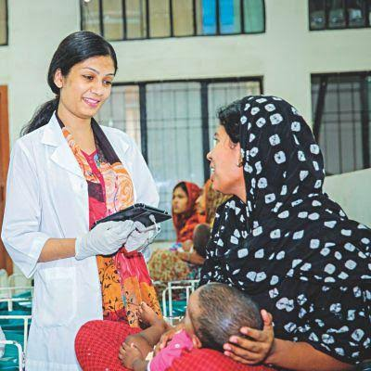
Words | Image | Meaning
Duty
Responsibility

Slide 10
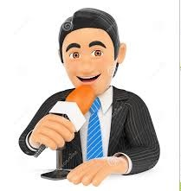
Words | Image | Meaning
Journalist
Reporter

Slide 11
Match the words with their meanings in pairs.
Words | Meanings
Take charge of | The feeling of happiness.
poverty | Have control over.
pleasure | Duty.
responsibility | The situation of being poor.

Slide 12
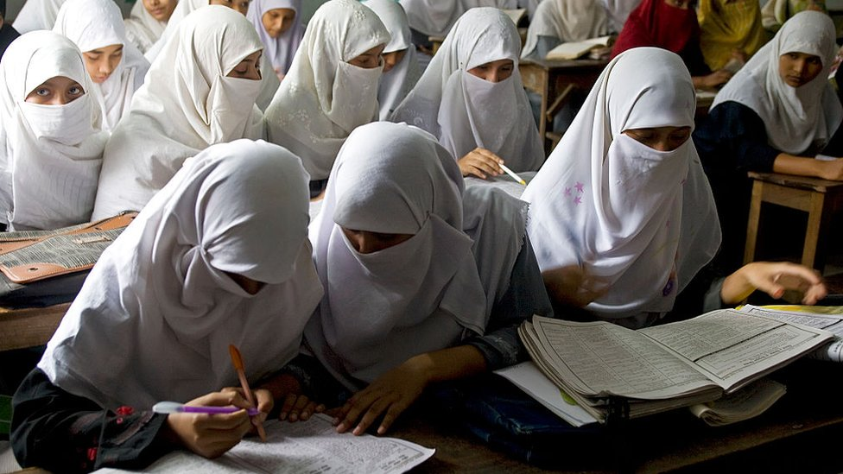
Read the text silently

Slide 13
Fill in the gaps with the right form of verbs in the box. You can use a word more than once, in individual.
help
give
choose
do
is
get
help
I want to________ the poor people. I will________ it to________ healthcare support to the poor. They do not ______ treatment because of poverty. So my dream _______ to be a doctor. To _______ the poor people , I will _______ my village to work.

Slide 14
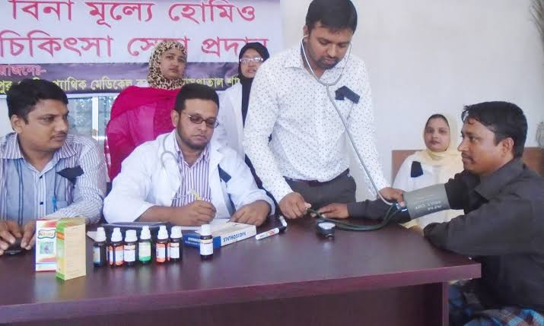
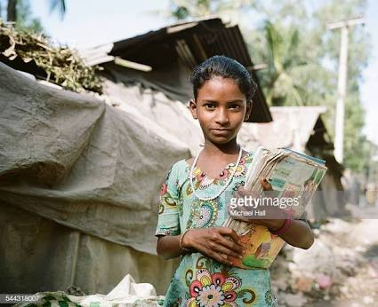
Evaluation
Look at the pictures and answer the following question in the next slide.

Slide 15
Question :
Is the healthcare support free to all?
Why is the doctor waiting for a torch bearer?
Who will be in charge of the center?

Slide 16
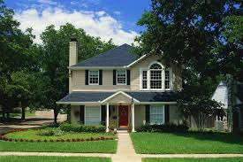
House work
Do you thing the money he gets from the patients is enough run the center? It is not sufficient to run the center.

Slide 17
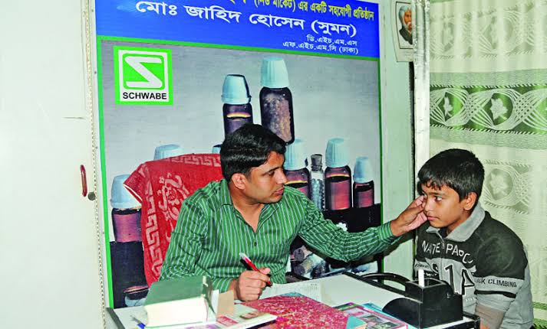
Thanks my dear students
See you again

