Slide 1
WELCOME
HOW ARE YOU ?

Slide 2
IDENTITY
Name: Nurul Amin Azad Assistant teacher: (English) Jahangirpur T,Amin Govt.
Pilot High School Madan,Netrakona
Lesson
ENGLISH GRAMMAR
TENSE
CLASS : Six

Slide 3
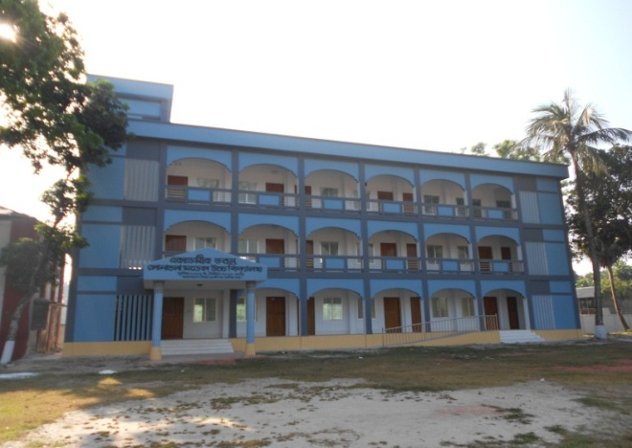
Look at the pictures and try to make Present, Past and Future Tense
Jarif reads in this school.
Asif was a student of this school.
Tasin will read in this school.
Notes:
At first pictures will be shown. Teacher can try to elicit the answer from the students. Then he/she can give feedback by clicking.

Slide 4
Again try to say their view.
Jarif reads in this
school.
Asif was a student of this school.
Tasin will read in this school.
Thanks a lot.
T. Do you know what does indicate the time of action.
S. Excuse me sir, It may be TENSE.
My dear students do you imagine what do have they expressed ?
S. Sir, I mean they have expressed the time of action.
Notes:
At first pictures will be shown. Teacher can try to elicit the answer from the students. Then he/she can give feedback by clicking.

Slide 5
So our today`s topic is TENSE
LESSON DICLARATION

Slide 6
LEARNING OUTCONES
After completing this lesson students will be able to
define of Tense.
say how many kinds of Tense.
Make correct sentence according to different rules of Tense.
Re-write sentences or passage present to past of future Tense.

Slide 7
DEFINITION AND CLASSIFICATION
Tense is the change of form in a verb to express the time of action.
There are three kinds of Tense.
They are : 1. Present Tense
2. Past Tense
3. Future Tense
Notes:
At first pictures will be shown. Teacher can try to elicit the answer from the students. Then he/she can give feedback by clicking.

Slide 8
Have there any more kinds of Tense ?
MORE CLASSIFICATION
Again these TENSES have divided into four forms.
They are : 1. Indefinite
2. Continuous
3. Perfect
4. Perfect Continuous
Notes:
. Teacher can try to elicit the answer from the students. Then he/she can give feedback by clicking.

Slide 9
Structure of Present Tense
Indefinite | Continuous | Perfect | Perfect continuous
Sub + main verb + obj | Sub + am,is, are + verb + ing | Sub + have/has+ past participle of verb`s | Sub + has been/have been + Verb + ing + since/ for
Now try to make four sentences according to above structure.
I eat rice.
I am eating rice.
I Have eaten rice.
I have been eating rice for one hour.
Notes:
Teacher can try to elicit the answer from the students. Then he/she can give feedback by clicking.

Slide 10
Structure of Past Tense
Indefinite | Continuous | Perfect | Perfect continuous
Sub + past form of verb + obj | Sub + was/were + verb + ing | Sub+ had + past participle of verb`s | Sub + had been +Verb + ing
Now try to make four sentences according to above structure.
I ate rice.
I was eating rice. We were eating rice.
I had eaten rice before the bell rang.
I had been reading in the primary school for 5 years.
Notes:
Teacher can try to elicit the answer from the students. Then he/she can give feedback by clicking.

Slide 11
Structure of Future Tense
Indefinite | Continuous | Perfect | Perfect continuous
Sub + shall/will + verb + obj | Sub + shall be / will be + verb + ing | Sub + shall have / will have + past participle of verb`s | Sub + shall have been/will have been + Verb + ing + since/ for
Now try to make four sentences according to above structure.
We shall eat rice.
We shall be eating rice.
We shall have eaten rice/ He/She will have eaten rice.
You Will have been reading in this school for 5 years.
Notes:
Teacher can try to elicit the answer from the students. Then he/she can give feedback by clicking.

Slide 12
INDIVIDUEL WORK
Make three sentences according to above picture:
Present Tense: …………………………………
Past Tense: ……………………………………
Future Tense: ……………………………………
Notes:
Teacher can try to elicit the answer from the students. Then he/she can give feedback by clicking.

Slide 13
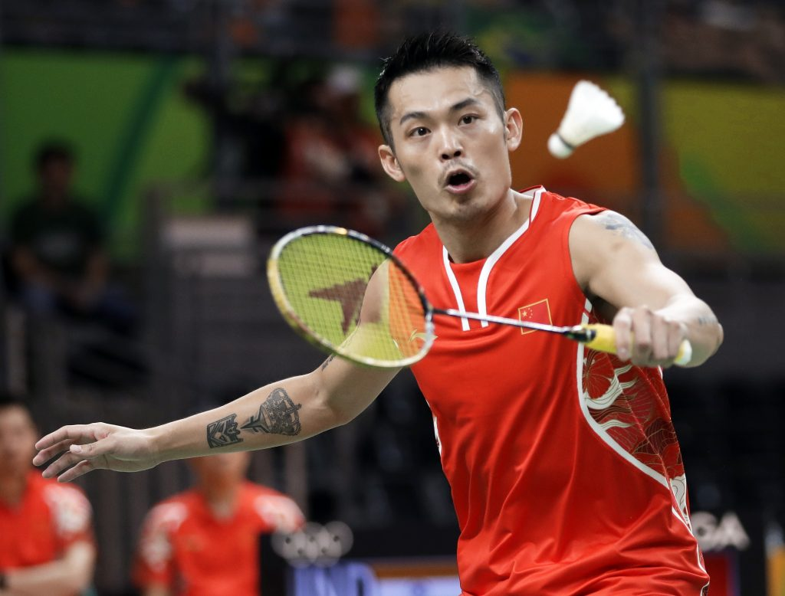
PAIR WORK
Fill in the gaps with the right from of verbs.
Read | Play | Go | Drink | obey
Jarif(a) ------------- in class six. He (b) -------- to school yesterday. He does not (c) ---------football. (d) Do you --------- milk everyday ? We should (e) ----------- our parents.
Ans: (a) reads (b) went (c) play (d) drink (e) obey
Notes:
Teacher can try to elicit the answer from the students. Then he/she can give feedback by clicking.

Slide 14
Group Works
Change the following sentences according to direction.
1. Neela sings very sweetly. ( present continuous tense).
2. Sister is boiling eggs for us ( Past continuous tense).
3. Brother went to Sylhet. ( Present perfect tense).
4. We are playing football. ( Present perfect continuous tense).
5. Sadaf drinks milk everyday. ( make it negative).
Notes:
Teacher can try to elicit the answer from the students. Then he/she can give feedback by clicking.

Slide 15
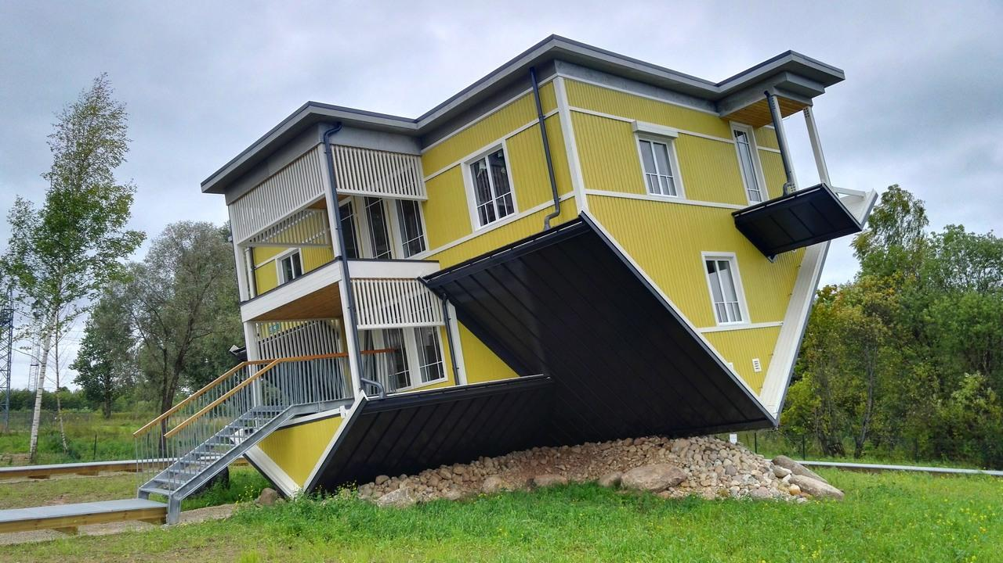
HOME WORK
Write all structures of Tense.
Notes:
TEACHER CAN GIVE SOME INSTRUCTIONS TO DO THE HOME WORK.

Slide 16
THANKS ALL.

