Slide 2
Teacher’s identity
Name:Shamsuddin.
Senior Asst. teacher.
Veduria Serajia Fazil Madrasah.
Lalmohan,Bhola.

Slide 5
Our today’s lesson
A paragraph on
“Importance of learning English.”

Slide 6
English is an international language.No nation can do without it today.Its imporatnce is increasing day by day.Many countries use it as their first language.

Slide 7
If a student wants to get higher education,he must have sound knowledge of english.

Slide 8
Because all books in higher classes are published in english.Lectures are given in the classes in english by the teachers.

Slide 9
More than 80% information of computers is in english.

Slide 10
Many of us have to go foreign countries for different purposes.If you have good command in english,you will overcome any situation easily.

Slide 11
Job in a hotel or restaurant is very common to the developing countries like ours.An international hotel always requires employees who can speak in english.

Slide 12
A foreign office can not function without english knowing people.Now a days all papers and documents in every office are to prepare in english.

Slide 13
Organizations appoint their employees who can read and write english.

Slide 14
International communities hold their meeting in english.

Slide 15
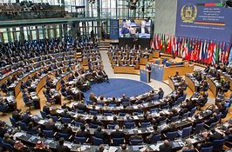
United nation,international olympic committee,Ilo,Icc,FIFA also hold their meeting in English.

Slide 16
Thus the necessity of learning english can not be ignored in way.So everyone of us should learn english.

Slide 17
Homework
Now write the sentences of each slides and you will read through the paragraph.You have to write the paragrph in the next class individually.

