Slide 1
Welcome

Slide 2
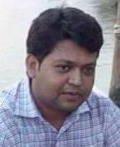
Identity
Md. Hossain Akanda
Assistant Teacher
Jobaida High School
Class : Seven
Subject : English 2nd Paper
Title : Verbs

Slide 3
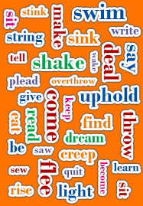

Slide 4
Guess Today’s Topic
?

Slide 6
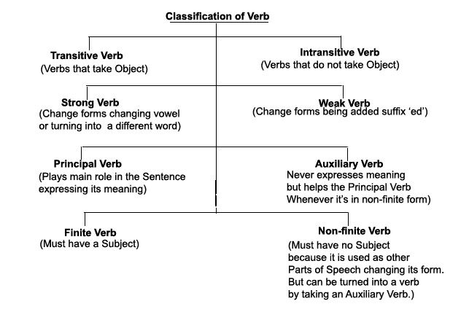

Slide 9
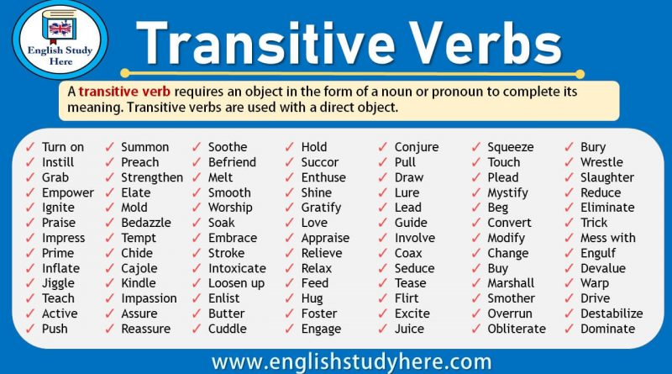

Slide 14
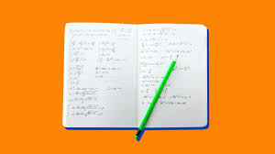
Write at least 10 Transitive verbs & 10 Intransitive verbs

Slide 15
Thanks

