Slide 2
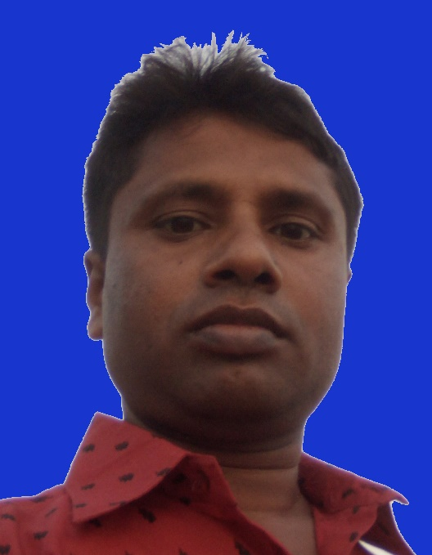
Identity
c
c
c
Class-Nine
Subject-English 1st paper.
Unit-Two
c
Md.Abul Hossain
Asst Teacher.
Banagram Manik Uddin High School.
Sarishabari,jamalpur,
.
c
c

Slide 3
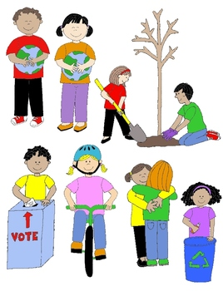
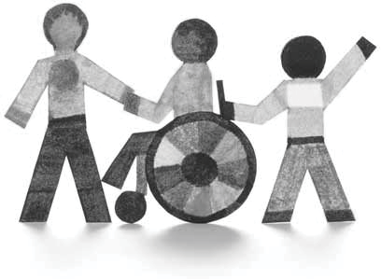
Look at the picture ? what can see the picture?

Slide 4
Unit-one
Good citizen
Lesson-4

Slide 6
Today’ is lesson
Responsibilities

Slide 7
Learning outcomes
After we have studied the lesson,we will be able to………………………………
Narrate incidents.
Participate in discussions.
Listen to understand others.
Describe something in writing.

Slide 9
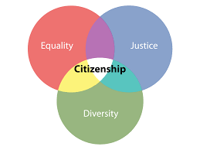
Responsibility

Slide 11
Group Work
Answer to the following Questions
What do you mean by responsibility?
Are there any difficulties in fulfilling the responsibilities?.
Briefly describe what might happen if people fail to fulfill the responsibilities.

Slide 12
Evaluation
Choose the best answer.
a) A__ is an obligation to do and not to do things.
i) punctuality ii) responsibility iii) honesty c iv) sincerity
b) We should __ school regularly.
i) be absent in ii) be present from iii) be inattentive iv) attend
c) It is our duty to __ neighbor in problems.
i) do norm to ii) help iii) exploit iv) prise
d) The govt has the responsibility to protect the __ rights of its citizens.
i) birth ii) fundamental iii) educate iv) Medicare
e)We have responsibility to cast vote at the age of….
i) 12 ii) 16 iii) 17 iv) 18 or over

Slide 13
Home work
Write a paragraph
Responsibilites

Slide 14
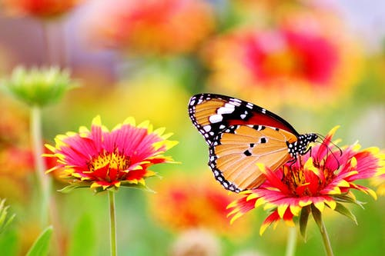
Thanks all the best.

