Slide 1
Welcome

Slide 2
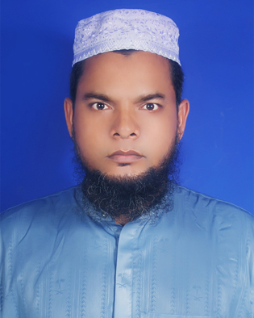
Identity
Presentator
Lesson
Md. Jahangir Hossain
Assistant teacher.
Sahadebpur D.S.D. Madrasa
Terki, Kalihati, Tangail.
Class-seven
Sub.-English 2nd paper
Date- 07 February 2019

Slide 4
Declaration of Lesson
Write an application to your
Superintendent praying for
a Full free studentship .

Slide 5
Date: 07 February, 2016
To,
The Superintendent
Sahadebpur darus Sunnah Dhakhil Madrasa
Terki, Kalihati, Tangail.
Subject: Prayer for a full free student ship.

Slide 6
Sir
I beg most respectfully to state that
I am a student of class seven of your
Madrasa.

Slide 7
My father is a poor farmer.
He is the only earning member in our family.
His income is very poor.
Two of my brothers and sister are studying in this madrasa.
So I need a full free studentship. /
So I need help from the poor fund.

Slide 8
I , therefore, pray and hope that
you would be kind enough to grant me
A full free student ship.

Slide 9
I
Remain
Sir,
Your most obedient pupil
Md. Abubakar SiddiQue
Class: Seven, Roll no- 01

Slide 10
Evaluation
Because of full free
1. My father is a poor farmer./
2. His income is very poor. /
3..

Slide 11
Home work
Write an application to your Superintendent
praying for a. transfer certificate.

Slide 12
Thank You everybody

