Slide 1
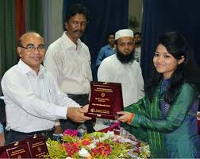


Slide 2

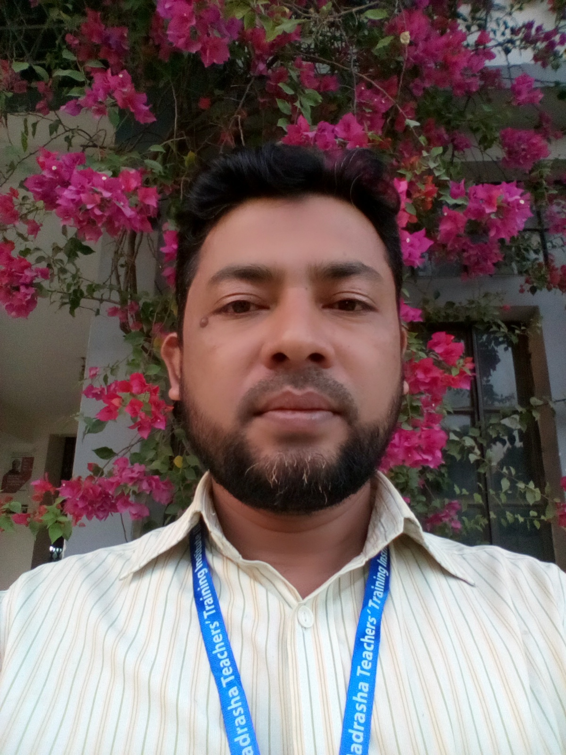
About Teacher
Name:Shamsuddin
Senior Asst. teacher.
Veduria serajia Fazil madrasah.
Lalmohan,Bhola.

Slide 3
About lesson
Class:Ten
Subject:English 1st paper
Unit:17
Time:45 minutes.

Slide 4
Let us enjoy the video

Slide 5

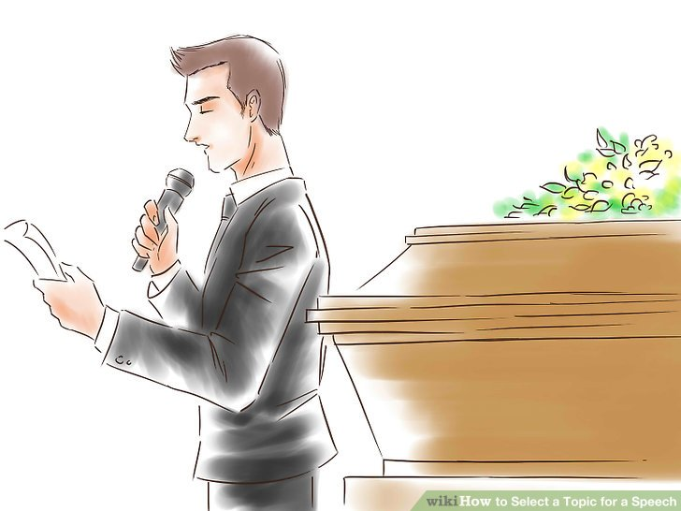
Our today’s lesson
A paragraph on “The Prize Giving ceremony”

Slide 6
A prize giving ceremony is really exciting . In every educational institution it is arranged at least once a year . It is held after the annual sports and annual examination . Students take part in various games . A few days ago our school also arranged a prize giving ceremony.

Slide 7
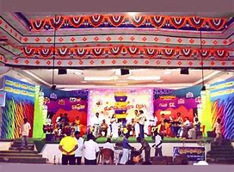
On that day our school decorated nicely . A nice stage was made in front of our school . The U.N.O. was the chief guest . The Headmaster was the president of the function.

Slide 8
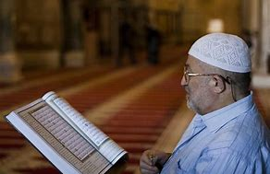
The function begins with the recitation from the holy Quran.

Slide 9
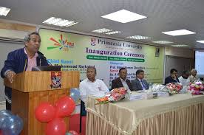
The Headmaster of our school read out the annual report of our school. He pointed out various aspect of our school.

Slide 10
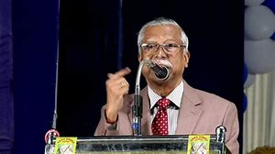
After that our English teacher declared the names of the winners. .

Slide 11
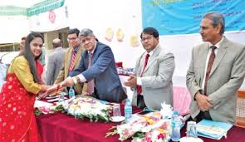
The winners took their prizes from the chief guest.

Slide 12
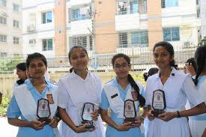
Four students from different classes got prizes for first in their classes . All were clapping to inspire them.

Slide 13
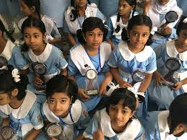
Winners were very happy getting prizes . They joined in group photograph.

Slide 14
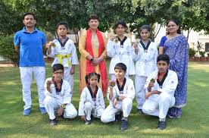
Some of the winners took photograph with teachers.

Slide 15
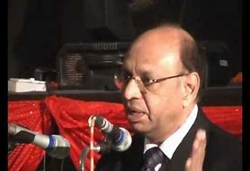
Then the chief guest was requested to deliver his speech . While delivering his speech , he thanked us to arrange such function . He also told us the importance of education . The function ended with the speech of our Headmaster.

Slide 16


Write above sentences as paragraph . You will be asked in the next class.

Slide 17


