Slide 1
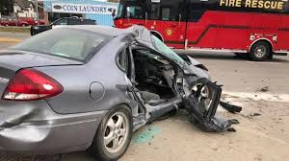

Slide 2
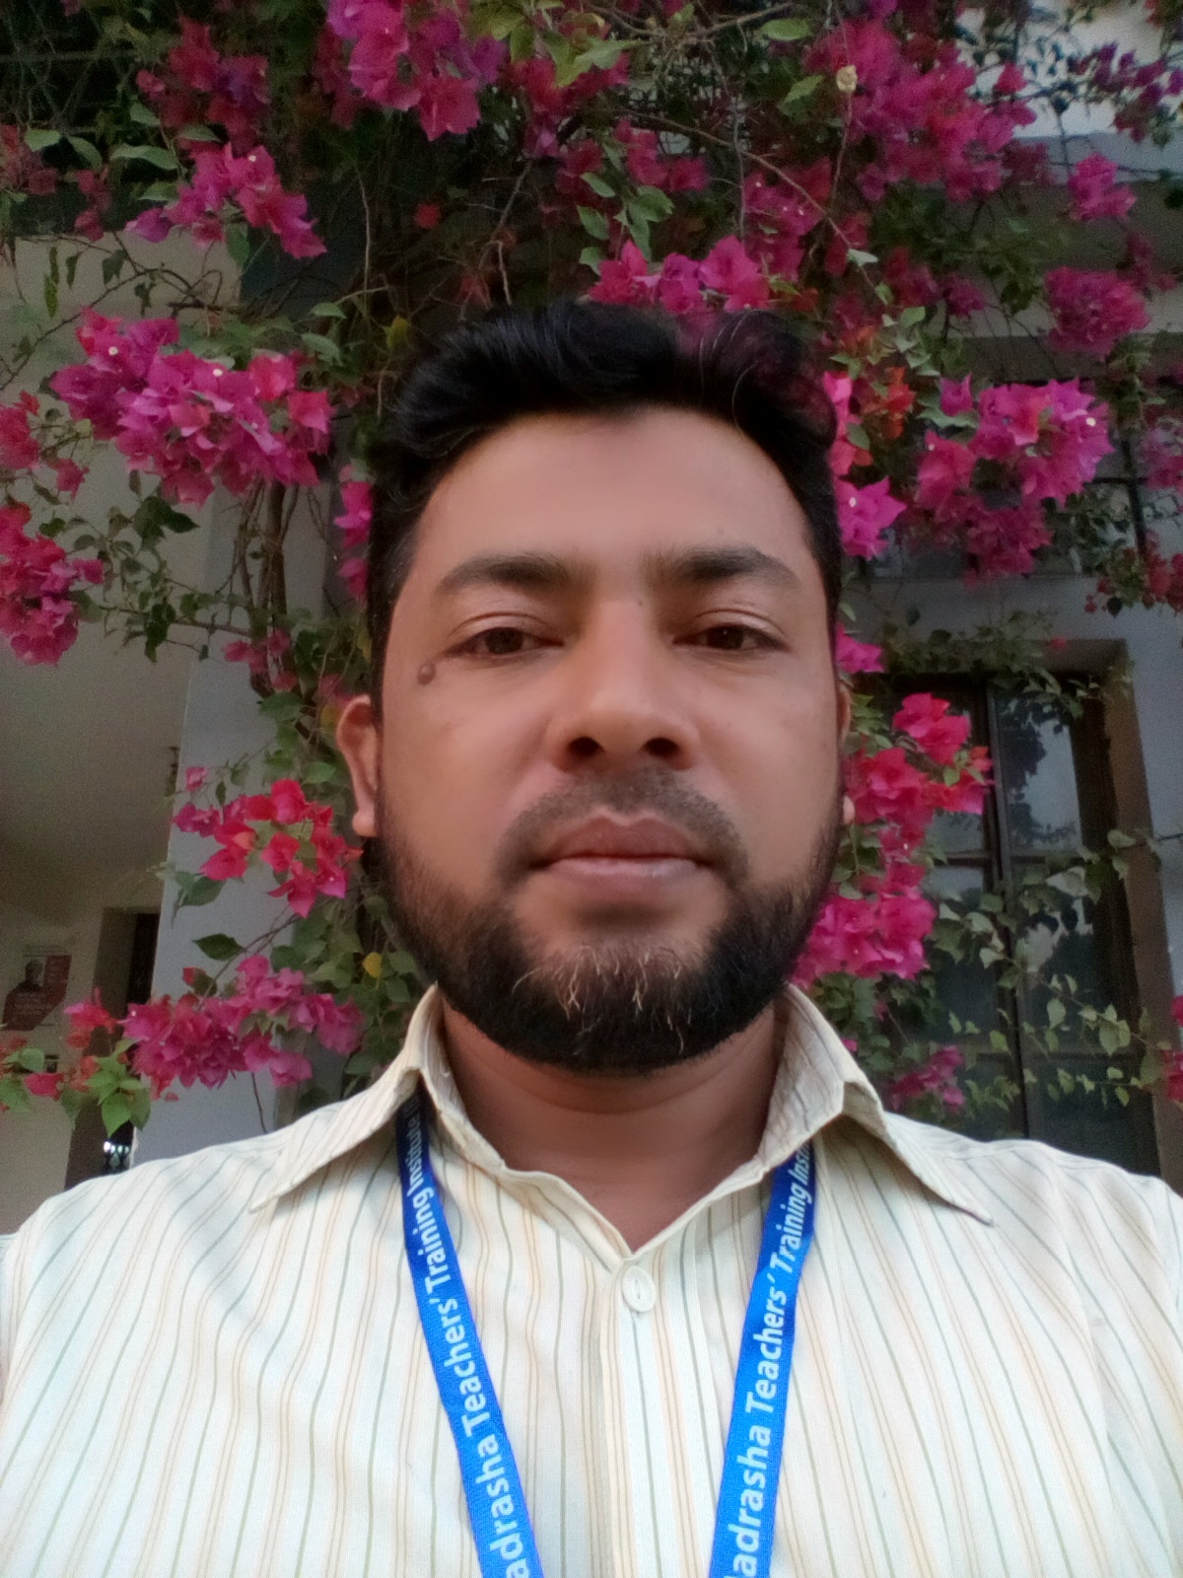
About teacher
Name:Shamsuddin
Senior Asst. teacher.
Veduria serajia Fazil madrasah.
Lalmohan,Bhola.

Slide 3
About lesson
Class:Ten.
Subject:English Grammar and composition.
Unit:17
Time:45 minutes

Slide 4
Let’s enjoy the video

Slide 5
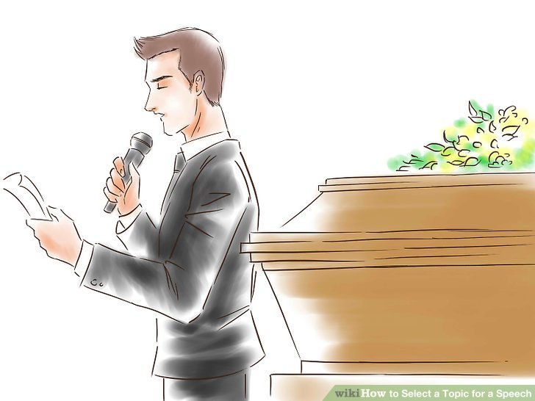
Our Today’s lesson
A paragraph on”Street Accident.”

Slide 6
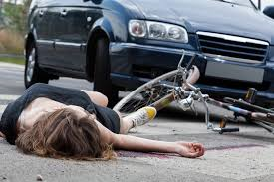
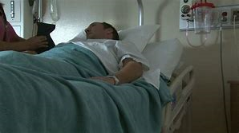
Street accident has become a common incident in Bangladesh.Everyday we find the news of street accident in dailies.Many people die by accident .Some become crippled.Steet accident is like a cure in our life.

Slide 7
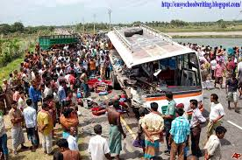
The main cause of street accident is reckless driving.Many drivers are unskilled.

Slide 8
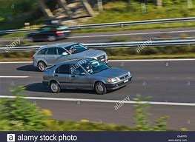
Overtaking tendency is seen while driving highway.

Slide 9
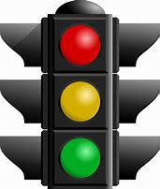
Violation of traffic rules is a common scene in our country.Drivers don’t want to follow the traffic signals.

Slide 10
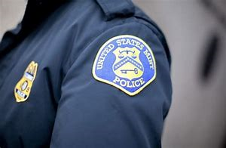
Even the police can not control the rule breakers.Our traffic police are not sufficient as demand.

Slide 11
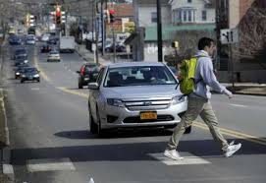
Everybody must aware of traffic rules to avoid street accident.

Slide 12
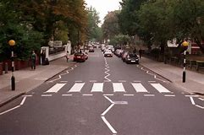
We must use zebra crossing to cross the roads.

Slide 13
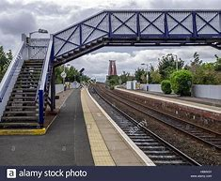
We can also use overbridge to get rid of accident.

Slide 14
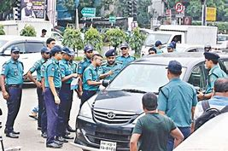
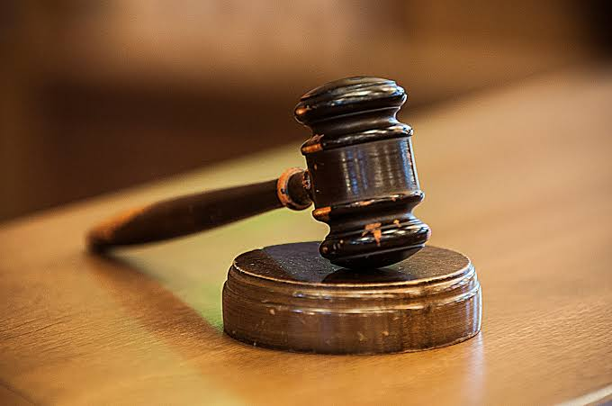
Law enforcing agencies must be strict to follow the traffic rules.Punishment should be given who break the traffic rules.Our government should take more steps to prevent street accident.

Slide 15
Read through the paragraph.

Slide 16
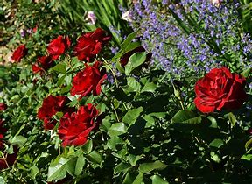
THANKS TO ALL.

