Slide 1
WELCOME

Slide 2
Rawsan Jahan
Assistant Teacher(English)
Robertsongonj High School and College, Rangpur.
ENGLISH FOR TO DAY
Class-Six
Lesson—3
Time: 50 minutes.

Slide 3
Learning outcomes
After completing the lesson learners will be able to----
talk about people, places and familiar objects in short and simple sentences
read and understand texts.
ask and answer the questions.

Slide 4
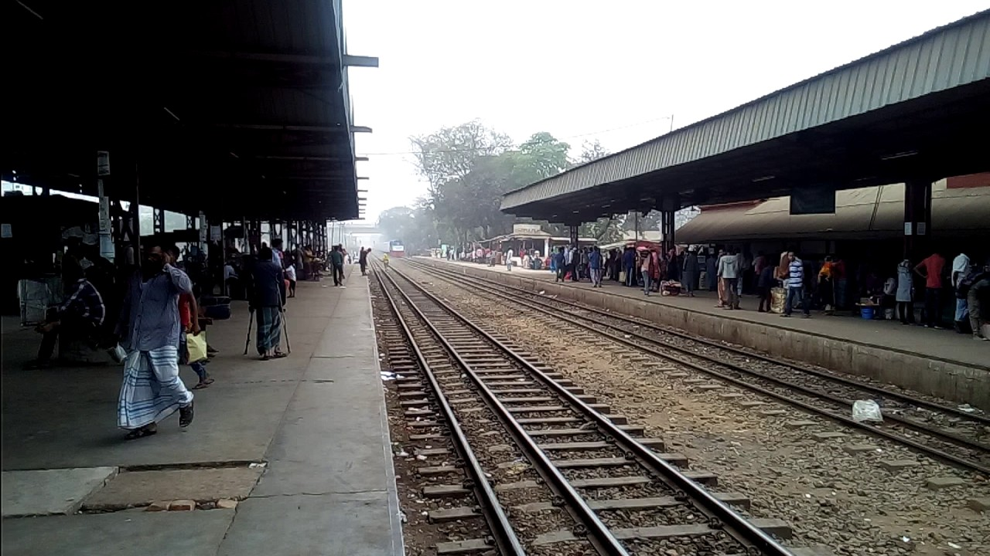
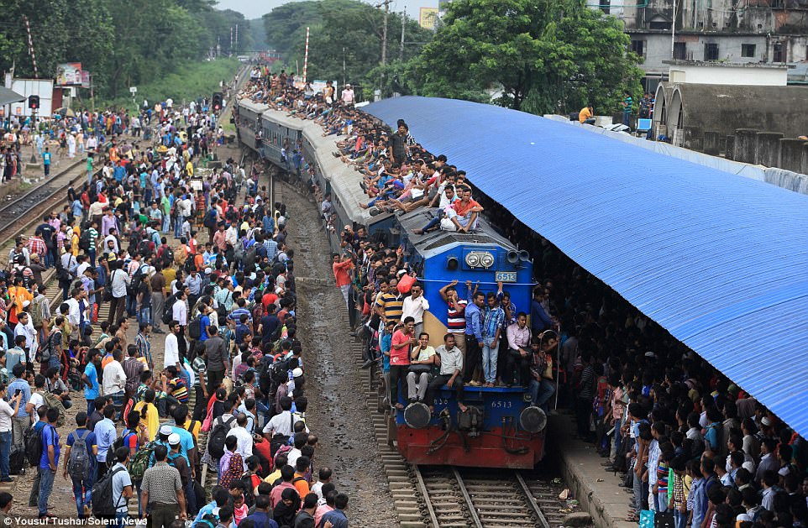
What can you see in these pictures?
What place is it?

Slide 5
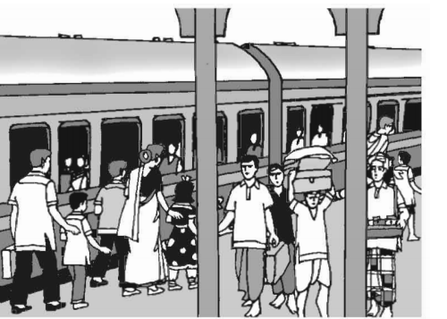
At a railway station.
Lesson --3

Slide 6
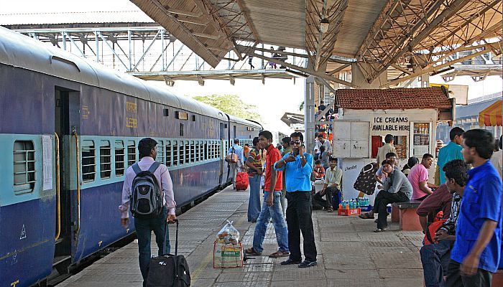
What are people doing?
Why do we go there?

Slide 7
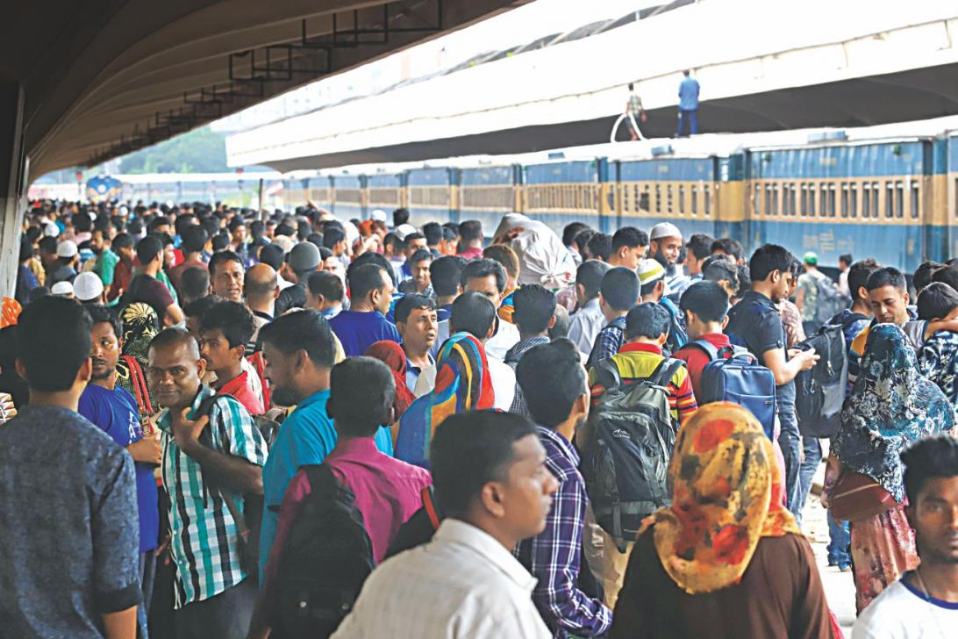
Now find out new words.
Crowded(adjective)
Very full of people
It was crowded there.

Slide 8
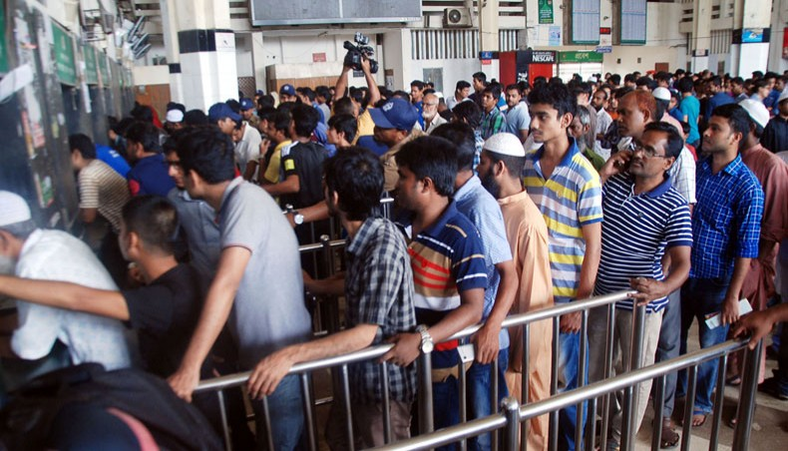
Queue(noun)
row
Men were standing in the queue at the ticket counter.

Slide 9
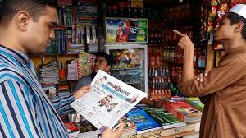
Magazine
journal
The man is reading a magazine.

Slide 10
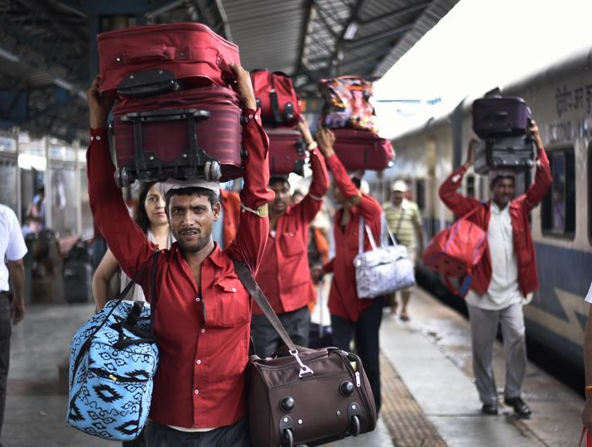
Luggage(noun)
baggage
They are caring luggage.

Slide 11
Individual work.
Look at the picture below. Talk about what things you see and are happening.
A train has arrived at the station. Some passengers have got down from compartments of the train. They are getting out of the platform. A porter is carrying luggage on his head. Other passenger are getting on the train. A hawker is also standing on the platform.

Slide 12
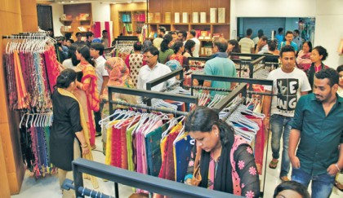
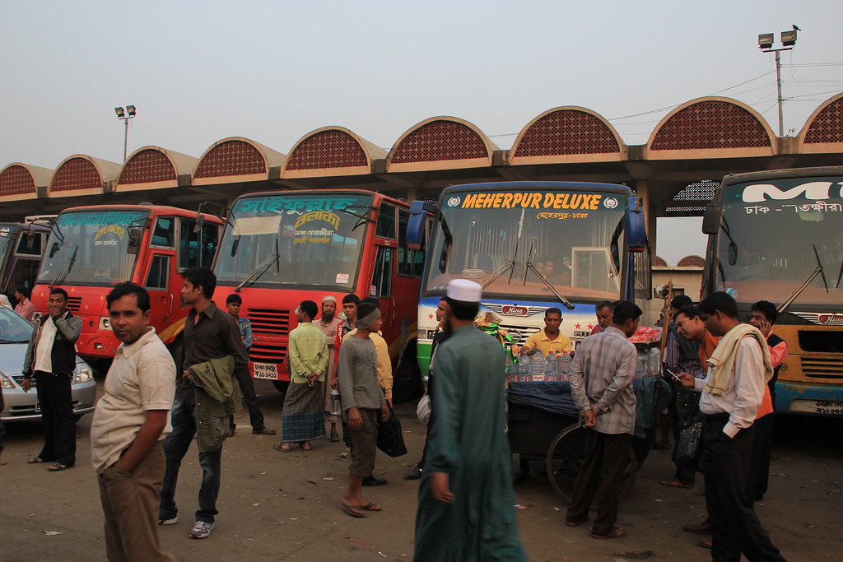
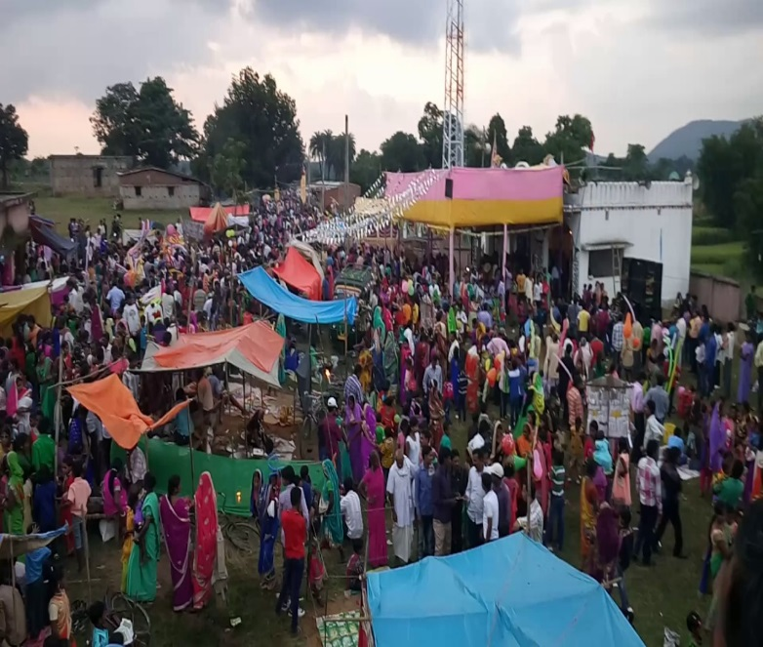
Group work
A shopping place
What can you see at these pictures?
What different activities are taking place there ?
Who are doing those activities?
A bus station
A fair

Slide 13
Evaluation
What is called station?
Why do we go there?
Why do we stand at the ticket counter?

Slide 14
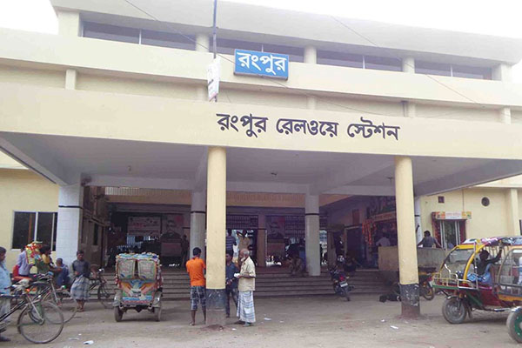
Home work
Write down ten sentences about your local railway station.

Slide 15
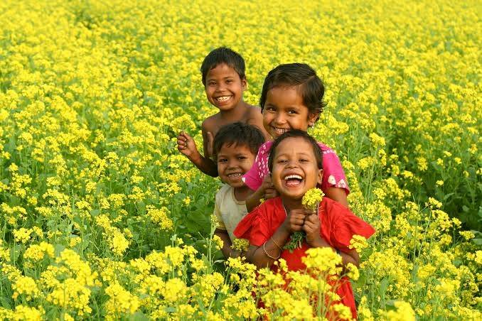
Thanks to all.

