Slide 1
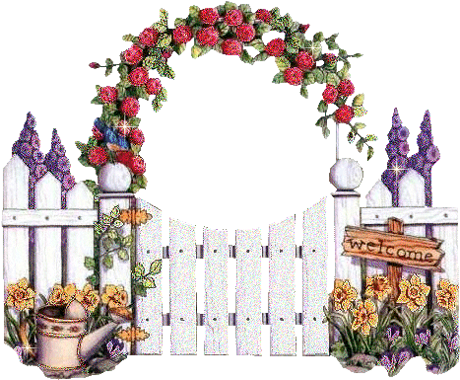
Good morning

Slide 2
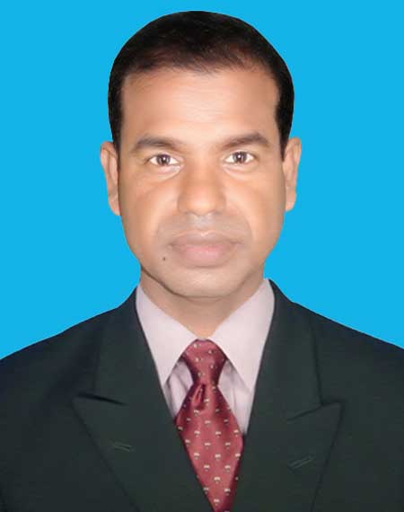
Introduction
Class: Tree
Subject: English
Numbers . Lesson:1-3,
Unite : 4. Page : 8
Md. Abdul Kuddus
Head Teacher
Kazirber Govt. Pri. School
Moheshpur, Jhenaidah.

Slide 3
Let’s watch a video

Slide 4
What can you see?
Can you guess what we are going to learn today?
1
2
3
4
5
6
7
8
9
10

Slide 5
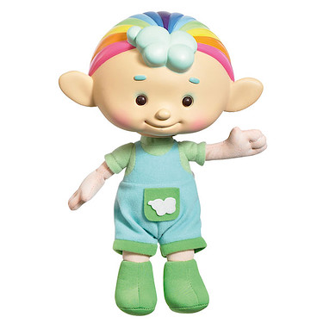
Lesson Declaration
Today we’ll learn
Numbers
1,2,3,4,5
Unite : 4

Slide 6
Learning outcomes
Students will be able-
Speaking:
Reading:
2.1.1 recognize and read cardinal numbers 1 to 5
1.1.2 say words, phrases and sentences with proper sound and stress
Writing:
2.1.1 write cardinal numbers 1 to 5 in figures
4.1.1 copy cardinal numbers 1to 5 in figures and in words
4.1.2 write cardinal numbers 1 to 5 both in figures & in words

Slide 7
Look and say.
1
2
3
4
5

Slide 8
Say, count and write the numbers
1
How many Elephant?

Slide 9
Say, count and write the numbers
2
How many Caps?

Slide 10
Say, count and write the numbers
3
How many Bags?

Slide 11
Say, count and write the numbers
4
How many Oranges?

Slide 12
Say, count and write the numbers
5
How many pencils?

Slide 13
Recognize the number
1

Slide 14
Recognize the number
2
3

Slide 15
Recognize the number
4
5

Slide 16
Count , write the number in figure and word
Click on the picture
1
One
Elephant

Slide 17
Count , write the number in figure and word
2
Click on the picture
Two
Caps

Slide 18
Count , write the number in figure and word
3
Click on the picture
Three
Bags

Slide 19
Count , write the number in figure and word
Click on the picture
4
Four
Oranges

Slide 20
Count , write the number in figure and word
Click on the picture
5
Pencils
Five

Slide 21
Say , trace and write numbers.
1
1
1
1
1
1
1
2
2
2
2
2
2
2
3
3
3
3
3
3
3

Slide 22
Say , trace and write numbers.
4
4
4
4
4
4
4
5
5
5
5
5
5
5

Slide 23
Say , trace and write words.
One
One
One
One
One
One
Two
Two
Two
Two
Two
Two
Three
Three
Three
Three
Three
Three

Slide 24
Say , trace and write words.
Four
Four
Four
Four
Four
Four
Five
Five
Five
Five
Five
Five

Slide 25
Count picture and write the number .
GW
Group-A
3
Group-B
1
Group-C
5
Group-D
2
Group-E
4

Slide 26
Match correctly:
P.W
1
2
3
4
5

Slide 27
I.W
Evaluation
Write the missing number or word.
3
4
5
1
2
Click on the Line
one
two
three
four
five

Slide 28
Good bye

