Slide 2
Identity
c
c
c
Class-Six
Subject-English 1st paper.
Unit-One
c
Md.Abul Hossain
Asst Teacher.
Banagram Manik Uddin High School.
Sarishabari,jamalpur,
.
c
c

Slide 3
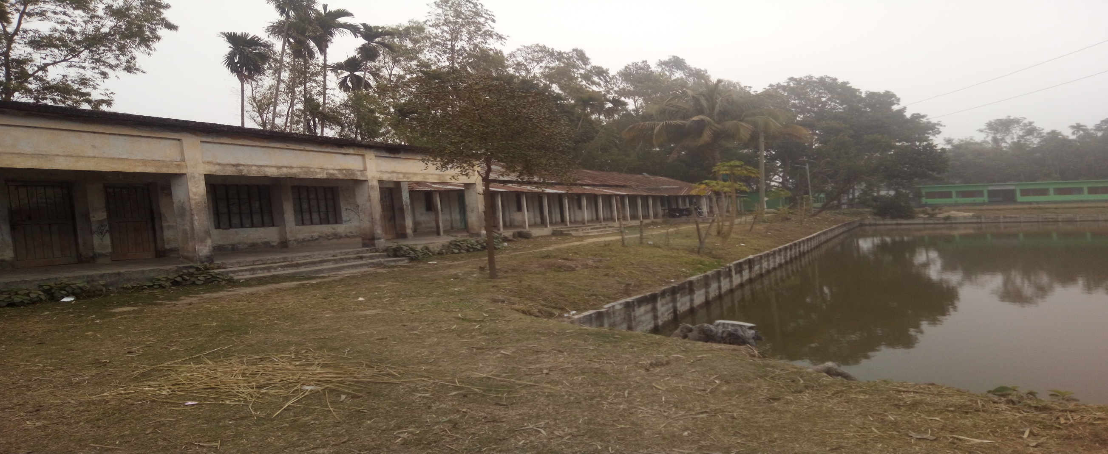
Look at the picture ? What can see ?

Slide 4
Today ’ is lesson
Unite –One
Lesson-One
Going to new school

Slide 5
Learning outcomes
After completing the lesson students will be able to………
Read and understand text.
Talk about people , places and familiar objects in short and simple sentences.
Write a paragraph.

Slide 6
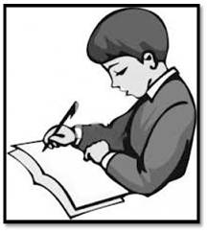
Go to section-A and try to know about Tarun

Slide 7
Section-A1
Now write down similar information about yourself

Slide 8
Section – B. Read the following passage about Tarun’s first day in the new school.
My ﬁrst day at the new school was interesting. I was going to school with my father in a rickshaw. We reached school after ﬁfteen minutes . My father said good bye and left me at the school gate. I went in and found that everyone had gone to class. I walked into my classroom and found a seat. After some time a teacher came and warmly greeted us. I found the students very friendly in my new class.

Slide 9
Key Word
Interesting
Greet
Receive
Warmly
Enjoyable
Exciting
মজাদার
মহ্যৎ
গ্রহন
উষ্ণ
আনন্দ
উত্তেজিত

Slide 10
Group work
Individual work
COLUMN A
COLUMN B
difficult Stuck Traffic Direction | route complicated jammed travel

Slide 11
Evaluation
Tarun went to his new school by? Tarun’s father left him ?
They rccehed the school after minutes ?

Slide 12
Home work
Write a paragraph
My first at the new school

Slide 13
Thanks all the best

