Slide 1
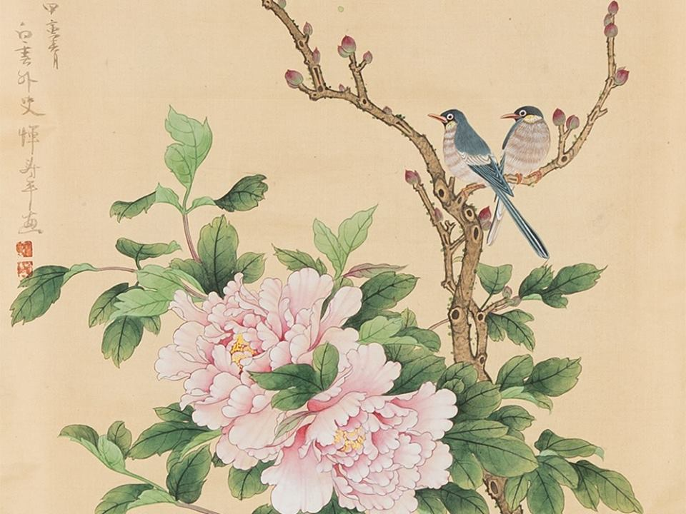
WELCOME

Slide 2
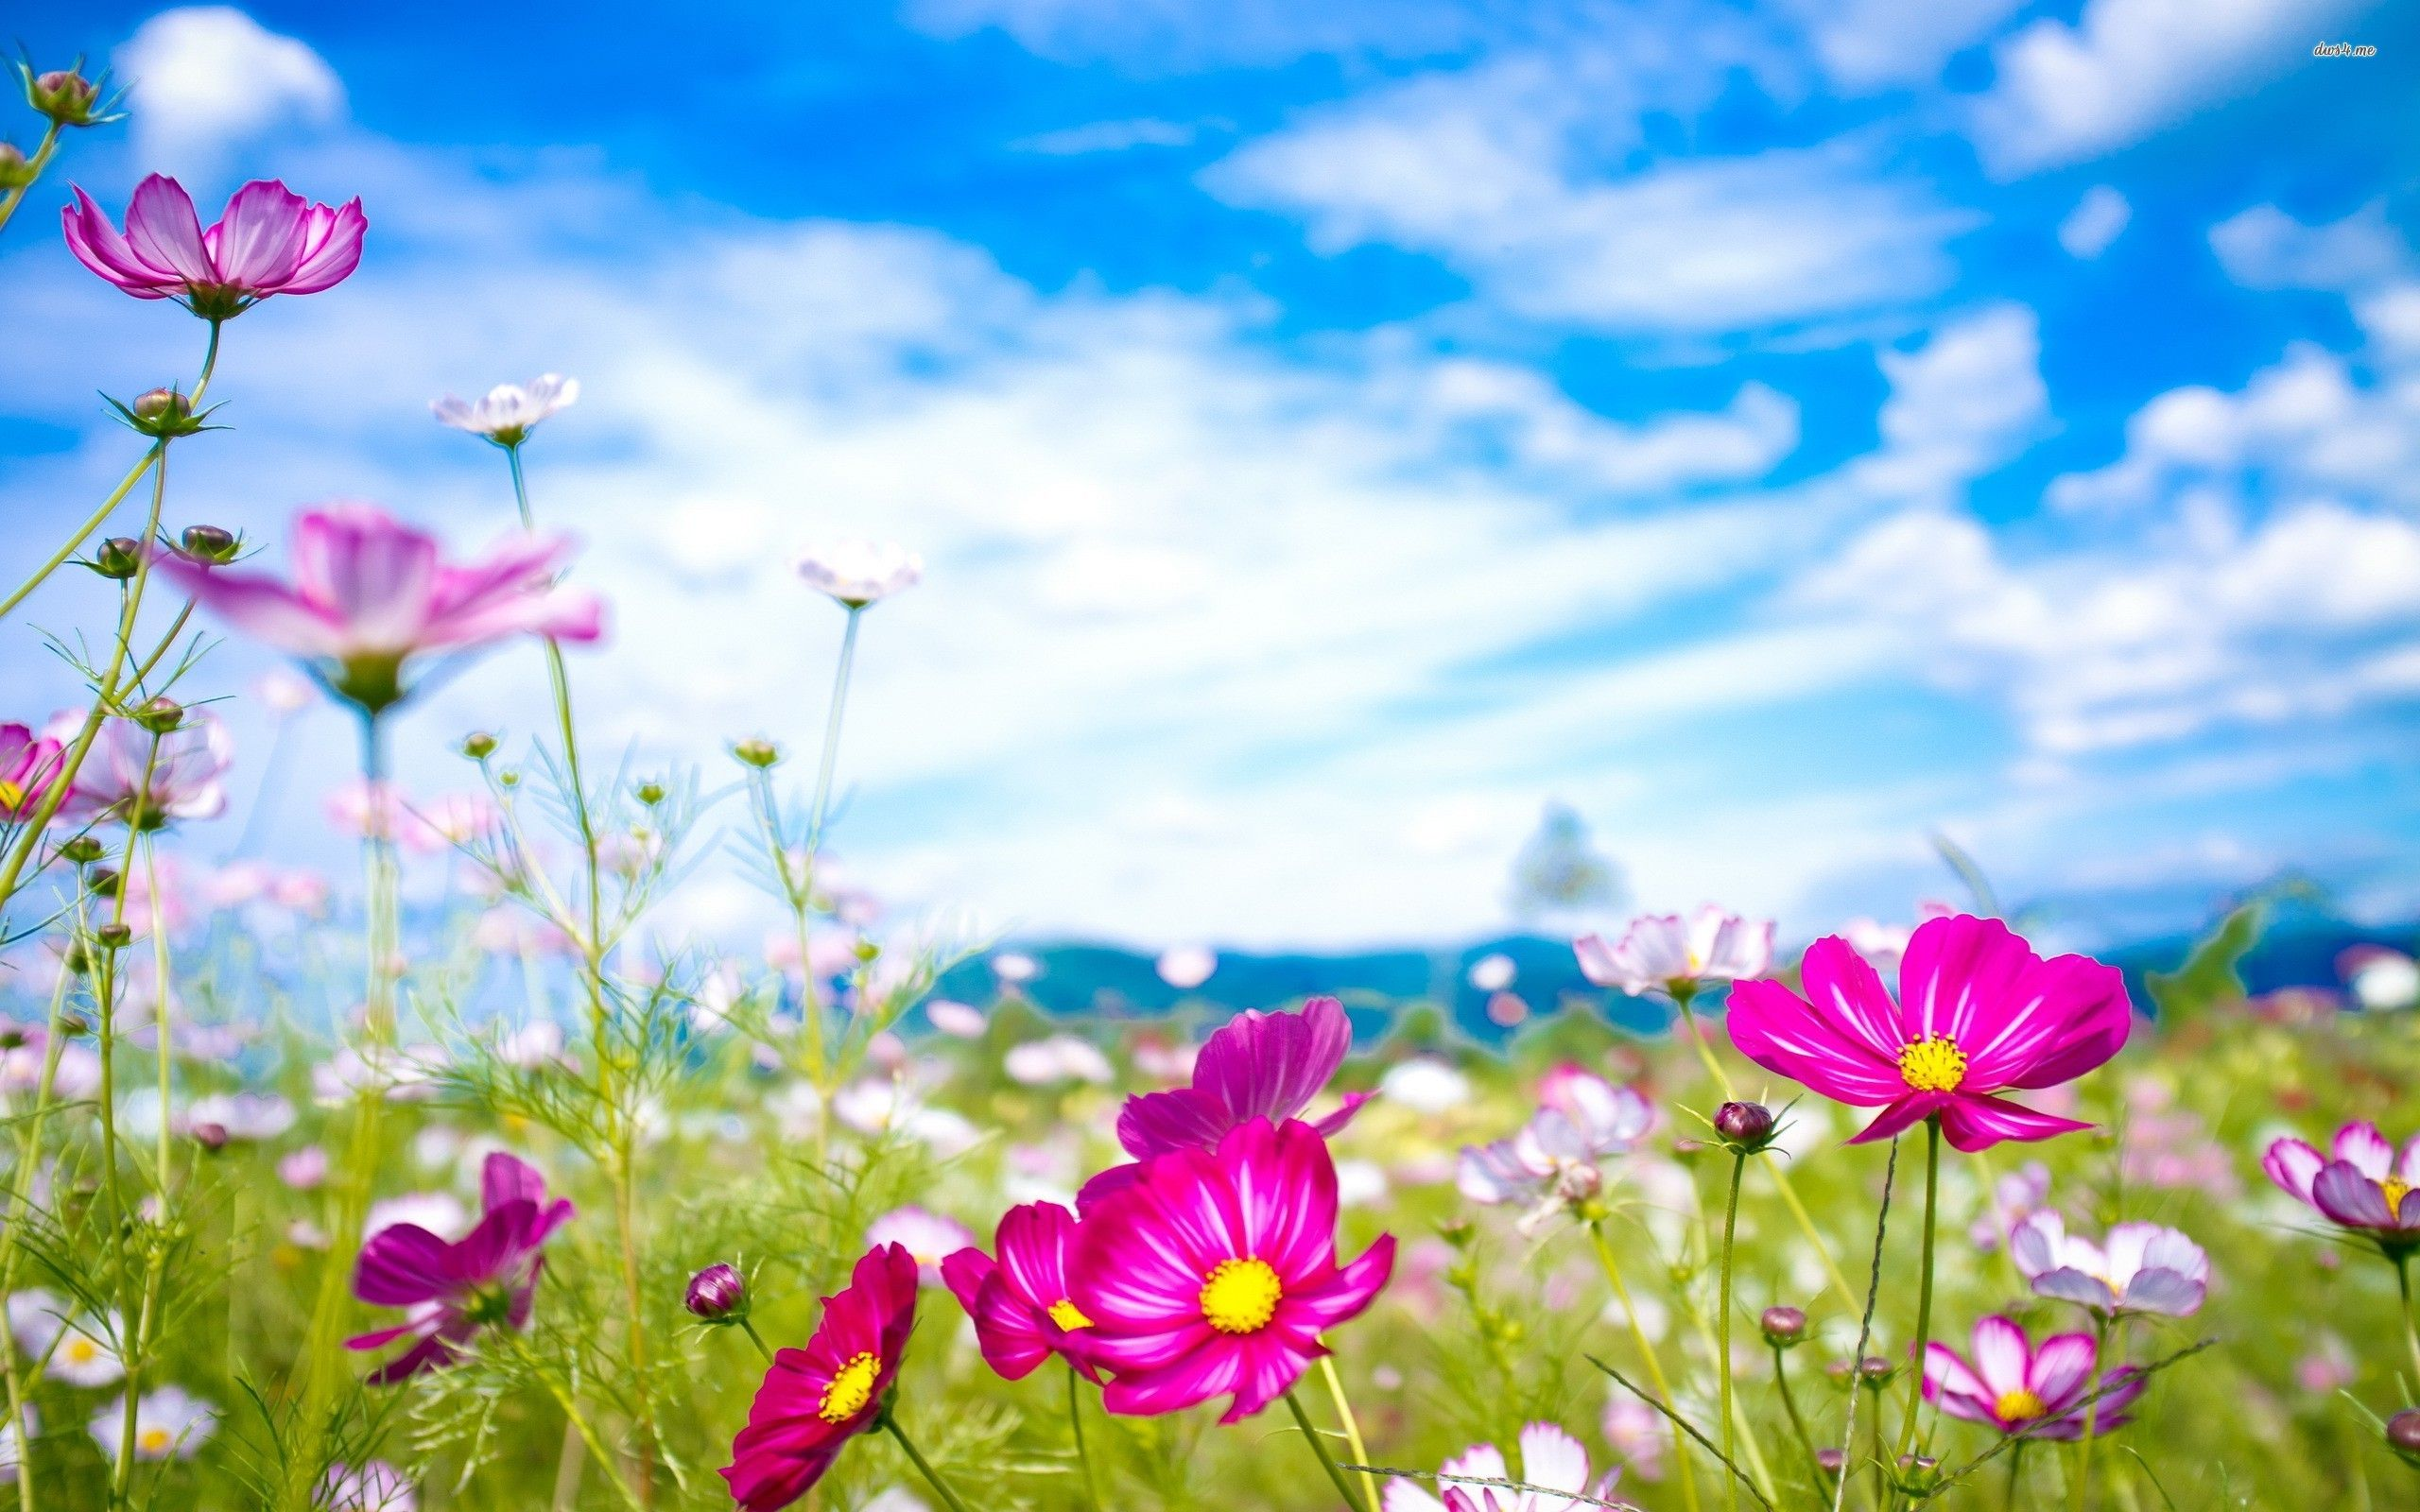
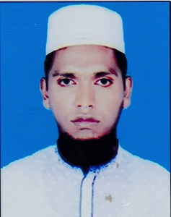
SIDDIQUR RAHMAN
Assistant Teacher
66 No Alhaj Ali Akbor Mal Govt.Primary School
Damudya, Shariatpur.

Slide 3
Lesson’s Identity
Subject: English
Class : Five
Unit : 5, Lesson : 1-2, Page: 58
Lesson : Happy Birthday
Part of the lesson : A person’s birthday….out the candle.
Time : 35 Minutes.
Dated : 00/00/2020

Slide 4
Learning Outcomes
Student will be able to:
Listening:
4.2.1 understand and enjoy simple stories.
Speaking:
1.1.1 say words, phrases and sentences with proper sounds and stress.
1.1.2 say sentences with proper intonation
Reading:
1.5.1 read words, phrases and sentences in the text with proper pronunciation,
stress and intonation.
Reading:
8.1.1 make sentences using words and phrases given in the textbook.

Slide 5
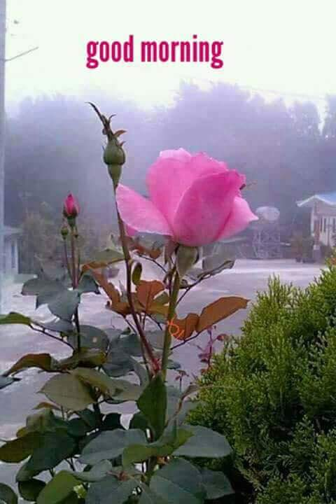

Slide 6
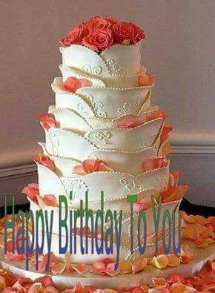
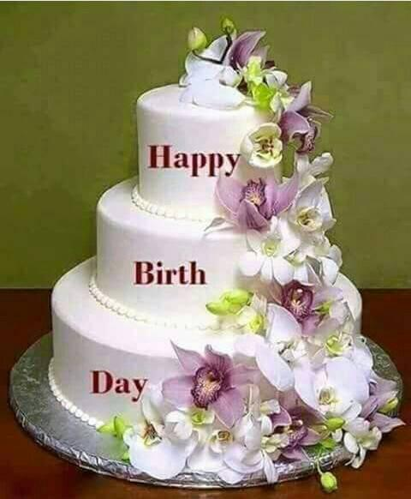
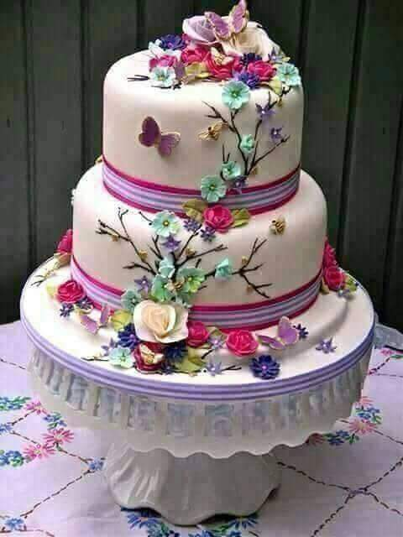
What can you see in the picture ?
Cakes

Slide 7
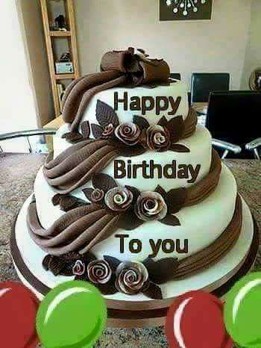
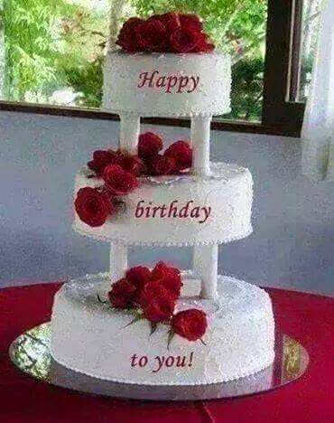
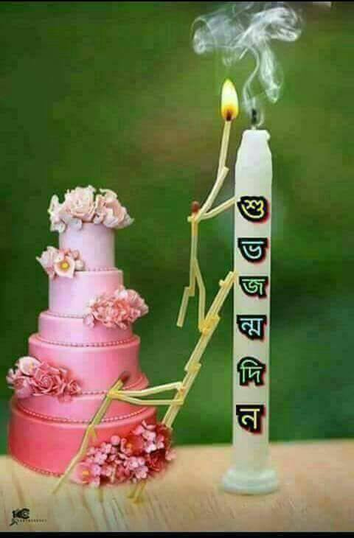
When we use cake ?
On someone’s Birthday Party

Slide 8
What day is today ?
Today is
Saturday

Slide 9
Who was born on today’s date ?

Slide 10
Happy Birthday

Slide 11
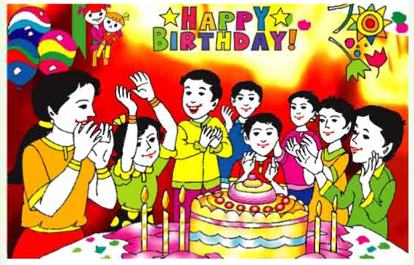
What can you see in the picture ?
A Birthday Party

Slide 12
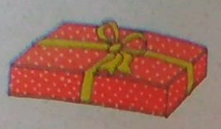
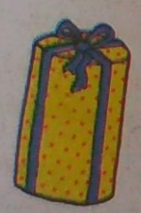
Look at the picture
What can you see in the picture ?
These are gift box

Slide 13
** When do we get gift from others ?
On the occation.
** When do we give gift to others ?
Someone’s Birthday or
Wedding ceremony

Slide 14
Let’s sing a song with the vedio.

Slide 15
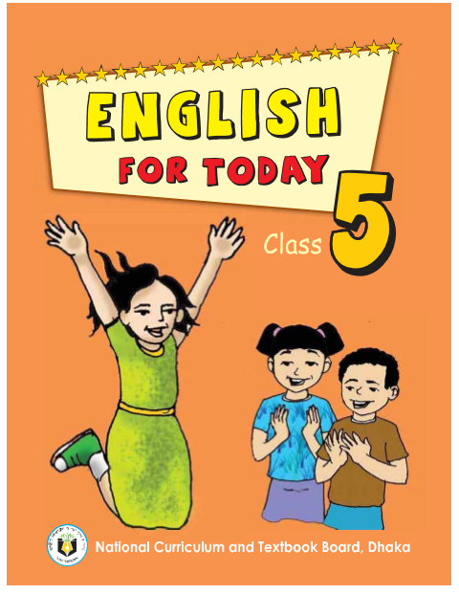
Take your book.

Slide 16
Open at page 58

Slide 17
I will read out the passage loudly
I read and students listen only.
Put your finger under the lines and words.

Slide 18
Students will read the passage Silently

Slide 19
Think alone
about the Topic

Slide 20
Make pair.
Discuss with pair.

Slide 21
Let’s play a “Bingo” game.

Slide 22
Person
celebrate
world
colorful
cake
candle
food
enjoy
friends
birthday
** Write any 5 words in your khata from above the words.

Slide 23
Person
cake
enjoy
Friends
food
celebrate
candle
colorful
Birthday
World
gift
gift
Bingo Game

Slide 24
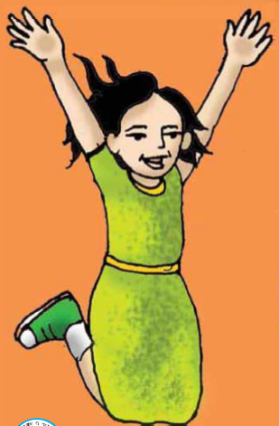
Bingo !!!

Slide 25
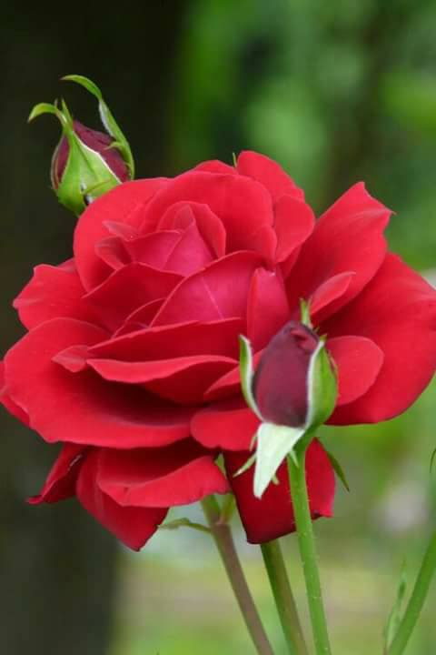
Devide into 2 groups.
a. Rose
b. Bird

Slide 26
Work in Groups

Slide 27
Bird group.
Underline the difficult words and write down in your khata

Slide 28
I will check out their khata and elicit

Slide 29
Rose group.
Make sentence with the words:
Birthday, Celebrate, Cake, Candle.

Slide 30
Birthday
birthday
A person’s is a special day.
Celebrate
People around the world birthdays in different ways.
Celebrate
Cake
cake.
There are candles on the
candle
Candle
There is one for each year of the person’s life..

Slide 31
Read the sentenses. Write ‘T’ for True or ‘F’ for False.
1. A birthday is the date when a person was born.
2. People celebrate birthdays in the same way around the world.
3. On a birthday cake, there is one candle for each year of a child’s age.
4. The friends and family blow out the candles on a birthday cake.
5. Children in some countries have a party for their birthday.
6. Gifts are the most important things for celebrating a birthday.
T
F
T
F
T
F

Slide 32
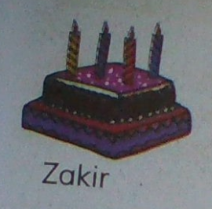
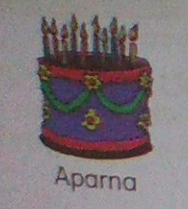
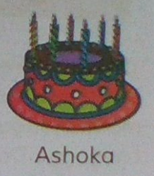
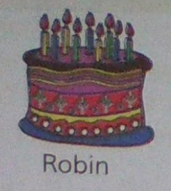
Count the candles on the cake and say how old each person is.
4
10
6
9

Slide 33
How do we write a date ?
We write the day
1
.
1
.
16
the month
and the year
1. 1. 16
1st January 2016
We say :
The first of January, 2016.

Slide 34
Answer the following questions:
1. Write your birth day in numbers and words.
2. Say the dates.
A 17 March B 26 Month
C 14 April D 1 May
E 16 December

Slide 35
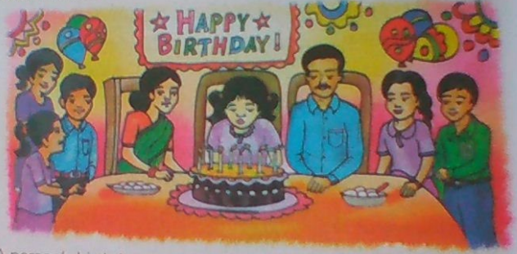
Tomorrow you will
write 5 sentences about your Birthday Celebration.

Slide 36
No more Today.
Bye bye.
See you tomorrow.

Slide 37
Thanks

