Slide 1
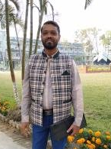
Introduction…
Md Emran Hossen
Assistant Teacher
Kattali Nurul Haque Chowdhury Government Primari School
Pahartali, Chattogram
01819893135
emran81hossen@gmail.com

Slide 2
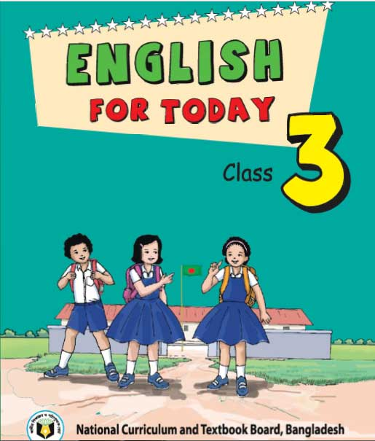
Lesson Contacts:
Class 3
Subject: English For Today
Unit: 21
Occupations
Lesson: 1-2
Page: 38

Slide 3
L
I
S
T
E
N
I
N
g
Learning Outcomes
1.1.1 Repeat words, phrases and sentences after the teacher with proper sound and stress.
SPEAK
I
N
g
1.4.1 Read and match words and sentences with pictures.
WRIT
I
N
G
3.1.2 To write words, phrases and sentences using non-cursive small letters .

Slide 4
Hello Students.
How are you today?
Welcome

Slide 5
How many members do you have in your family?
What do they do?

Slide 6

Lets see a picture.
Look at the picture and think about it very carefully.
The work a person do to earn money for living is called occupation.
There are many persons. They do different works.
What are you seeing?

Slide 7
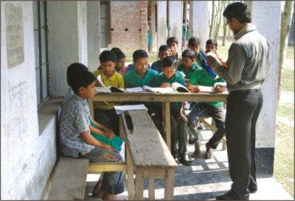
I teach you. I’m a teacher.
That means my occupation is teaching.

Slide 8
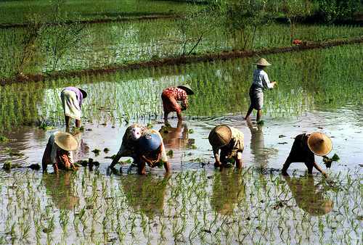
Look and think.
They are cultivating in the field.
A farmer grows foods.
They are farmer.

Slide 9
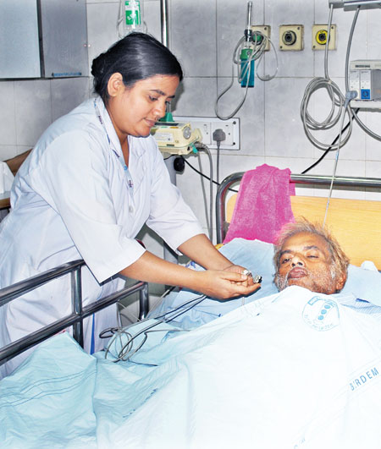
Look and think.
The doctors helps us by treatment.
When we feel ill. Then we go to Doctor’s chamber.

Slide 10
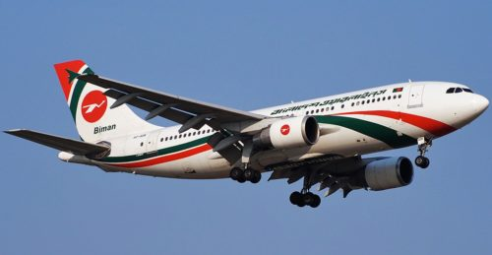
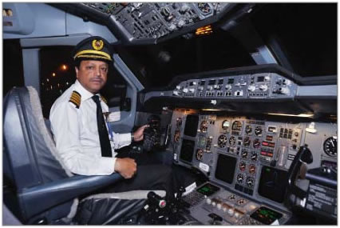
Look and think.
Its a plane.
Who drives a plane is called pilot.
A pilot flies a plane.

Slide 11
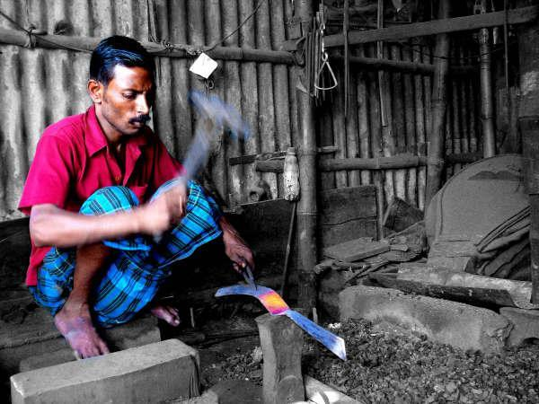
Look and think
He is a blacksmith.
A blacksmith makes metal things.
He makes chopper, knife, scythe, grubber etc.
The man is working with metal things.

Slide 12

Look at the pictures in activity A.
Open your textbook at page 38
Connecting to textbook.
কৃষক
ডাক্তার
বিমান চালক
কামার
Farmer
Doctor
Pilot
Blacksmith
What do they do?
Who are they?
Who the persons in the pictures?

Slide 13
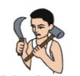



Individual work
1
2
3
4
Write the occupations according to numbers.
1
2
3
4
Pilot
Doctor
Blacksmith
Farmer

Slide 14
Pair work
Read out the sentences to each other..
Farmer
A farmer grows foods.
Doctor
A doctor helps people.
Pilot
A pilot flies plane.
Blacksmith
A blacksmith makes metal things.

Slide 15
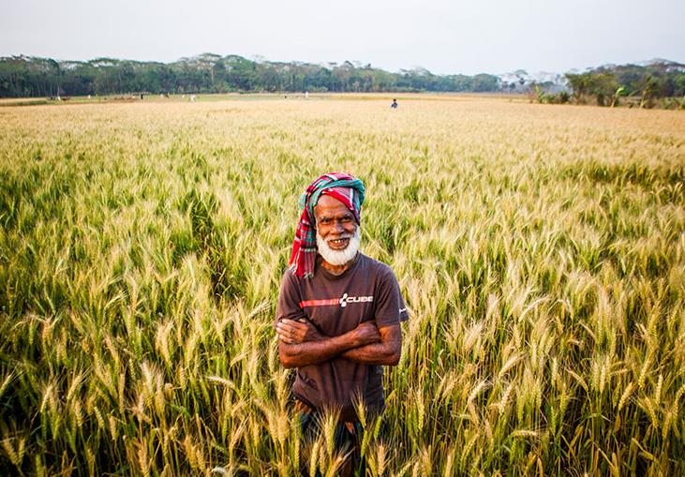
Look, listen and say again…
A farmer grows foods.

Slide 16
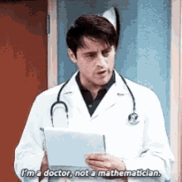
Look, listen and say again…
A doctor helps people.

Slide 17
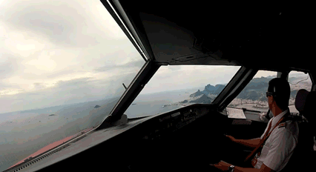
Look, listen and say again…
A pilot flies a plane.

Slide 18
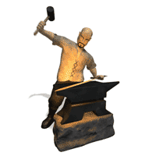
Look, listen and say again…
A blacksmith makes metal things.

Slide 19
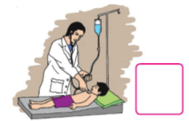
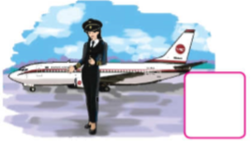
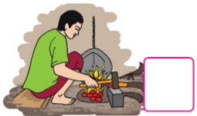
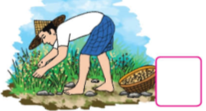
Task
1 . A blacksmith makes metal things.
1
2 . A farmer grows foods.
2
Read and match with the picture and write the correct number in the box.
3 . A doctor helps people.
3
4
4. A pilot flies a plane.

Slide 20
Thanks to all for your great attentions.

