Slide 1
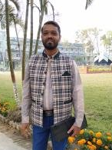
Introduction…
Md Emran Hossen
Assistant Teacher
Kattali Nurul Haque Chowdhury Government Primari School
Pahartali, Chattogram
01819893135
emran81hossen@gmail.com

Slide 2

Lesson Contacts:
Class 3
Subject: English For Today
Unit: 21
Occupations
Lesson: 3-4
Page: 39

Slide 3
L
I
S
T
E
N
I
N
g
Learning Outcomes
1.1.1 Repeat words, phrases and sentences after the teacher with proper sound and stress.
SPEAK
I
N
g
1.4.1 Read and match words and sentences with pictures.
WRIT
I
N
G
3.1.2 To write words, phrases and sentences using non-cursive small letters .

Slide 4
Hello Students.
How are you today?
Welcome

Slide 5
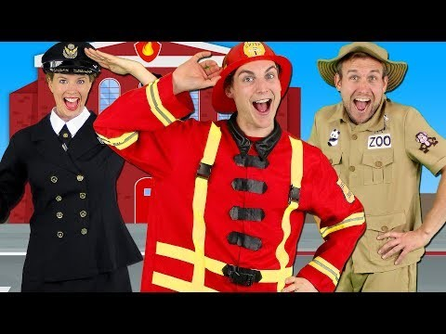
Lets see a video.

Slide 6



What does he/she do?

Slide 7

Open your textbook page at 39 and see the pictures in activity A.
Cobbler
Tailor
Driver
Teacher
মুচি
দর্জি
চালক
শিক্ষক
What do you see in the pictures? What does he/she do?

Slide 8
Write the occupations in the line.
Cobbler
Tailor
Driver
Teacher

Slide 9
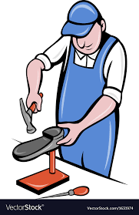
Look and think.
A Cobbler mends shoes.
He is a Cobbler

Slide 10
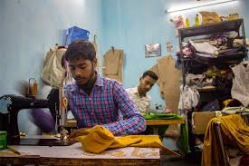
Look and think.
A Tailor makes clothes.
We wear various clothes like shirts, pants, frock, payzama etc.

Slide 11
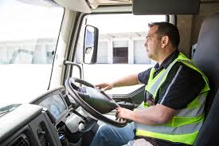
Look and think.
A driver drives a bus, truck or any vehicles .
Who drives a bus, truck or any vehicles is called driver.
He is a driver.

Slide 12
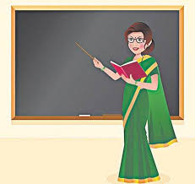
Look and think
A teacher teaches at school.
She is a teacher.

Slide 13
Pair work
Read out the sentences to each other..
Cobbler
A cobbler mends shoes.
Tailor
A tailor makes clothes.
Driver
A driver drives a bus.
Teacher
A teacher teaches at school.

Slide 14
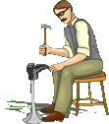
Look, listen and say again…
A cobbler mends shoes.

Slide 15
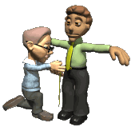
Look, listen and say again…
A tailor makes clothes.

Slide 16
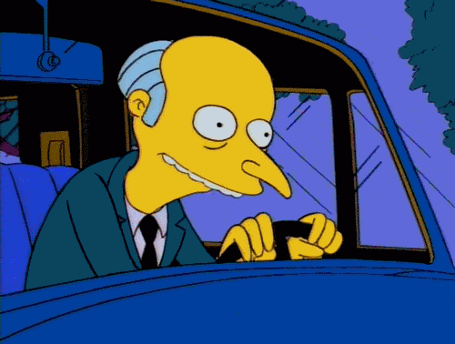
Look, listen and say again…
A driver drives a bus.

Slide 17
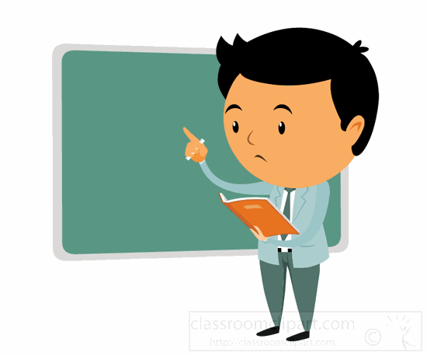
Look, listen and say again…
A teacher teaches at school.

Slide 18
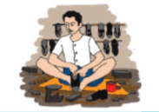
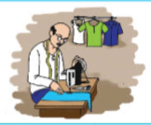
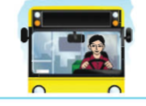
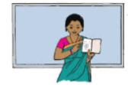
Task
1 . A driver drives a bus.
1
2 . A teacher teaches at school.
2
Read and match with the picture and write the correct number in the box.
3 . A cobbler mends shoes.
3
4
4. A tailor makes clothes.

Slide 19
Thanks to all for your great attentions.

