Slide 1
Welcome to my English Class

Slide 2
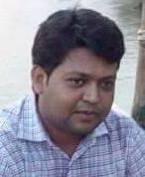
Identity
Subject : English Grammar & Composition
Class : Seven
Unit : Three
Title : Subject Verb Agreement
Time : 50 min Date : 30 December 2019
Md. Hossain Akanda
Assistant Teachetr (English)
Jobaida High School
Ashekpir, Tangail
hossainnu01@gmail.com

Slide 7
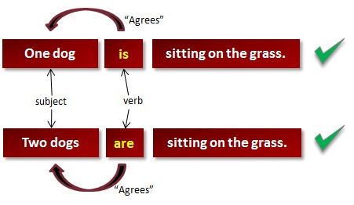

Slide 8
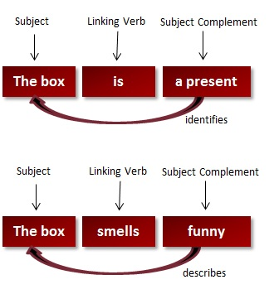

Slide 18
Thanks to all

